Slide 1
Welcome to the Spring 2017 Writing Workshop!
Sign in
Get goodies
Get a practice packet
Fill out a raffle ticket

Slide 2
Creating A Reference List Cathy Qi, Pisarn Bee Chamcharatsri, and Julia Scherba de Valenzuela
ACADEMIC WRITING WORKSHOPS
March 3, 2017

Slide 3
Workshop Objectives
Participants will learn how to create a reference list in APA Style:
Simple to complex
Focus on details of several basic types of references

Slide 4
Format of the Workshop
We will provide reference examples in APA style by type and opportunities to practice in each of the following categories:
Books
Book chapters
Periodicals
Advanced practice: Meetings & symposia

Slide 5
Books (non-edited)
Basic format
Multiple authors
Editions
Learning objectives:
How to read examples in APA manual.
Critical details:
punctuation
spacing
italics

Slide 6
Books: Single Author
Format:
Author, A. A. (year). Title of work. Location: Publisher.
Example:
Berger, A. (2011). Self-regulation: Brain, cognition, and development. Washington, DC: American Psychological Association.
From: American Psychological Association. (2010). Publication manual of the American Psychological Association. Washington, D.C.: American Psychological Association.

Slide 7
Important Components:
Author name – one space between initials (see p. 184)
Date – typically year (see p. 185)
Title – capitalize initial word and proper nouns, use italics (see p. 185)
Location: City + abbreviation for state (see pp. 186-187)
Publisher:
Delete: Publishers, Co., & Inc
Keep: Books and Press
Finish with a period.

Slide 8
Practice
Book title: The handbook for evidence-based practice in communication disorders
Author: Christine Ann Dollaghan
Publication year: 2007
Location of the publisher: Baltimore
Publisher: Brookes

Slide 9
Answer
Dollaghan, C. A. (2007). The handbook for evidence-based practice in communication disorders. Baltimore, MD: Brookes.

Slide 10
Practice another one
See #1 in your handout (Frame work in language and literacy)

Slide 11
Answer
Duchan, J. F. (2004). Frame work in language and literacy: How theory informs practice. New York, NY: The Guilford Press.

Slide 12
Books: Two Authors
Format:
Author, A. A., & Author, B. B. (year). Title of work. Location: Publisher.
Example:
Vierra, A., & Pollock, J. (1988). Reading educational research. Scottsdale, AZ: Gorsuch Scarisbrick.

Slide 13
Practice another one
See # 2 in your handout (Bilingual and ESL classrooms)

Slide 14
Answer
Ovando, C. J., & Collier, V. P. (1985). Bilingual and ESL classrooms: Teaching in multicultural contexts. New York, NY: McGraw-Hill.

Slide 15
Books: Second edition
Note:
ed. = edition
Ed. = editor
Format:
Author, A. A. (year). Title of work (xx ed.). Location: Publisher.
Example:
Cohen, L. G., & Spenciner, L. J. (2011). Assessment of children and youth (4th ed.). Boston, MA: Pearson.

Slide 16
Practice another one
See #3 and #4 in your handout:
Childhood motor speech disability
Adapting early childhood curricula…

Slide 17
Answers:
Love, R. J. (2000). Childhood motor speech disability (2nd ed.). Boston, MA: Allyn & Bacon.
Cook, R. E., Klein, M. D., & Chen, D. (2012). Adapting early childhood curricula for children with special needs (8th ed.). Boston, MA: Pearson.

Slide 18
Books Chapters
Basic format
Multiple authors
Editions
Learning objectives:
What is an edited book?
Critical details:
punctuation
spacing
italics

Slide 19
For a chapter in an edited book, use the following formats:
Two editors:
Author, A. A., & Author, B. B. (2017). Title of chapter. In A. Editor & B. Editor (Eds.), Title of book (pp. xx-xx). Location: Publisher.
Three editors:
Author, A. A., & Author, B. B. (2017). Title of chapter. In A. Editor, B. Editor, & C. Editor (Eds.), Title of book (pp. xx-xx). Location: Publisher.
American Psychological Association. (2010). Publication manual of the American Psychological Association. Washington, D.C.: American Psychological Association.

Slide 20
Chapter written by one author in a book edited by one editor
Gauvain, M. (2009). Social and cultural transactions in cognitive development: A cross-generational view. In A. Sameroff (Ed.), The transactional model of development: How children and contexts shape each other (pp. 163-182). Washington, DC: American Psychological Association.

Slide 21
Example: Chapter written by two authors in a book edited by two people
Mirenda, P., & Brown, K. E. (2009). A picture is worth a thousand words: Using visual supports for augmented input with individuals with autism spectrum disorders. In P. Mirenda & T. Iacono (Eds.), Autism spectrum disorders and AAC (pp. 303-332). Baltimore, MD: Brookes.

Slide 22
Practice (see handouts)
See # 5 and #6 in your handout:
Evidence-based treatment for children with autism: The CARD model
Autism spectrum disorders and AAC

Slide 23
Answers:
Tarbox, J., & Persicke, A. (2014). Play. In D. Granpeesheh, J. Tarbox, A. C., Najdowski, & J. Kornack (Eds.), Evidence-based treatment for children with autism: The CARD model (pp. 223-241). Waltham, MA: Elsevier.
Wilkinson, K. M., & Reichle, J. (2009). The role of aided AAC in replacing unconventional communicative acts with more conventional ones. In P. Mirenda & T. Iacono (Eds.), Autism spectrum disorders and AAC (pp. 355-382). Baltimore, MD: Brookes.

Slide 24
Journal Articles
Basic format
DOI
Learning objectives:
Critical details:
punctuation
spacing
italics
What is a DOI?

Slide 25
Basic Format: Journal Articles
Author, A. A., Author, B. B., & Author, C. C. (year). Title of article. Title of Periodical, xx(x), xx-xx.
From: American Psychological Association. (2010). Publication manual of the American Psychological Association. Washington, D.C.: American Psychological Association.
Page numbers
Italicize the volume number
Issue number -- do NOT italicize

Slide 26
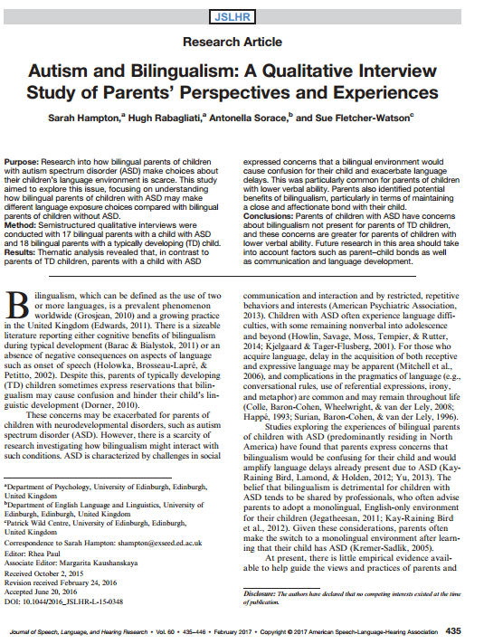
Try it with your partner: A journal article written by four authors (#7 in your handout) –

Slide 27
Practice

Slide 28
Now you are my technical editor.
Hampton, S., Rabagliati, H., Sorace, Antonella, and Fletcher-Watson, S. (2017). Autism and Bilingualism: A Qualitative Interview Study of Parents’ Perspectives and Experiences. Journal of Speech, Language, and Hearing Research. Vol. 60. 435-446.

Slide 29
Answer:
Hampton, S., Rabagliati, H., Sorace, A., & Fletcher-Watson, S. (2017). Autism and bilingualism: A qualitative interview study of parents’ perspectives and experiences. Journal of Speech, Language, and Hearing Research, 60, 435- 446.

Slide 30
Now you are my technical editor.
Carlson, S. M. and Wang, T. S. (2007). Inhibitory Control and Emotion Regulation in Preschool Children. Cognitive development, 22, 489-510.

Slide 31
Answer: Journal Articles Written by Two authors
Carlson, S. M., & Wang, T. S. (2007). Inhibitory control and emotion regulation in preschool children. Cognitive Development, 22, 489-510.

Slide 32
Digital Object Identifiers: DOI
“A digital object identifier (DOI) is a unique alphanumeric string assigned by a registration agency (the International DOI Foundation) to identify content and provide a persistent link to its location on the Internet. The publisher assigns a DOI when your article is published and made available electronically.”
www.apastyle.org/learn/faqs/what-is-doi.aspx

Slide 33
Journal Article with Digital Object Identifier (DOI)
Author, A. A., Author, B. B., & Author, C. C. (year). Title of article. Title of Periodical, xx(x), xx-xx. doi: xx.xxxx/xxxxxxxxxx
American Psychological Association. (2010). Publication manual of the American Psychological Association. Washington, D.C.: American Psychological Association.
Notes:
Citing an article in the references list needs the author's last name first, followed by the first initial, the publication year in parenthesis, the title of the article with only the first word capitalized, and the name of the journal in italics with each word capitalized.

Slide 34
New Format for DOI
http://blog.apastyle.org/apastyle/2017/03/doi-display-guidelines-update-march-2017.html
Format:
Morey, C. C., Cong, Y., Zheng, Y., Price, M., & Morey, R. D. (2015). The color-sharing bonus: Roles of perceptual organization and attentive processes in visual working memory. Archives of Scientific Psychology, 3, 18–29. https://doi.org/10.1037/arc0000014

Slide 35
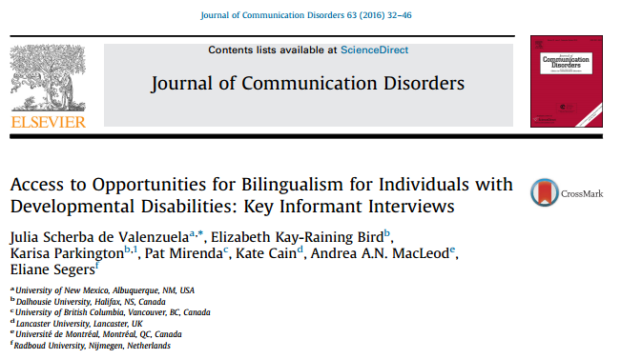
Try one (#8 in your handout)

Slide 36
Answer
de Valenzuela, J. S., Kay-Raining Bird, E., Parkington, K., Mirenda, P., Cain, K., MacLeod, A. A. N., & Segers, E. (2016). Access to opportunities for bilingualism for individuals with developmental disabilities: Key informant interviews. Journal of Communication Disorders, 63, 32-46. doi:10.1016/j.jcomdis.2016.05.005

Slide 37
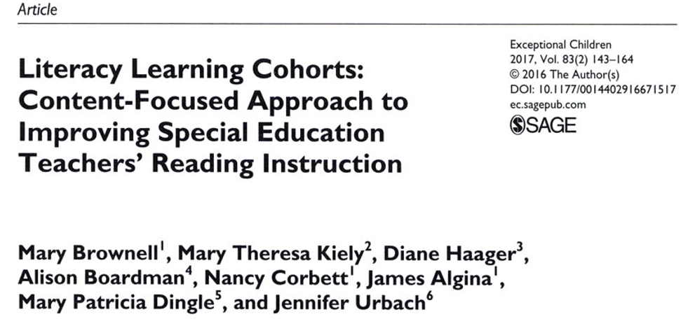
Practice: More than seven authors (#9 in handout)

Slide 38
Answer
Brownell, M., Kiely, M. T., Haager, D., Boardman, A., Corbett, N., & Algina, J., … Urbach, J. (2017). Literacy learning cohorts: Content-focuses approach to improving special education teachers’ reading instruction. Exceptional Children, 83(20), 143-164. doi: 10.1177/001442916671517

Slide 39
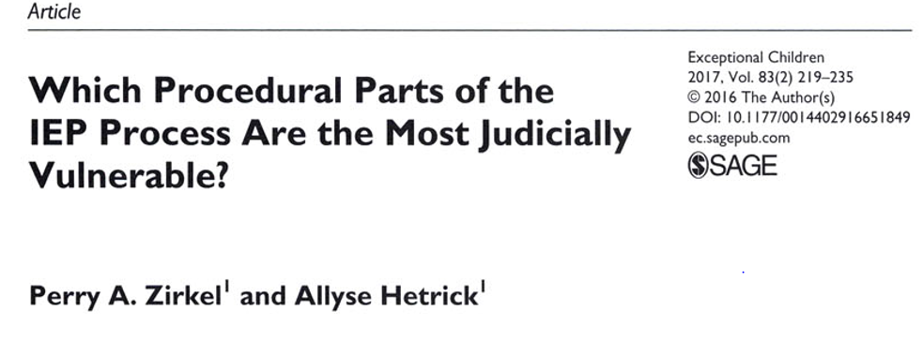
Where to locate the DOI? (Answer: first page of the article) - #10 in handout
Notes:
Provide the DOI if one has been assigned to the content. (you can find this information most of the times on the first page of an article)

Slide 40
Answer
Zirkel, P. A., & Hetrick, A. (2017). Which procedural parts of the IEP process are the most judicially vulnerable? Exceptional Children, 83(2), 219-235. doi:10.1177/00114402916651849

Slide 41
Now you are my technical editor.
Cluley, V. (2017). Using photovoice to include people with profound and multiple learning disabilities in inclusive research. British Journal of Learning Disabilities. 45, 39–46. doi:10.1111/bld.12174

Slide 42
Answer: Journal Article with DOI, One Author
Cluley, V. (2017). Using photovoice to include people with profound and multiple learning disabilities in inclusive research. British Journal of Learning Disabilities, 45, 39–46. doi:10.1111/bld.12174

Slide 43
Practice: Journal Article Written by One Author

Slide 44
Now you are my technical editor.
Van Norman, E. R. (2016). Curriculum-based measurement of oral reading: a preliminary investigation of confidence interval overlap to detect reliable growth. School Psychology Quarterly, 31(3), 405-418, doi:10.1037/spq0000146.

Slide 45
Answer: Journal Article Written by One Author
Van Norman, E. R. (2016). Curriculum-based measurement of oral reading: A preliminary investigation of confidence interval overlap to detect reliable growth. School Psychology Quarterly, 31(3), 405-418. doi:10.1037/spq0000146

Slide 46
Thank You and Raffle Prizes!

