Slide 1
APA Boot Camp
September 16, 2016
Susan R. Copeland, Phd, BCBA-D
susanrc@unm.edu

Slide 2
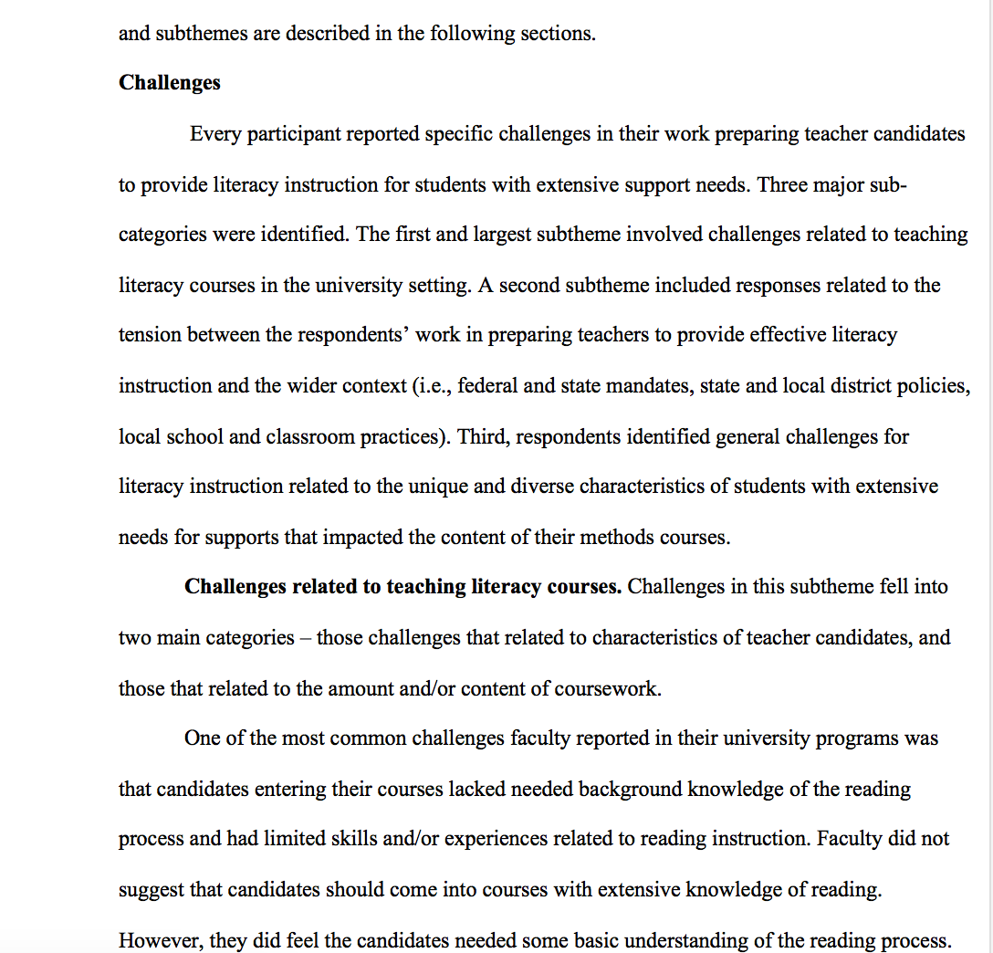
Headers and Headings & Other Organizational Tools
Formatting headers, headings, page numbers; using headings to help organize a paper
Chapter 3 in the APA Manual of Style (6th ed.)

Slide 3
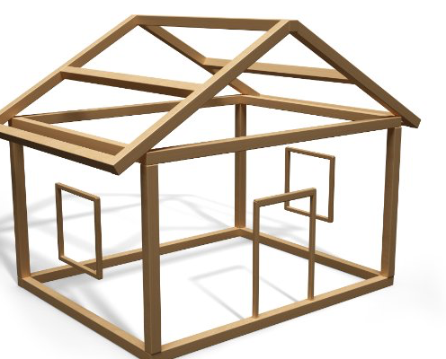
Headings (APA Manual of Style, sections 3.02, 3.03)
Headings help organize your paper. Tip: outline your paper before writing and make the points in your outline the headings
Each section of the paper begins with the highest level of heading EXCEPT the Introduction.
Do not use a heading for the Introduction that labels it as Introduction (p. 63)

Slide 4
Resources on headings in the APA Manual
Table 3.1 (p. 63) showing levels of headings
“If only one level of heading is needed use Level 1; for a paper with two levels of heading, use Levels 1 and 2; if three levels are needed, use Levels 1, 2, and 3; and so forth.” (p. 63)
Figure 2.1 (sample paper, pp. 41-59) showing how headings look (font and spacing) within a paper. Tip: Don’t rely on a published article because journals and books use different fonts and formats.

Slide 5
Test your skills!
Work with someone sitting next to you to find and correct the APA errors on the three sample manuscript pages.

Slide 6
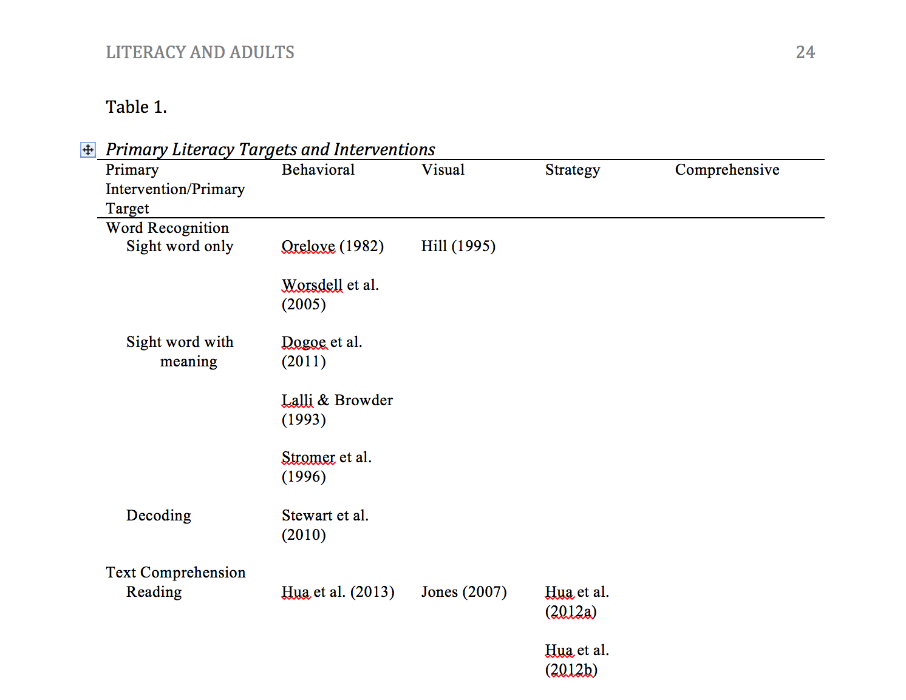
Tables
Constructing and formatting tables
Chapter 5 in the APA Manual of Style (6th ed.)

Slide 7
Tables (Chapter 5 Displaying Results)
Tables convey important information for your paper. When considering whether or not to use a table or what type of table to use, ask yourself first what is the purpose of your table, look at published examples of tables with that same purpose to see how others have conveyed that type of information, talk with your course instructor or advisor about whether or not to use a table and/or how to use one effectively.

Slide 8
Parts of a Table
Look at Table 5.1 in the APA Manual of Style (6th Ed.)

Slide 9
Tables
Table 1
Demographic Information
Table 2
Description of Themes
Number tables in the order in which you will refer to them in your paper (Section 5.05).
Give tables a title that briefly conveys what the information in the table is about. Italicize the title (5.12).
Single or double space tables but always consider readability (5.17).

Slide 10
Tables
In this section we describe both the formats researchers used to elicit perceptions of satisfaction (e.g., types of questions used in interviews) and the process or manner in which researchers conducted interviews (see Table 1).
Refer to tables in the body of your paper as Table 1, Table 2, Table 3, etc.
Do NOT put in things like “Insert Table 1 here”.
ALWAYS get someone to read over your table (and your paper) to check for typos, formatting issues, etc. If that is not possible, complete your paper a few days ahead of a deadline, put it down, and then go back to it after a few days to edit. You will be amazed at how many more errors you can find after putting it aside for a few days.

Slide 11
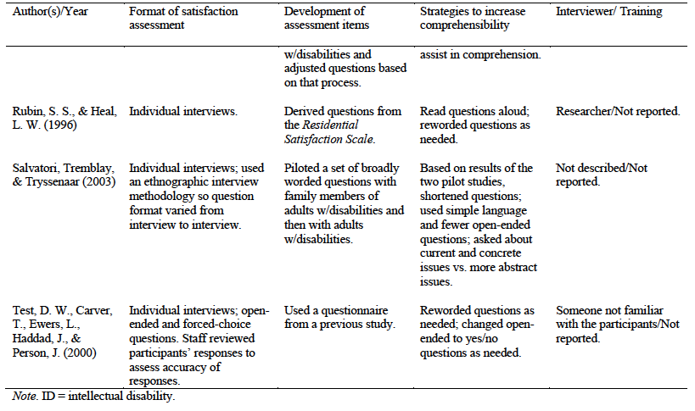
Tables
Use general, specific, and/or probability notes to help readers understand the information in your table (Section 5.16).
These go below the table.

Slide 12
Placement of Tables
Title page
Abstract
Body of the paper
References
Tables
Figures
Appendices
Place tables after the Reference section within your paper. (See Section 8.03, pp. 229-230, for the order of manuscript pages.)
Each table gets its own page(s).

Slide 13
How to insert a table into a Word document
Home
Open Word document
Insert
Table – create size you want (if you want a landscape table go back to format document and select landscape)
Put in the content you want
Borders – select the rules (lines) to match APA guidelines
Borders & Shading – click lines (rules) off/on until you have what is needed for this table.

Slide 14
You try it
Open the template Dr. Griffin gave you at the last Boot Camp (or a Word document)
Use the task analysis on the previous slide; your version of Word may be older or newer than mine, but the order is still the same.

Slide 15
You try it!
Work with someone sitting next to you to find and correct the APA formatting errors on the sample table. How many can you find???

Slide 16
Other Resources
Presenting Your Findings: A Practical Guide for Creating Tables, 6th Ed. (American Psychological Association; ISBN: 978-1-4338-0705-3)
http://www.apastyle.org/products/4316117.aspx?tab=1
Table Tips (APA Style Blog) http://blog.apastyle.org/apastyle/2009/11/table-tips.html?_ga=1.96169307.698588307.1471111007

