Slide 1
Common spelling & word choice errors

Slide 2
Common spelling errors
its/it’s
your/you’re
their/there/they’re
two/too/to
aid/aide
What is similar about these pairs?

Slide 3
Homophone?
“A word that is pronounced like another word but is different in meaning, origin, or spelling.”
Ex.: moose, mousse
Source: Merriam-Webster's Learner's Dictionary, n.d.

Slide 4
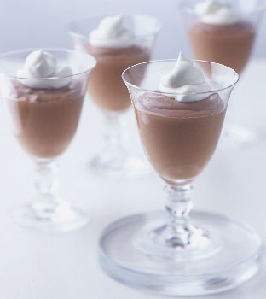
Example of homophone
moose
mousse

Slide 5
Homophones with contractions
its/it’s
your/you’re
their/there/they’re
Question: How do we indicate contractions?

Slide 6
Other errors
lose/loose
chose/choose
two/too/to
aide/aid
there/their
than/then

Slide 7
Compare with known word: moose
lose/loose:
Loose (not tight enough)
Lose (didn’t win or misplace)

Slide 8
Other Strategies?
chose/choose; two/too/to; aide/aid; there/their; than/then
Make a list of your common errors and keep it handy.
Use spell/grammar check
Use a program, like grammarly to check

Slide 9
Common word choice errors
who/that
he/she vs. they
which/that

Slide 10
Who vs. That
Common usage:
Who and that are interchangeable
APA rule:
“Use who for human beings; use that or which for nonhuman animals or for things” (APA, 2010, p. 79).

Slide 11
Who vs. that
Teachers who are invested in student learning…
One book that you need for graduate school is the APA manual.

Slide 12
The problem of the missing gender-neutral third person pronoun…
He
She
It
?

Slide 13
Common (incorrect) usage:
We observed the first teacher three times. During the observations, they... Their classroom...
What should we do if we don’t know the teacher’s gender?
We observed the first teacher three times. During the observations,...

Slide 14
“Which” vs. “That”
“Which” and “that” are often used interchangeably and “which” is often over-used.
“That is the defining, or restrictive, pronoun, which the nondefining, or nonrestrictive” (Strunk & White, 2000, p. 59).
“The lawn mower that is broken is in the garage. (Tells which one.)
The lawn mower, which is broken, is in the garage (adds a fact about the only mower in question.)”

Slide 15
Restrictive Elements
According to ‘Grammar Girl’ (2010) “when a restrictive element is left out, it changes the meaning of the sentence.”
Restrictive elements are not surrounded by commas.
Grammar girl provides this example:
Dogs that howl make me crazy.
http://grammar.quickanddirtytips.com

Slide 16
Nonrestrictive Elements
According to Grammar Girl (2009) “nonrestrictive elements [which] are surrounded by commas”, providing this example:
“Dogs, which make great companions, are usually furry.”

Slide 17
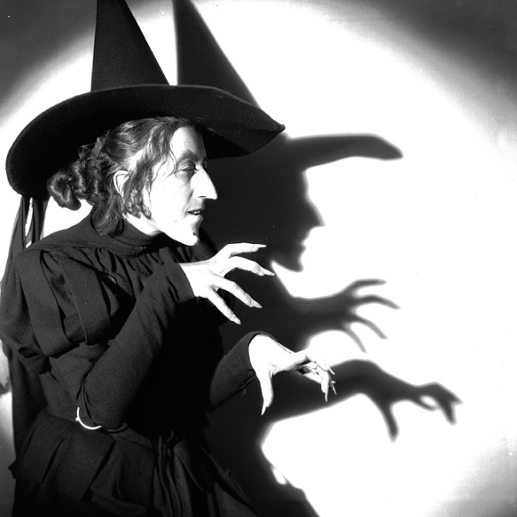
A quick and dirty tip from Grammar Girl
“If you think of the Wicked Witch (Which) of the West from The Wizard of Oz, you know it’s okay to throw her out. You won’t change the meaning of the sentence without the which phrase. So, you can throw out the which (or witch) clause, commas and all.”
From: http://grammar.quickanddirtytips.com

Slide 18
Ask yourself:
Does the additional information help define what I am talking about?
Is it necessary?
If the answer is yes, use “that” for objects or “who” for people (e.g. “The student on the end who is giggling…”).
Ex.: “The lawn mower that is broken is in the garage.”

Slide 19
Practice makes perfect!
“With a little help from my friends…”

