Slide 1
X-Ray Analytical Methods
X-rays were discovered by W.C. Röentgen in 1895,
and led to four major uses:
X-ray radiography is used for creating images of light-opaque materials relies on the relationship between density of materials and absorption of x-rays. Applications include a variety of medical and industrial applications.
X-Ray absorption spectroscopy (XAS), extended xray absorption spectroscopy (EXAFS), X-ray absorption near-edge spectroscopy (XANES).
X-ray fluorescence spectrometry relies on characteristic secondary radiation emitted by materials when excited by a high-energy x-ray source and is used primarily to determine amounts of particular elements in materials.
X-ray crystallography relies on the dual wave/particle nature of x-rays to discover information about the structure of crystalline materials.

Slide 2
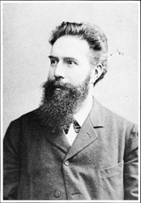
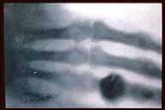
William Conrad Roentgen
Discovery of X-rays November 8, 1895
Mrs. Roentgen’s hand-an early X-ray absorption experiment

Slide 3
Uses of X-Ray Powder Diffraction
Basic material to be covered in this course:
Radiation safety for users of X-ray diffraction
The generation of X- rays
The geometry of diffraction
Bragg’s Law
Basics of X-ray crystallography
Sample and specimen preparation techniques
Basic error analysis for X-Ray diffraction dataai
Quantitative analysis of XRD data (Rietveld analysis)

Slide 4
Uses of X-Ray Powder Diffraction
Analytical methods you should learn in this course:
Identification of single-phase materials – minerals, chemical compounds or other engineered materials.
Identification of multiple phases in microcrystalline mixtures (i.e., rocks)
Determination of crystal structure of identified materials
Identification and structural analysis of clay minerals (an introduction by Dr. Dewey Moore)
Recognition of amorphous materials in partially crystalline mixtures.
Quantitative analysis of XRD data

Slide 5
Uses of X-Ray Powder Diffraction
Analytical methods that will be introduced in this course:
Crystallographic structural analysis and unit-cell calculations for crystalline materials.
Quantitative determination of amounts of different phases in multi-phase mixtures by peak-ratio calculations.
Quantitative determination of phases by whole-pattern refinement.
Determination of crystallite size from analysis of peak broadening.
Determine of crystallite shape from study of peak symmetry.
Study of thermal expansion in crystal structures using in-situ heating stage equipment.

Slide 6
XRD for Dummies: From Specimen to analyzed sample with minimal math
Specimen vs. Sample – An important distinction
Mathematics is unavoidable when dealing with
x-rays and crystallography, but modern analytical
methods, software and computers can eliminate
much of the tedium of calculations
Avoid “Black Box” errors by understanding what
is going on in your analyses

Slide 7
The Bragg Equation
where n is an integer λ is the wavelength of the x-rays d is the interplanar spacing in the specimen
θ is the diffraction angle (discussed later!)
The Bragg equation is the fundamental equation, valid only for monochromatic X-rays, that is used to calculate interplanar spacings used in XRD analysis.

Slide 8
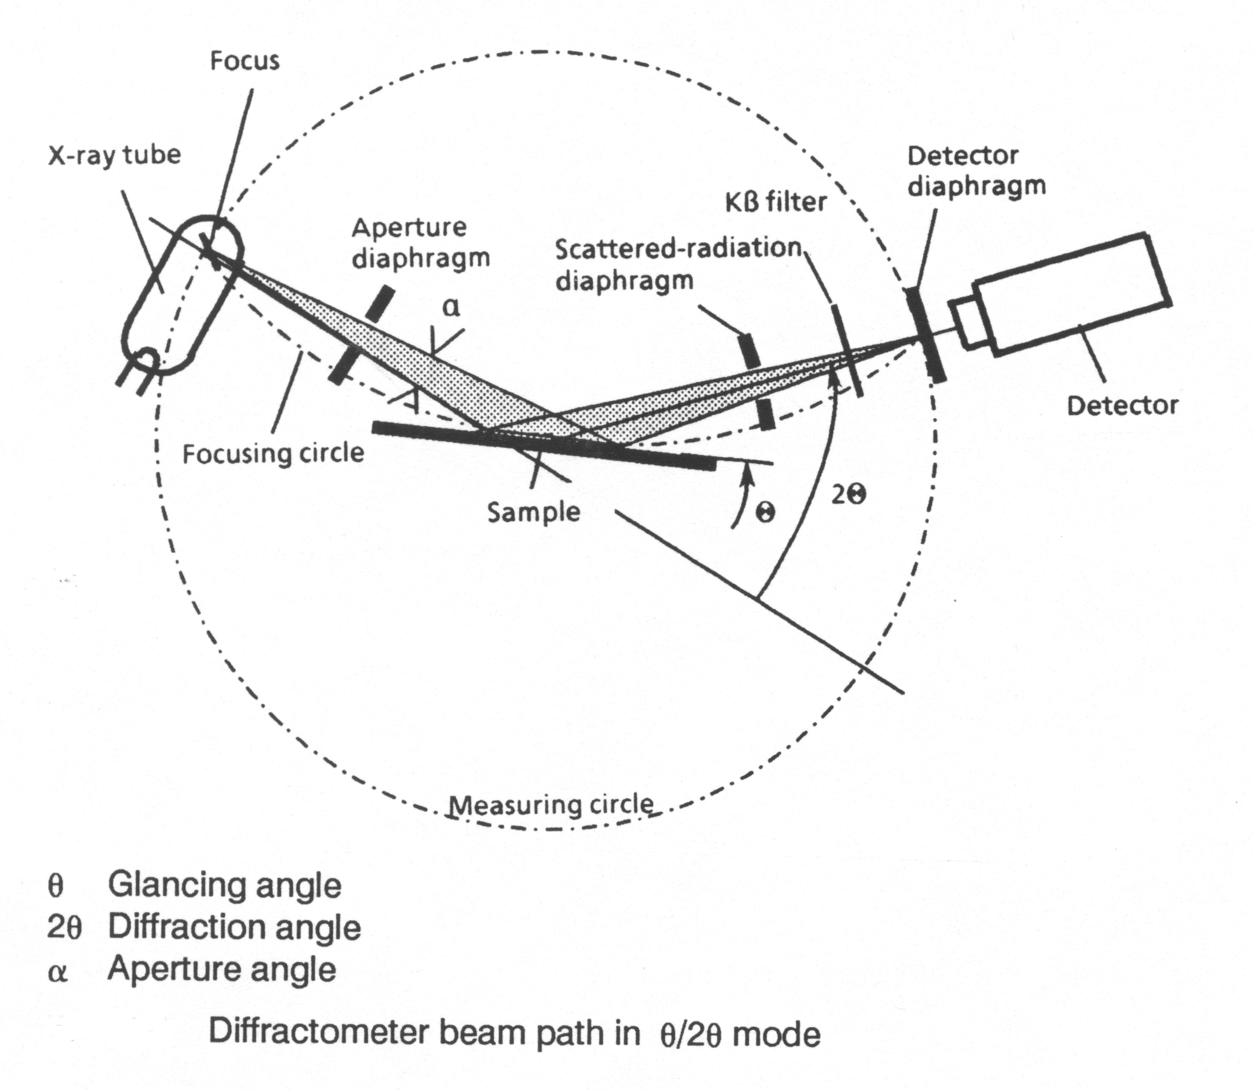
Diffractometer Components and Geometry

Slide 9
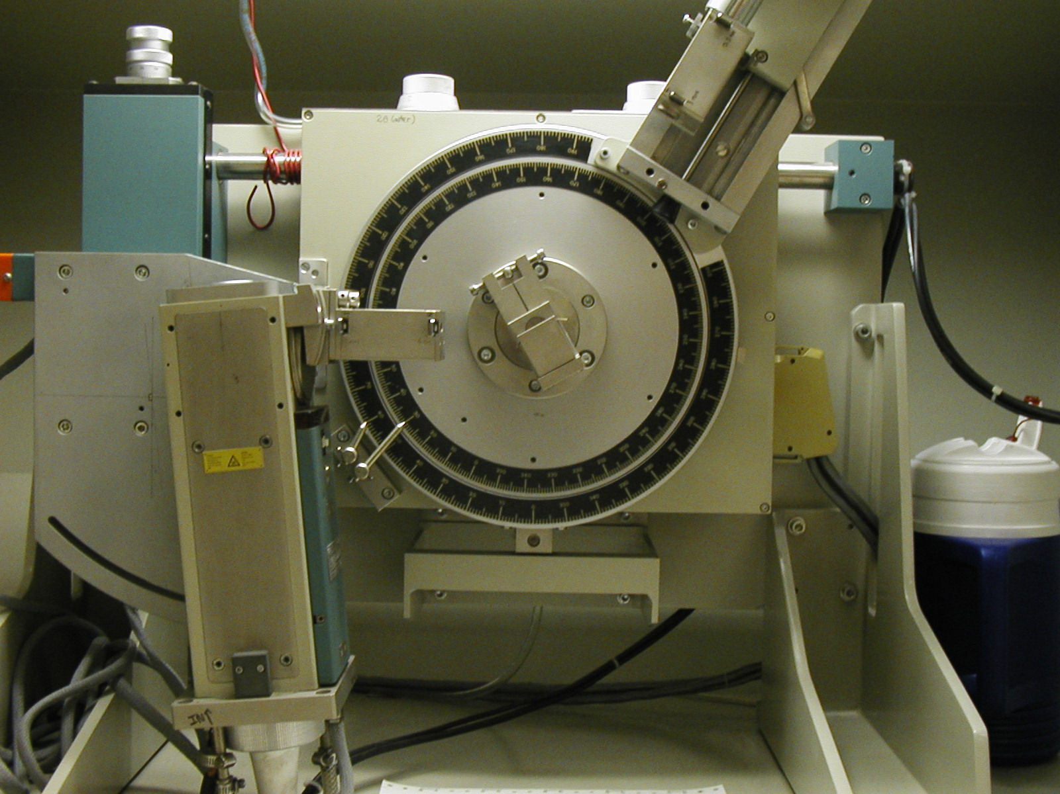
Our Scintag Diffractometer (Pt. 1)

Slide 10
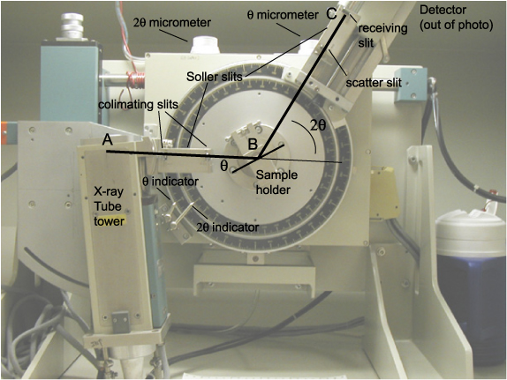
Scintag Diffractometer Geometry

Slide 11
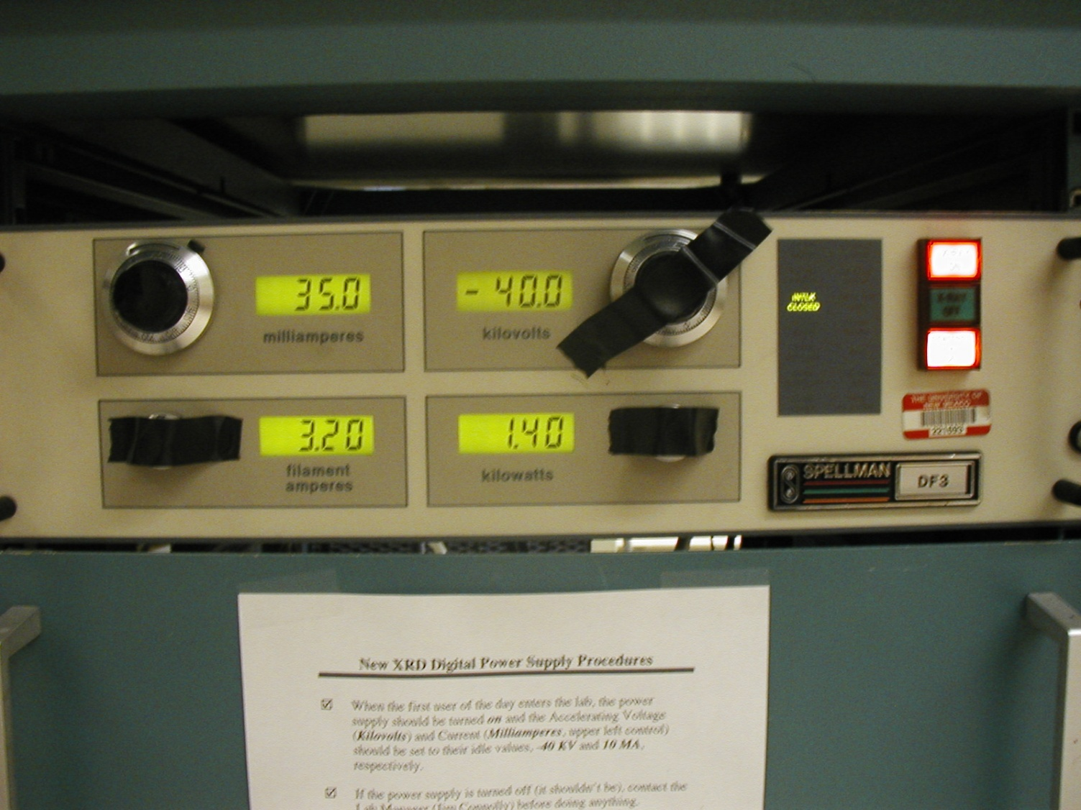
Scintag Diffractometer HV Power Supply
Spellman DF 3 Solid State High-voltage generator power supply

Slide 12
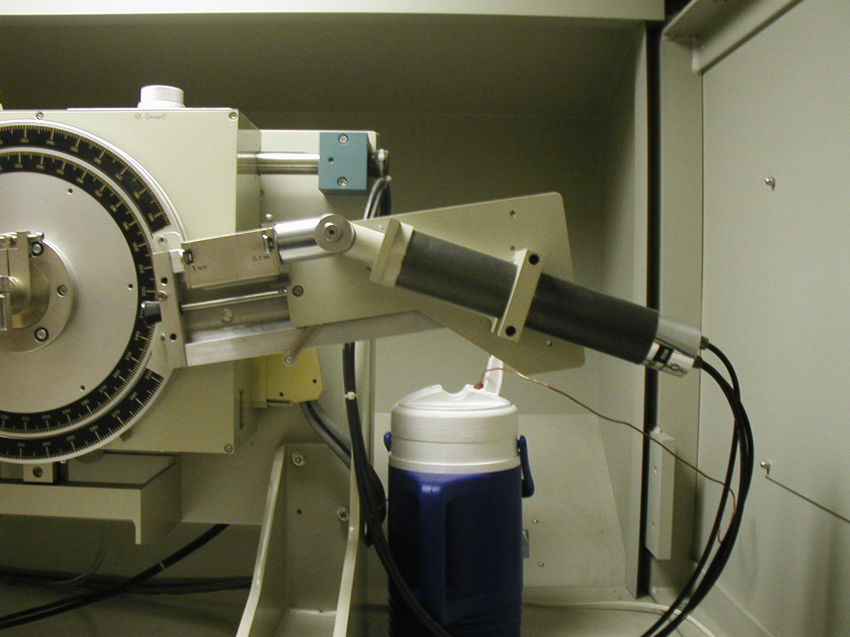
Scintag Diffractometer Detector
Bicron Scintillation Detector and Monochromator

Slide 13
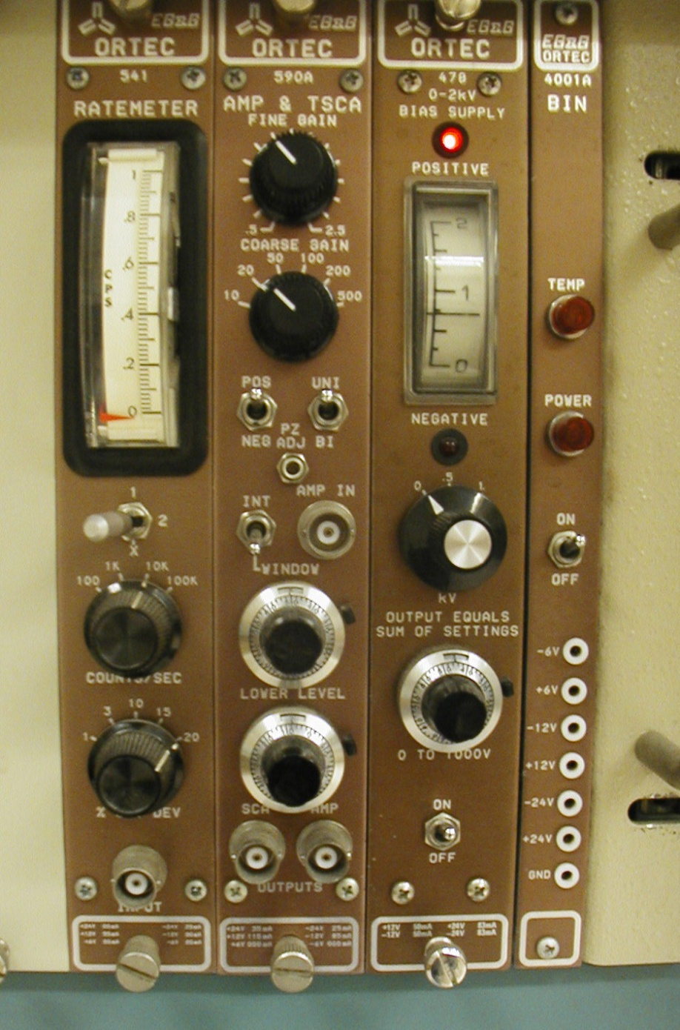
Scintag Diffractometer Detector Power Supply
From right to left:
Power module
Bias Power Supply
Signal Amplifier
Ratemeter (counter)

Slide 14
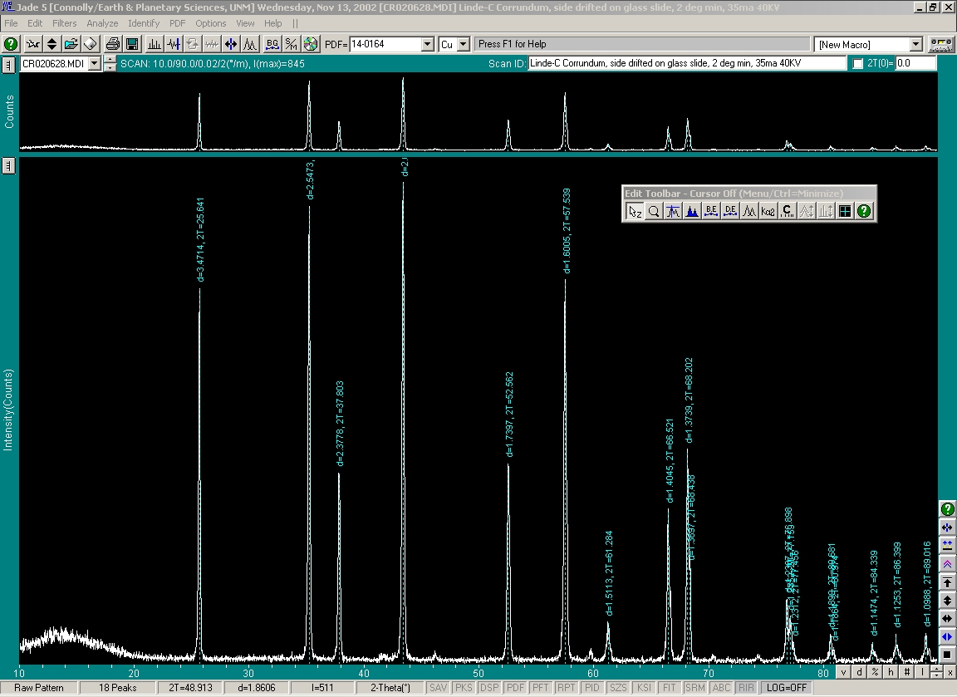
An XRD Data Plot: 2θ (x-axis) vs. intensity (y-axis)

Slide 15
Determining Phases Present in a Specimen The “Legacy” Method
Determine d-spacings and intensities from experimental data (film or strip chart)
Use paper indexes to determine likely phases
Compare likely phases with database of standard minerals by matching peaks
Problems with the method:
Error prone,tedious and time consuming,
Indexes difficult to search, particularly as database grows
Multi-phase samples are very difficult to deal with

Slide 16
Determining Phases Present in a Specimen The “Modern” Method of Basic Phase Identification
Automated diffractometer is operated using electronic data acquisition and control software.
Data are collected in digital (not analog form).
Software is used to search, analyze, and determine the peak positions and intensities in the pattern.
Software is used to compare digital pattern with all (or a selected subset) of the ICDD “Powder Diffraction File” database of experimental and calculated patterns; software will “flag” possible phases present.
Identified patterns are visually compared with the sample data and best match(es) are selected.

Slide 17
Determining Phases Present in a Specimen Advanced Phase Identification Techniques
Single phase samples can usually be identified easily using basic methods; multiphase samples require more work.
Identify dominant phase in pattern and digitally remove peaks associated with that phase.
Re-search the ICDD database using the “reduced” pattern.
Repeat process until all phases are identified.

Slide 18
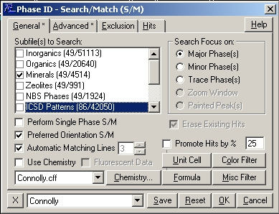
Search/Match Dialog: Basic

Slide 19
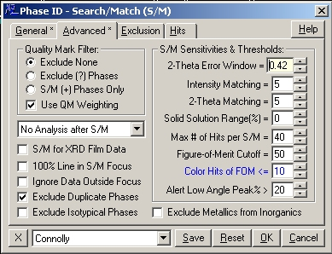
Search/Match Dialog: Advanced

Slide 20
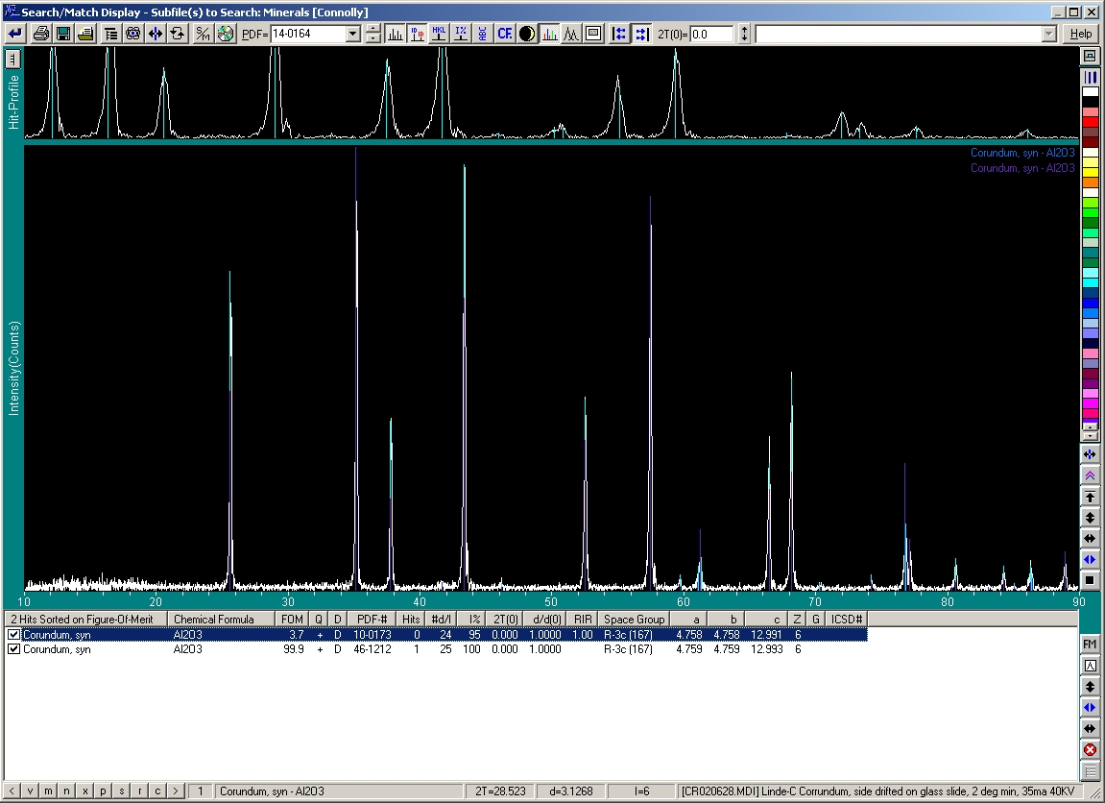
Search/Match: Results Display

Slide 21
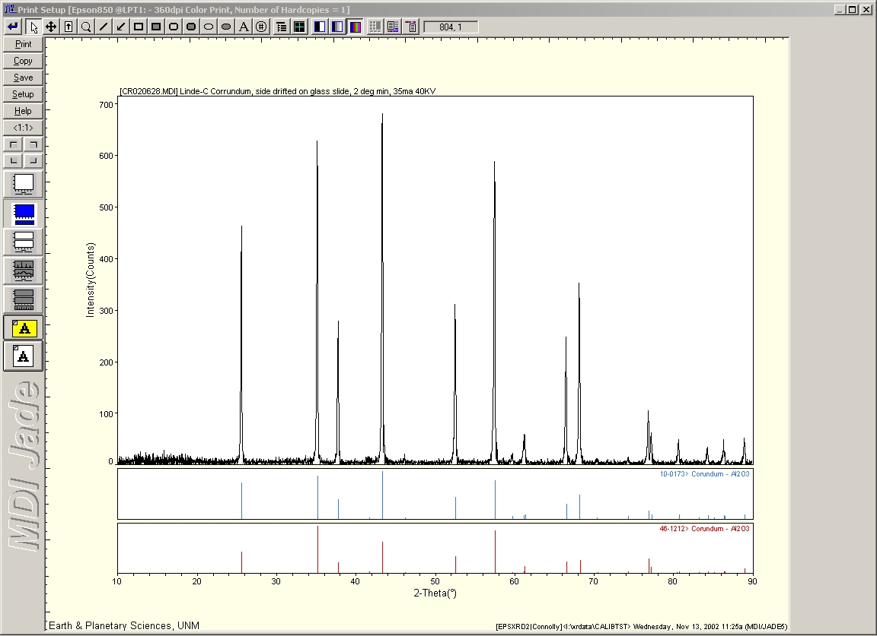
Search/Match: Printout of Results (background removed)

Slide 22
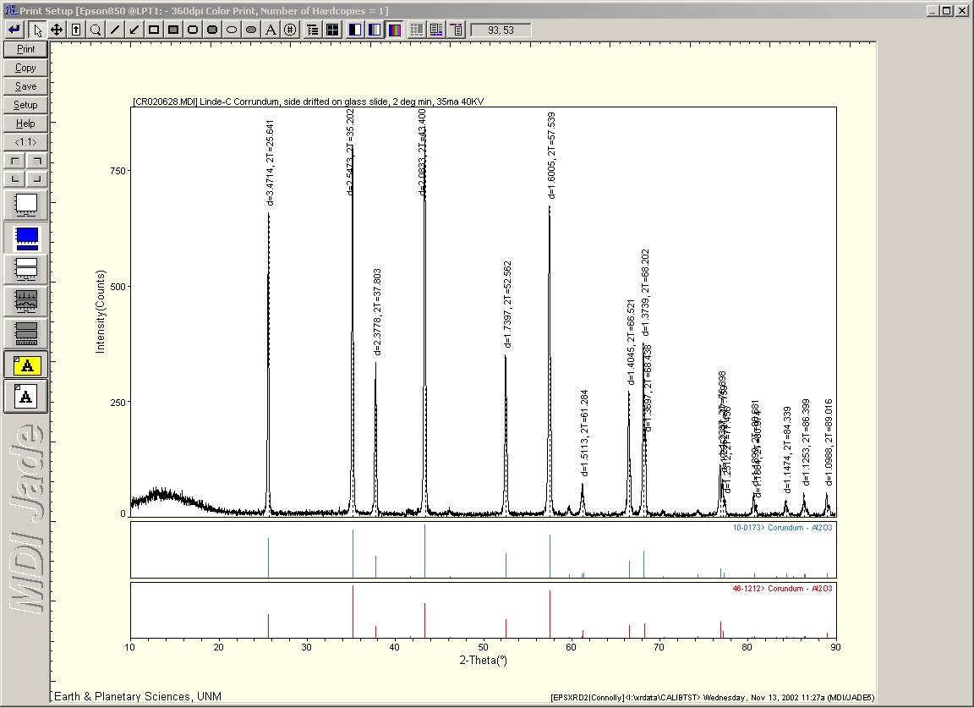
Search/Match: Printout of Results (background restored)

Slide 23
Problems with Computerized Search/Match
Experimental patterns rarely match database patterns exactly (so pattern subtractions distort data for subsequent searches)
Preferred orientation effects
Crystal chemistry variation from ICDD database
Structural variations from ICDD database
Different materials with same structure can have same pattern
Peak shifts from systematic errors can throw automatic matches off
Axial-Divergence Error
Flat-Specimen Error
Specimen transparency (penetration) errors
Specimen displacement errors
Alignment errors
Spurious peaks from tube contamination
Know your Sample; don’t accept unreasonable results!

