Slide 1
Capital Structure
Refers to the mix of debt and equity that a company uses to finance its business
Capital Restructuring
Capital restructuring involves changing the amount of leverage a firm has without changing the firm’s assets
The firm can increase leverage by issuing debt and repurchasing outstanding shares
The firm can decrease leverage by issuing new shares and retiring outstanding debt

Slide 2
Capital Structure Theory
Modigliani and Miller Theory of Capital Structure
Proposition I – firm value
Proposition II – WACC
The value of the firm is determined by the cash flows to the firm and the risk of the assets
To change firm value
Change the risk of the cash flows
Change the cash flows

Slide 3
Capital Structure Theory Under Three Special Cases
Case I – Assumptions
No corporate or personal taxes
No bankruptcy costs
Case II – Assumptions
Corporate taxes, but no personal taxes
No bankruptcy costs
Case III – Assumptions
Corporate taxes, but no personal taxes
Bankruptcy costs

Slide 4
Case I – Propositions I and II
Value of the firm (Proposition I)
The value of the firm is NOT affected by changes in the capital structure
The cash flows of the firm do not change; therefore, value doesn’t change
WACC (Proposition II)
The WACC of the firm is NOT affected by capital structure

Slide 5
Case I - Equations
WACC = R_{A} = (E/V)R_{E} + (D/V)R_{D}
R_{E} = R_{A} + (R_{A} – R_{D})(D/E)
R_{A} is the “cost” of the firm’s business risk, i.e., the risk of the firm’s assets
(R_{A} – R_{D})(D/E) is the “cost” of the firm’s financial risk, i.e., the additional return required by stockholders to compensate for the risk of leverage

Slide 6
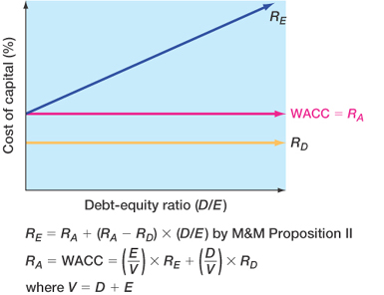

Slide 7
Case II
Interest is tax deductible
Therefore, when a firm adds debt, it reduces taxes, all else equal
The reduction in taxes increases the cash flow of the firm
How should an increase in cash flows affect the value of the firm?

Slide 8
Case II - Example
 | Unlevered Firm | Levered Firm
EBIT | 5,000 | 5,000
Interest | 0 | 500
Taxable Income | 5,000 | 4,500
Taxes (34%) | 1,700 | 1,530
Net Income | 3,300 | 2,970
CFFA | 3,300 | 3,470

Slide 9
Interest Tax Shield
Annual interest tax shield
Tax rate times interest payment
6,250 in 8% debt = 500 in interest expense
Annual tax shield = .34(500) = 170
Present value of annual interest tax shield
Assume perpetual debt for simplicity
PV = 170 / .08 = 2,125
PV = D(R_{D})(T_{C}) / R_{D} = DT_{C} = 6,250(.34) = 2,125

Slide 10
Case II – Value of the firm (Proposition I)
The value of the firm increases by the present value of the annual interest tax shield
Value of a levered firm = value of an unlevered firm + PV of interest tax shield
Value of equity = Value of the firm – Value of debt
Assuming perpetual cash flows
V_{U} = EBIT(1-T) / R_{U}
V_{L} = V_{U} + DT_{C}

Slide 11
Example: Case II – Value of the firm (Proposition I)
Data
EBIT = 25 million; Tax rate = 35%; Debt = $75 million; Cost of debt = 9%; Unlevered cost of capital = 12%
V_{U} = 25(1-.35) / .12 = $135.42 million
V_{L} = 135.42 + 75(.35) = $161.67 million
E = 161.67 – 75 = $86.67 million

Slide 12
Note also that you can calculate the value of the firm as the sum of the present values of the cash flows to debt and equity
V_{L} = D + E
= R_{D}D/R_{D} + {(EBIT – R_{D}D)(1-t)}/R_{E}
= 75 + {(25-6.75)(.65)}/0.1369
EBIT – R_{D}D
1-t
R_{E} - see calculation on slide #15 below
= 86.65

Slide 13
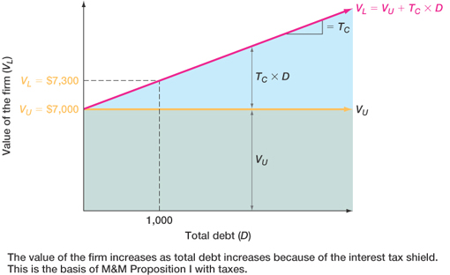

Slide 14
Case II – WACC (Proposition II)
The WACC decreases as D/E increases
R_{A} = (E/V)R_{E} + (D/V)(R_{D})(1-T_{C})
R_{E} = R_{U} + (R_{U} – R_{D})(D/E)(1-T_{C})
The after-tax cost of debt is lower
The cost of equity does not rise as fast as it does when T_{C} = 0

Slide 15
Example: Case II – WACC (Proposition II)
R_{E} = 12 + (12-9)(75/86.67)(1-.35) = 13.69%
R_{A} = (86.67/161.67)(13.69) + (75/161.67)(9)(1-.35) R_{A} = 10.05%
Suppose that the firm changes its capital structure so that the debt-to-equity ratio becomes 1.
What will happen to the cost of equity under the new capital structure?
R_{E} = 12 + (12 - 9)(1)(1-.35) = 13.95%
What will happen to the weighted average cost of capital?
R_{A} = .5(13.95) + .5(9)(1-.35) = 9.9%

Slide 16
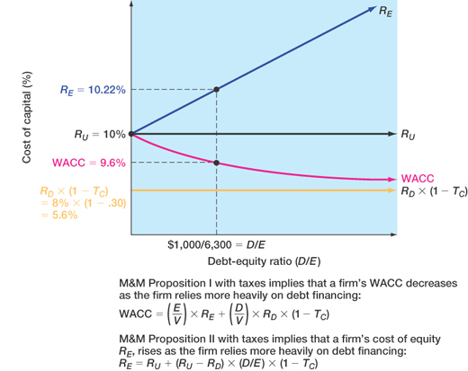

Slide 17
Case III
Now we add bankruptcy costs
As the D/E ratio increases, the probability of bankruptcy increases
This increased probability will increase the expected bankruptcy costs
At some point, the additional value of the interest tax shield will be offset by the increase in expected bankruptcy cost
At this point, the value of the firm will start to decrease and the WACC will start to increase as more debt is added

Slide 18
Bankruptcy Costs
Direct costs
Legal and administrative costs
Ultimately cause bondholders to incur additional losses
Disincentive to debt financing
Financial distress
Significant problems in meeting debt obligations
Most firms that experience financial distress do not ultimately file for bankruptcy

Slide 19
Indirect bankruptcy costs
Larger than direct costs, but more difficult to measure and estimate
Stockholders want to avoid a formal bankruptcy filing
Bondholders want to keep existing assets intact so they can at least receive that money
Assets lose value as management spends time worrying about avoiding bankruptcy instead of running the business
The firm may also lose sales, experience interrupted operations and lose valuable employees

Slide 20
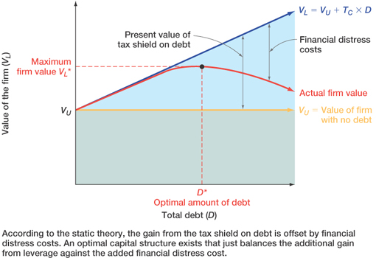

Slide 22
Conclusions
Case I – no taxes or bankruptcy costs
No optimal capital structure
Case II – corporate taxes but no bankruptcy costs
Optimal capital structure is almost 100% debt
Each additional dollar of debt increases the cash flow of the firm
Case III – corporate taxes and bankruptcy costs
Optimal capital structure is part debt and part equity
Occurs where the benefit from an additional dollar of debt is just offset by the increase in expected bankruptcy costs

Slide 23
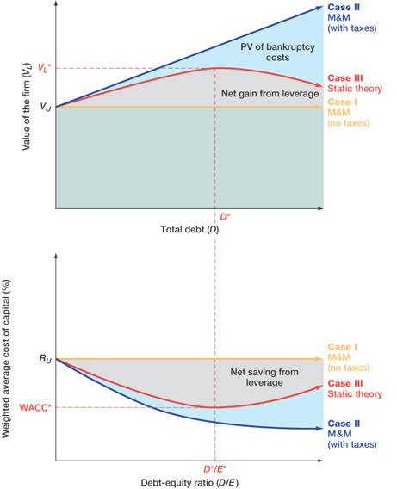

Slide 24
Managerial Recommendations
The tax benefit is only important if the firm has a large tax liability
Risk of financial distress
The greater the risk of financial distress, the less debt will be optimal for the firm
The cost of financial distress varies across firms and industries and as a manager you need to understand the cost for your industry

