Slide 1
Bond Prices and Yields
10
Bodie, Kane, and Marcus
Essentials of Investments, 9th Edition

Slide 2
10.1 Bond Characteristics
Bond
Security that obligates issuer to make payments to holder over time
Face Value, Par Value
Payment to bondholder at maturity of bond
Coupon Rate
Bond’s annual interest payment per dollar of par value
Zero-Coupon Bond
Pays no coupons, sells at discount, provides only payment of par value at maturity

Slide 3
Figure 10.1 Prices/Yields of U.S. Treasury Bonds
U.S. Treasury Quotes: Treasury note and bond data are representative over-the-counter quotations as of 3pm Eastern time.
Maturity | Coupon | Bid | Asked | Change | Asked Yield
8/15/2012 | 1.750 | 101.570 | 101.594 | -0.016 | 0.151
8/15/2014 | 4.250 | 111.547 | 111.594 | -0.094 | 0.358
12/31/2015 | 2.125 | 105.789 | 105.820 | -0.164 | 0.769
8/15/2017 | 4.750 | 120.219 | 120.266 | -0.234 | 1.234
2/15/2020 | 8.500 | 152.063 | 152.094 | -0.344 | 1.847
8/15/2023 | 6.250 | 137.406 | 137.438 | -0.688 | 2.598
2/15/2027 | 6.625 | 145.547 | 145.594 | -0.719 | 2.941
2/15/2031 | 5.375 | 130.266 | 130.297 | -0.953 | 3.263
11/15/2039 | 4.375 | 111.766 | 111.813 | -0.813 | 3.697
5/15/2041 | 4.375 | 111.719 | 111.750 | -0.938 | 3.718

Slide 4
10.1 Bond Characteristics

Slide 5
10.1 Bond Characteristics
Corporate Bonds
Call provisions on corporate bonds
Callable bonds: May be repurchased by issuer at specified call price during call period
Convertible bonds
Allow bondholder to exchange bond for specified number of common stock shares

Slide 6
10.1 Bond Characteristics
Corporate Bonds
Puttable bonds
Holder may choose to exchange for par value or to extend for given number of years
Floating-rate bonds
Coupon rates periodically reset according to specified market date

Slide 7
10.1 Bond Characteristics
Preferred Stock
Commonly pays fixed dividend
Floating-rate preferred stock becoming more popular
Dividends not normally tax-deductible
Corporations that purchase other corporations’ preferred stock are taxed on only 30% of dividends received

Slide 8
10.1 Bond Characteristics
Other Domestic Issuers
State, local governments (municipal bonds)
Federal Home Loan Bank Board
Farm Credit agencies
Ginnie Mae, Fannie Mae, Freddie Mac

Slide 9
10.2 Bond Pricing

Slide 10
10.2 Bond Pricing
Prices fall as market interest rate rises
Interest rate fluctuations are primary source of bond market risk
Bonds with longer maturities more sensitive to fluctuations in interest rate

Slide 11
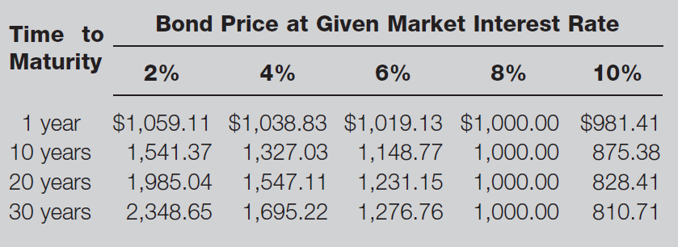
Table 10.2 Bond Prices at Different Interest Rates

Slide 12
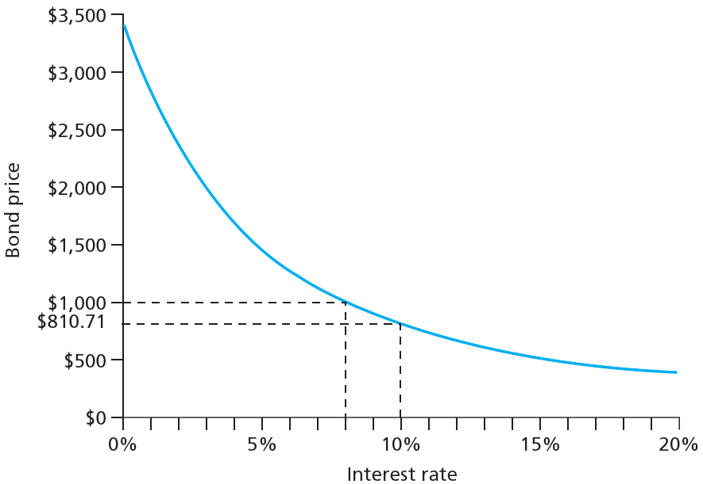
Figure 10.3 Inverse Relationship between Bond Prices and Yields

Slide 13
10.2 Bond Pricing
Bond Pricing between Coupon Dates
Invoice price = Flat price + Accrued interest
Bond Pricing in Excel
=PRICE (settlement date, maturity date, annual coupon rate, yield to maturity, redemption value as percent of par value, number of coupon payments per year)

Slide 14
Spreadsheet 10.1 Valuing Bonds
 | 6.25% coupon bond, |  | 4.375% coupon bond, |  | 8% coupon bond,
 | maturing August 15, 2023 | Formula in column B | maturing Nov 15, 2039 |  | 30-year maturity
Settlement date | 8/15/2011 | =DATE(2011,8,15) | 8/15/2011 |  | 1/1/2000
Maturity date | 8/15/2023 | =DATE(2023,8,15) | 11/15/2039 |  | 1/1/2030
Annual coupon rate | 0.0625 |  | 0.04375 |  | 0.08
Yield to maturity | 0.02598 |  | 0.03697 |  | 0.1
Redemption value (% of face value) | 100 |  | 100 |  | 100
Coupon payments per year | 2 |  | 2 |  | 2
Flat price (% of par) | 137.444 | =PRICE(B4,B5,B6,B7,B8,B9) | 111.819 |  | 81.071
Days since last coupon | 0 | =COUPDAYBS(B4,B5,2,1) | 92 |  | 0
Days in coupon period | 184 | =COUPDAYS(B4,B5,2,1) | 184 |  | 182
Accrued interest | 0 | =(B13/B14)*B6*100/2 | 1.094 |  | 0
Invoice price | 137.444 | =B12+B15 | 112.913 |  | 81.071

Slide 15
10.3 Bond Yields
Yield to Maturity
Discount rate that makes present value of bond’s payments equal to price.
Current Yield
Annual coupon divided by bond price
Premium Bonds
Bonds selling above par value
Discount Bonds
Bonds selling below par value

Slide 16
Spreadsheet 10.2 Finding Yield to Maturity
 | Semiannual coupons |  | Annual coupons
Settlement date | 1/1/2000 |  | 1/2/2000
Maturity date | 1/1/2030 |  | 1/2/2030
Annual coupon rate | 0.08 |  | 0.08
Bond price (flat) | 127.676 |  | 127.676
Redemption value (% of face value) | 100 |  | 100
Coupon payments per year | 2 |  | 1
Yield to maturity (decimal) | 0.0600 |  | 0.0599
The formula entered here is =YIELD(B3,B4,B5,B6,B7,B8)

Slide 17
10.3 Bond Yields
Yield to Call
Calculated like yield to maturity
Time until call replaces time until maturity; call price replaces par value
Premium bonds more likely to be called than discount bonds

Slide 18
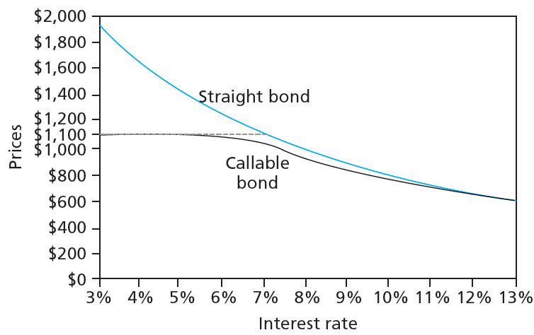
Figure 10.4 Bond Prices: Callable and Straight Debt

Slide 19
10.3 Bond Yields
Realized Compound Returns versus Yield to Maturity
Realized compound return
Compound rate of return on bond with all coupons reinvested until maturity
Horizon analysis
Analysis of bond returns over multiyear horizon, based on forecasts of bond’s yield to maturity and investment options
Reinvestment rate risk
Uncertainty surrounding cumulative future value of reinvested coupon payments

Slide 20
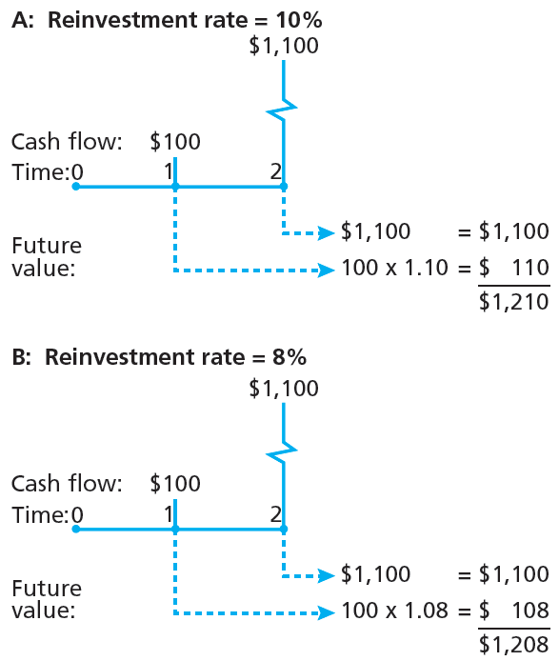
Figure 10.5 Growth of Invested Funds

