Slide 1
Mergers & Acquisitions
Alexander Motola, CFA

Slide 2
Motivations
Bigger is Better (“Ego”)
Compensation
Desperation
MSFT for YHOO; TW for AOL
Strategic
GILD for Triangle
Consolidation
XMSR and SIRI (2008)
Roll Up (search for “US Office Products” “Ledecky” & “Harvard Crimson”)
Can be cheaper/faster to BUY than BUILD (retail, for example)
Notes:
Tip: Add your own speaker notes here.

Slide 3
Dilution & Accretion
2 Types of Deal
Stock Deal
Share count (not “free”) increase
Cash Deal
Foregone interest income
Opportunity cost
As a shareholder, would you rather they just gave you the cash?
Mgmts love to announce “accretive” deals but that’s a very short term perspective; it’s easy to “do” accretive deals, it’s hard to integrate companies
Notes:
Tip: Add your own speaker notes here.

Slide 4
Deals Gone Wrong
MSFT & YHOO – what if MSFT had paid $45B for YHOO (2008)?
Quaker buys Snapple (1994): paid $1.7B, didn’t integrate, three years later sells Quaker to Triarc for $300mm
Daimler-Benz buys Chrysler (1998) for $40B; lost billions (net income), sold 9 years to P/E firm for $6B
YHOO buys Broadcast.com for $5.7B (1999); service was soon shuttered, but Mark Cuban laughed last
Notes:
Tip: Add your own speaker notes here.

Slide 5
Deals Gone Right
Gilead’s acquisition of Triangle (12/4/02)
Strategic – rationale was to acquire strategic drug (Coviricil) with similar dosing traits as their blockbuster (Viread)
Cost - $464mm in cash; deal was dilutive for 2003, neutral 2004, and accretive post 2005
This deal was a massive success, driving returns for over a decade as Viread & Coviricil were co-formulated and formed the standard of care for 2/3rds of the HIV cocktail.
Notes:
Tip: Add your own speaker notes here.

Slide 6
Dissecting the Announcement
INTC buys ALTR ($16.7B, Cash); June 1, 2015
"Intel's growth strategy is to expand our core assets into profitable, complementary market segments," said Brian Krzanich, CEO of Intel. "With this acquisition, we will harness the power of Moore's Law to make the next generation of solutions not just better, but able to do more. Whether to enable new growth in the network, large cloud data centers or IoT segments, our customers expect better performance at lower costs. This is the promise of Moore's Law and it's the innovation enabled by Intel and Altera joining forces. We look forward to working with the talented team at Altera to deliver this value to our customers and stockholders.“
What does all of this even mean?
Notes:
Tip: Add your own speaker notes here.

Slide 7
Dissecting the Announcement
"Given our close partnership, we've seen firsthand the many benefits of our relationship with Intel—the world's largest semiconductor company and a proven technology leader, and look forward to the many opportunities we will have together," said John Daane, President, CEO and Chairman of Altera. "We believe that as part of Intel we will be able to develop innovative FPGAs and system-on-chips for our customers in all market segments. Together, we expect to drive meaningful value for our customers, partners and employees around the world. This is an exciting transaction that provides immediate and significant value to our stockholders. We look forward to working closely with the Intel team to ensure a smooth transition and complete the transaction as quickly as possible."
Again, pretty much boilerplate. INTC has a long history of not-very good acquisitions. Why would this be different?
Notes:
Tip: Add your own speaker notes here.

Slide 8
Dissecting the Announcement
"Altera will become an Intel business unit to facilitate continuity of existing and new customer sales and support. Intel plans to continue support and development for Altera's ARM-based and power management product lines.”
Fairly necessary given INTC’s lack of traction in mobile
“The transaction is expected to be accretive to Intel's non-GAAP EPS and free cash flow in the first year after close. Intel intends to fund the acquisition, which is expected to close within six to nine months, with a combination of cash from the balance sheet and debt.”
If ALTR makes any money at all, it would be difficult for this not to be accretive; accretion alone does not make this a good deal
INTC’s business declined from 2014 to 2015
Notes:
Tip: Add your own speaker notes here.

Slide 9
Revenue – Observations (M&A)
“Earnings drive stock prices”, how much your company grows has a lot to do with how valuable (multiple) it is/will be
The amount a company exceeds or misses expectations will directly and dramatically effect stock prices
Investors pay a lot for “Internal Growth” (high multiple) but very little for “External Growth” or “Manufactured Earnings” (low multiple)
Huge incentive for MGMT to mislead or blur the line about what’s internal and what’s external; in a few cases, it’s an impossible mystery, but many times a good analyst can determine the truth

Slide 10
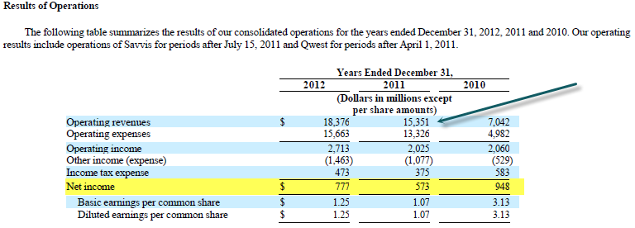
10-K: Part II – MD&A (CTL)
We get some idea of the acquisitions and their impact. Notice the dates the acquisitions closed.
Revenue growth looks pretty good?
Qwest was 100% in 2012 revenues, and about 75% of 2011…
Notes:
Tip: Add your own speaker notes here.

Slide 11
10-K: Part II – MD&A
Did they really grow in 2011 (internally or organically)? We are going to try to figure that out…
- Clearly access lines are declining, and it’s hard to gauge the rate of growth in broadband subs without more data…
Notes:
Tip: Add your own speaker notes here.

Slide 12
10-K: Part II – Acquisitions
Lots to examine here
This is what they reported…
This is what it would look like if they owned the new companies all along…
Is CTL REALLY growing?
Notes:
Tip: Add your own speaker notes here.

Slide 13
Organic Growth: MFE (INTC)
Notes:
Tip: Add your own speaker notes here.

Slide 14
Organic Growth: MFE (INTC)
A lot of investors owned MFE because mgmt claimed the organic growth was fairly high; I didn’t agree at high prices because I thought the organic (non-acquisition) growth was much lower. In fact, my best guess is it was 0%
Revenue Model (R166- 357)
R193-243 focuses on acquisition analysis; it shows revenue contribution from various acquired companies or combinations of acquired companies
For example, MFE bought SCUR+Reconnex+Solidcore (R208-209); look at 3Q09, if they had those companies in 2Q09, revenue growth would have been 3.6% yoy, instead of the reported +18% (R325)
Notes:
Tip: Add your own speaker notes here.

Slide 15
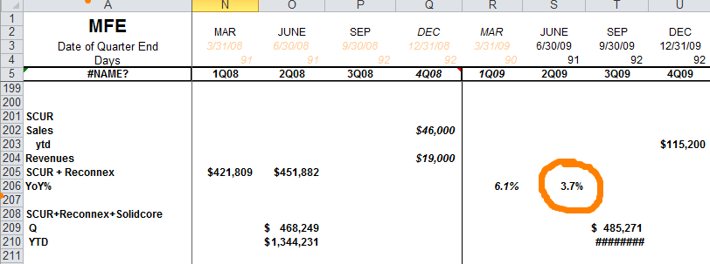
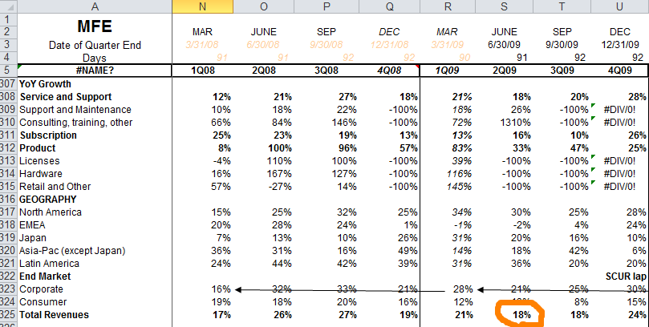
Organic Growth: MFE (INTC)
Notes:
Tip: Add your own speaker notes here.

Slide 16
Organic Growth: MFE (INTC)
Lots of acquisitions, with suspicious timing, and a lot of touting of how well the business was doing. In 2Q09, mgmt was claiming organic growth of 10%, but a close analysis revealed this wasn’t the case at all
INTC eventually bought MFE; it hasn’t been a big success
Notes:
Tip: Add your own speaker notes here.

Slide 17
Proxy Statement
Form DEF 14A
Voting procedure
Conflicts of interest, board member CV
Board and executive compensation
Audit fees, information, and who is on the audit and comp committees

Slide 18
How Does the CEO get paid? (Autoliv)
Proxy Analysis – do bonuses depend on sales growth, ebitda growth, stock price growth, market share?
“Reflective of our compensation philosophy, the compensation of our named executive officers is significantly affected by our financial results. As in previous years, the annual non-equity incentive financial performance metric for our named executive officers in 2011 was operating income. Based on the Company’s 2011 operating income of $889 million, which represents a 2.3% increase over operating income in 2010, each of our named executive officers earned slightly above the target payout for annual non-equity incentive awards in 2011. However, in 2011, the long-term equity incentive element of our named executive officers’ compensation was negatively affected by the performance of the Company’s stock price during 2011.” (ALV, 2011 Schedule 14A “Proxy” filing, pgs. 30-31)

Slide 19
How Does the CEO get paid?
What does this mean? ALV goes on to explain the formula:
— Threshold: If the Operating Income is 70% or less of the previous year’s Operating Income, the Company does not pay any annual incentive.
— Maximum: If the Operating Income is 130% or more of the previous year’s Operating Income, the payment equals two times the target amount, the maximum payout under the program.
— Target: Where the relevant Operating Income is between 70% and 130% of the previous year’s Operating Income, the incentive is calculated through linear interpolation (“along a straight line”) between said levels.
Incentives matter, so understand what your management is paid to do

Slide 20
Income Statement Analysis - PROFITS
Alexander Motola, CFA

Slide 21
10-K: Part II – Financials, etc.
Basic Financials, plus comprehensive income, Statement of Shareholder’s Equity, etc.
Footnotes
Revenue Recognition – this is extremely IMPORTANT. It tells what can be recognized as revenue, and when
“We recognize revenue for services when the related services are provided. Recognition of certain payments received in advance of services being provided is deferred until the service is provided. These advance payments include activation and installation charges, which we recognize as revenue over the expected customer relationship period, which ranges from eighteen months to over ten years depending on the service.”
Notes:
Tip: Add your own speaker notes here.

Slide 22
10-K: Why Read It?
We are looking for things that are material, that as investors we want more clarity on, that might give us an advantage versus other investors
It is not fraud free nor hyperbole free, but it is the “cleanest” source of primary information we will get
“K” has much more detail than the “Q” or the press releases
There is an art and a science to this; experience helps, and being alert helps – you are basically a detective or an investigative reporter
Notes:
Tip: Add your own speaker notes here.

Slide 23
10-K: What is it?
SEC filing, delivered to SEC within a specific time from the FYE (for your companies it is 75 days for the K, 40 for the Q)
It is NOT reviewed in most cases by the SEC; just made available to the investing public
Required of US based (Domicile) companies; some companies are TRADED in the US, but not headquartered here – those companies file an abbreviated document called a 6-K
It covers specifically the just completed fiscal year (Annual Report), but has comparable data in it from prior years
There is actually a different document which is referred to as the “Annual Report” (technically the “Annual Report to Shareholders”)
SEC filing are available in many places, but always on EDGAR (sec.gov)
Notes:
Tip: Add your own speaker notes here.

Slide 24
10-K: Part I – Legal Proceedings
Extremely important
Mgmt. tends to be dismissive of litigation, either they will win or they are insured, reserved, etc.
Legal cases can be quite serious
You will want to understand what is serious and what is not, you will be asked (IAC)
Notes:
Tip: Add your own speaker notes here.

Slide 25
Quality of Earnings, Ch. 4 “Differential Disclosure”
When revenues grow rapidly, you normally expect margins to expand – why?
Hiring usually lags growth (lower opex/cogs)
Advertising leverage
Manufacturing efficiencies, procurement efficiencies
Sometimes this doesn’t happen
Extreme discounting
Like with the iDevices, airfreight to meet demand ate up a lot of margin
Large customer discounts or other low margin distribution changes (getting into Wal-Mart)
Notes:
Tip: Add your own speaker notes here.

Slide 26
More on Margins
Margins are a % of revenue (common sized income statement)
The most important margins (we covered this earlier) are: Gross Margin, Operating Margin, and Net Margin.
GM and OM can be used to compare within and across industries
These 3 margins are what is being referred to when the “profitability” of a company is being discussed
Notes:
Tip: Add your own speaker notes here.

Slide 27
More on Margins
Negative GM is rare, but it means that a company is selling goods in total for less than it costs to make or buy them; this is unsustainable
Companies with high fixed costs generally have volatile GM and companies with variable GM usually have more stable GM
Notes:
Tip: Add your own speaker notes here.

Slide 28
More on Margins
If GM improves, then – all else being equal – OM improves, and NM improves
Be sure to understand where the improvement or deterioration is coming from
If you calculate growth rates (YoY, or even QoQ) for all line items (revenue and each expense), then these will literally “jump off the page” at you, and the margin % can help understand the magnitude
Notes:
Tip: Add your own speaker notes here.

Slide 29
More on Margins
For investors, rising margins are great (assuming they are rising for the right reasons)
Company grows (+ve) (business is good and/or well managed)
Margins expand (+ve) (growth and mgmt leverage and control expenses)
Earnings grow faster than revenue (+ve) (direct result of margin expansion)
Often equals earnings surprises (+ve) (analysts underestimate margin exp)
Earnings estimates get revised higher (+ve) (analysts try to correct)
P/E multiples (discussed later) expand (+ve) (investors value the stock more)
This creates a situation where the stock price grows much faster than revenues/earnings, and translates into huge investor profits
Notes:
Tip: Add your own speaker notes here.

Slide 30
Shares Outstanding
Shares Outstanding = how many pieces the ownership pie is divided into
Fully Diluted – includes options, warrants, converts, etc. Used to calculate EPS if Net Income is >= 0
Basic – only issued shares, used to calculate EPS is Net Income is < 0
Most companies grow SO by 1.5%-2% due to options issuance to employees
Equity offerings trade more shares outstanding for cash, which can be used to growth the company
If SO shrinks, then each share is worth more
Notes:
Tip: Add your own speaker notes here.

Slide 31
Quality of Earnings, Ch. 5 Non-Operating/Non-Recurring Income
It’s pretty easy to do a basic model (income statement) of a company – you just copy the income statement into Excel, and divide net income by shares outstanding, get EPS
Where does the model add value?
Incremental information
Analyzing routine information in a different way
Marrying the qualitative to the quantitative for additional insight
Notes:
Tip: Add your own speaker notes here.

Slide 32
Quality of Earnings, Ch. 5 Non-Operating/Non-Recurring Income
Incremental information
“If you believe Standard & Poor’s Stocks Reports and Moody’s Handbook of Common Stocks, those two reference bellwethers, in 1982 Pepsico (PEP) reported $2.40 per share which rose to $3.01 the following year, for an increase of 25 percent. But subscribers to The Value Line Investment Survey, an equally reputable publication, were informed that the 1982 earnings did not come to $2.40, but rather to $3.24 and 1983’s to $3.01, for a decline of 7% percent” (QoE, pg. 55)
Analysts make choices; this difference was driven by choices in how to handle “charges” – unusual and supposedly non-recurring expenses related to write downs, mergers, and other “one time events”
Notes:
Tip: Add your own speaker notes here.

Slide 33
Quality of Earnings, Ch. 5 Non-Operating/Non-Recurring Income
There is no “right or wrong” answer to handling this, it’s the analyst’s judgment based on their research
It is important to be consistent in how you handle modeling items or comparability gets disrupt and the value of your model becomes less
PEP did grow EPS 25% and decline 7% in the same year, in accounting terms; the key is to understand why
Even if the “Street” choses one method, you might not agree – which is fine, just be prepared to provide your rationale.
Some companies have a long history (UIS – Unisys, mentioned in the earlier chapter) of taking “non-recurring charges” every single or nearly every quarter – is that truly “non-recurring”?
Notes:
Tip: Add your own speaker notes here.

Slide 34
Quality of Earnings, Ch. 5 Non-Operating/Non-Recurring Income
What’s the attraction of “charging off” expenses?
Wall Street usually ignores the charges, resulting in a higher pro forma EPS, which would normally – over time – translate into a higher stock price
Being overly aggressive with charges (“The Big Bath”) creates a “cookie jar” where expenses charged off can be reversed in future period to increase earnings (confused – ask the question)
Tiny amounts can matter
Notes:
Tip: Add your own speaker notes here.

