Slide 1
Market Expectations
Alexander Motola, CFA

Slide 2
Expectations
This is the key difference between theory and practice
This is probably the lecture from this class that most relates to actually making money in the stock market
This isn’t a “secret”, but helps you understand how the market works
Notes:
Tip: Add your own speaker notes here.

Slide 3
ex·pec·ta·tion
a strong belief that something will happen or be the case in the future.
The market as a whole has a future belief “built in” to it, based on its price level
Each individual security has a future belief “priced in” as well
Notes:
Tip: Add your own speaker notes here.

Slide 4
Stock Value Theory
In theory, a stock is worth the NPV of all future cash flows
  There are two key estimates
    #1) each individual future cash flow (firm specific)
    #2) the discount rate
      Risk to market
      Risk to stock (cash flows)
If a stock’s price differs materially from its value, then there is a profit opportunity
Notes:
Tip: Add your own speaker notes here.

Slide 5
Stock Value Theory
If PERCEIVED market risk goes UP, discount rates go up, and stocks and the market go DOWN
  Obviously, the reverse is true as well
If PERCEIVED risk to a company’s future cash flows goes UP, its discount rate goes UP as well, and the stock goes down
  Reverse is true
If future cash flows are PECEIVED to be HIGHER today than investors thought yesterday, the stock goes UP
Notes:
Tip: Add your own speaker notes here.

Slide 6
Stock Value Theory – Take Away
The market believes there is a certain future for each company; this future is implied in the current stock price; this future encompasses:
  The amount of cash flow a company will generate in perpetuity
  The GROWTH rate of the cash flows (and the company)
  The risk associated with the cash flows
  The risk associated with the stock market
Notes:
Tip: Add your own speaker notes here.

Slide 7
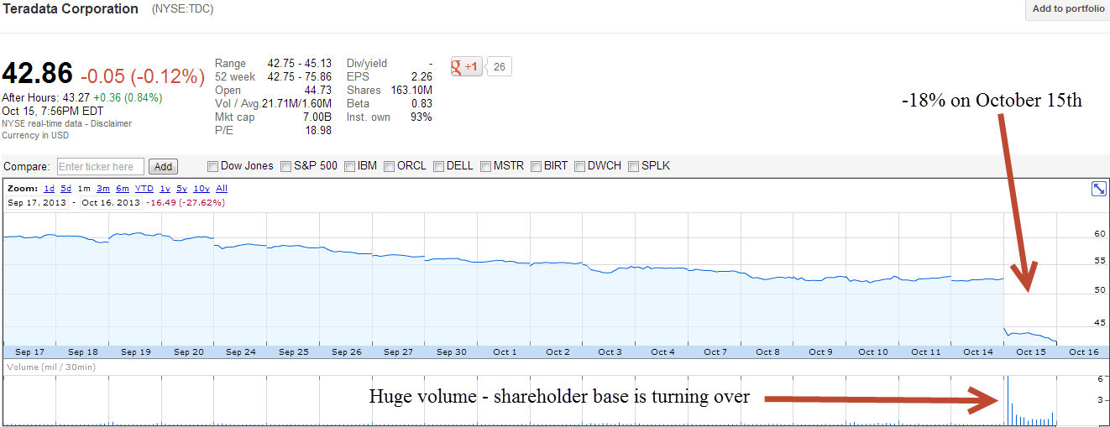
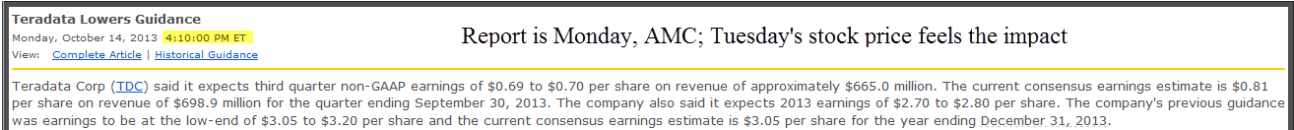
Stock Value Theory – What We See Each Day
Notes:
Tip: Add your own speaker notes here.

Slide 8
Stock Value Theory – What We See Each Day
Do investors believe that future cash flows for TDC will be lower?
Are they also worried that the risk (probability of achieving) of those cash flows has increased?
This is why even though the growth of the company might have slowed just a little, the stock gets hammered
Has market risk changed?
  Not really, perhaps if a lot of companies started disappointing…
Notes:
Tip: Add your own speaker notes here.

Slide 9
Stock Value Theory – What We See Each Day
We are not using a DCF, so why does this matter?
  We are using a forecast of company performance (earnings, sales, etc.) AND we are using a discounting proxy (multiple)
  If we think of TDC in those terms, the price has declined, so either the multiple or the multipliee has declined
    Or, as is often the case, both have declined, resulting in a lower stock price
Notes:
Tip: Add your own speaker notes here.

Slide 10
Stock Value Theory – Take Away
Investors tend to over-react to everything in the short term, which is why there is so much volatility
It is also why valuation is such a poor indicator of future futures over short time periods – the market is a voting machine in the short run, and a weighing machine in the long run.
  The longer your investment horizon, the more important your valuation work becomes
Notes:
Tip: Add your own speaker notes here.

Slide 11
Making Money
A stock’s price implies a certain growth in cash flows, discounted at a certain rate; this is what’s “priced in”
If you have a material difference of opinion with the current stock price, based on your research, you have a chance to generate a lot of alpha
Usually a difference in the growth rate of future cash flow will ultimately also entail a correlated difference in the discount rate (or multiple)
Notes:
Tip: Add your own speaker notes here.

Slide 12
“Priced In”
If it’s in the newspaper, or on CNBC, it’s priced in
Most information – at face value – from SEC filings, presentations, conference calls, etc. is priced in
How do you find things that are not?
  Analyzing data and arriving at a different conclusion
    Directional differences
    Magnitude differences
    Things that are completely missed
Notes:
Tip: Add your own speaker notes here.

Slide 13
“Priced In”
Differences in Magnitude are the most common
  Expectations – without a big external shock (like a guide down) – are usually slow to change
  Next slides shows Actuals and Estimates for Earnings of the S&P 500
    Estimates were directionally correct
    Magnitude was materially wrong
      If you had somehow realized this, there was a profit opportunity
      By “realized”, I mean had a strong factually based thesis
Notes:
Tip: Add your own speaker notes here.

Slide 14
Consensus Earnings - S&P 500
Year Reported EPS % Change
October 2003 (half of the year reported)
2001 $45.17 - 20%
2002 $48.13 + 7%
2003 (E) $52.62 + 9%
2004 (E) $57.75 +10%
July 2005 (1Q and part of 2Q reported)
2001 $45.17 - 20%
2002 $48.13 + 7%
2003 $55.55 +15%
2004 $66.99 +21%
2005 (E) $72.68 + 8%
2006 (E) $76.16 + 5%
February 2006
2005 (E) $75.18 +12%
2006 (E) $81.31 + 8%
2007 (E) $85.00 + 5%
December 2006
2005 $76.29 +14%
2006 (E) $87.00 +14%
2007 (E) $91.33 + 5%
2008 (E) 101.75 +11%
Upside is chronically understated when things are going well
Source: First Call
Notes:
ADD CAGR of earnings growth

Slide 15
Expectations: Variant Perception
“I defined variant perception as holding a well-founded view that was meaningfully different from market consensus … the only analytical tool that mattered was an intellectually advantaged disparate view.”
“It was also critical to have a keen understanding of what the market expectations truly were. Thus, the process by which a disparate perception, when correct, became consensus would almost inevitably lead to meaningful profit.”
“Understanding market expectations was at least as important as, and often different from, fundamental knowledge.”
--Michael Steinhardt
Notes:
Pg 129 of the 2001 edition for all quotes

Slide 16
Expectations: Some Thoughts
“The basic principle of investor return states: The long-term return on a stock depends not on the actual growth of its earnings, but on the difference between its actual earnings growth rate and the rate that investors expect. Investors will receive a superior return only when earnings grow at a rate higher than expected, no matter whether that growth rate is high or low.” – Jeremy Siegel, “The Growth Trap,” Fortune, December 27, 2004 – pg 168 – summarizing his book “The Future for Investors”

Slide 17
Expectations: Some Thoughts
“If we buy the stock today, then each day we move forward, the headlights of the market move forward one day (let's call it). The return that I earn over the next twelve months is the difference between the market's expectations for the first twelve months relative to the expectations it will have twelve months hence. You are looking at an expectation set change one year forward.” – Bill Miller, 2005
“I agree with Ben Graham that the market is not unaware of the outlook for most businesses over the next six to twelve months. The real question is my judgment is not what the market thinks will happen over the next twelve months. Instead, in twelve months, what will the market be looking at twelve months hence? That is the viewpoint that will determine whether or not a stock is attractively priced today. It has nothing to do with the next twelve months, unless it is really surprising.” - Bill Miller

Slide 18
Expectations: Earnings Surprises
“Indeed, nothing is more highly correlated with stock returns than knowing which companies are going to report the most positive and most negative earnings surprises one year from now.” Greg Forsythe, Charles Schwab
(from Barron’s Online, 11/27/2006, “The Schwab Advantage” by Vito Racanelli)
Notes:
Greg Forsythe – Schwab – runs their Schwab Equity Rating System (SER) – he built their model. SER has done the best of all the brokers recommendations.

Slide 19
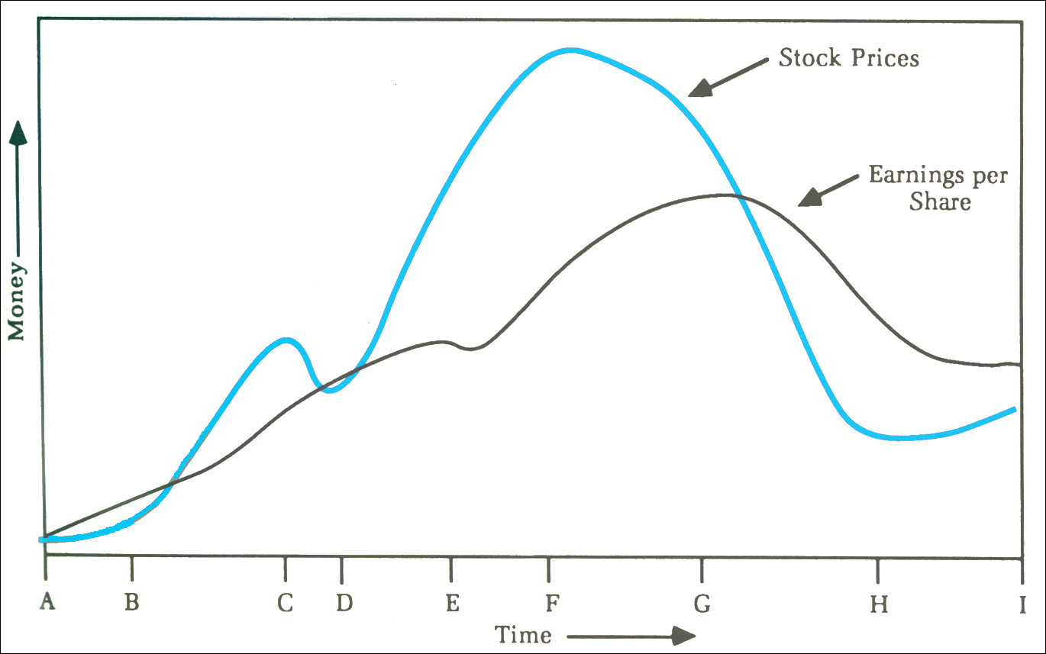
Expectations: A Typical Growth Stock
Reflexivity in the stock market
Source: George Soros, The Alchemy of Finance

Slide 20
The Soros Model
(AB) Recognition of the underlying trend is lagging but the trend is strong enough to manifest itself in earnings per share
(BC) When the underlying trend is finally recognized, it is reinforced by rising expectations
(CD) Doubts arise, but the trend survives. Alternatively, the trend waivers but reasserts itself. Such testing may be repeated several times, but here I show it only once
(DE) Eventually, conviction develops and it is no longer shaken by a setback in the earnings trend
(EF) Expectations become excessive, and fail to be sustained by reality
(FG) The bias is recognized as such and expectations are lowered
(G) Stock prices lose their last prop and plunge
(GH) The underlying trend is reversed, reinforcing the decline
(HI) Eventually, the pessimism becomes overdone and the market stabilizes
Notes:
Greg Forsythe – Schwab – runs their Schwab Equity Rating System (SER) – he built their model. SER has done the best of all the brokers recommendations.

Slide 21
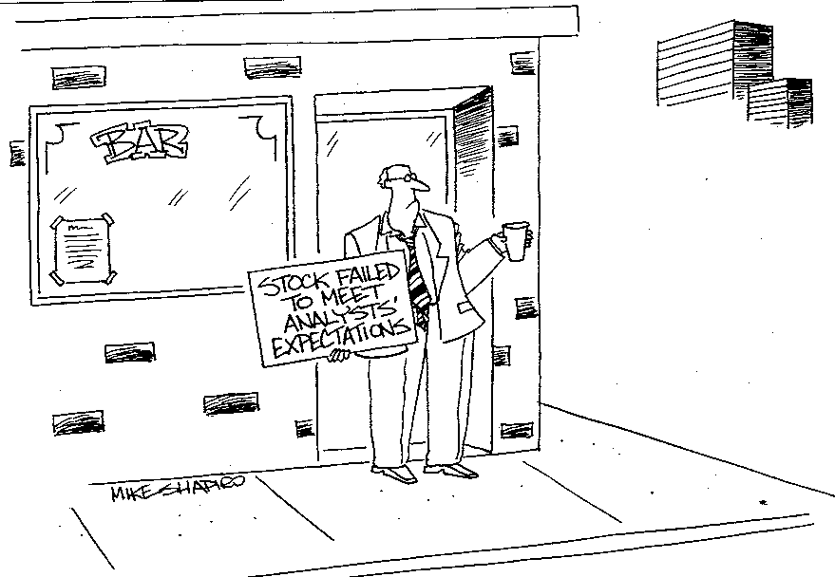
Failure to Meet Expectations

Slide 22
Summary
You need to understand why (right or wrong) your stock is priced where it is (understanding the market)
You need to understand – based on your research and your modeling – how you reached your view of the future for your company
If your expectations are different than the market, you should have no difficulty in reaching a “Buy” or “Sell” recommendation
If you agree with the market, then you have no edge or real opportunity to beat the market; should you keep the stock?
Notes:
Tip: Add your own speaker notes here.

Slide 23
Summary
If you have a “variant perception”, you should be able to provide a roadmap (thesis) to success – what milestones need to be reached to confirm your thesis is “on track”
  These can be sales numbers, GM%, units sold, market share – but they should be a quantifiable way to track your thesis
  This makes “the next guy’s” job easier too
  This is how you get a job on Wall Street
Notes:
Tip: Add your own speaker notes here.

Slide 24
More Thoughts
“More money is lost by players who know what the right thing to do is, but don’t do it, than for any other reason. Having a Strategy, a Game Plan, and the Discipline to stick with it are, along with a sufficient Bankroll, the four most important things that a player needs to be a winner”
-- Ken Warren, Winner’s Guide to Texas Hold’Em Poker (page 162)
Notes:
Tip: Add your own speaker notes here.

Slide 25
More Thoughts
“There are two things that I tell our analysts. First, 100% of the information that we have about any company or any investment reflects the past. 100% of the value of that investment depends on the future. The real question is how the past data connects with the future.”
-- Bill Miller
Notes:
Tip: Add your own speaker notes here.

Slide 26
More Thoughts
“I agree with Ben Graham that the market is not unaware of the outlook for most businesses over the next six to twelve months. The real question is my judgment is not what the market thinks will happen over the next twelve months. Instead, in twelve months, what will the market be looking at twelve months hence? That is the viewpoint that will determine whether or not a stock is attractively priced today. It has nothing to do with the next twelve months, unless it is really surprising.”
-- Bill Miller
Notes:
Tip: Add your own speaker notes here.

