Slide 1
Enrollment Management 103 Intro to Student Financial Aid
1st Level Training
Banner Forms, Common Questions,
and Resources

Slide 2
Topics
1 – Scholarships Offered by The University of New Mexico
2 – Processing the Free Application for Federal Student Aid (FAFSA)
3 – UNMs uses for FAFSA Information
4 - Cost of Attendance
5 - Student Documentation
7 - More on Student Loans
8 – Disbursement and Billing
9 – Satisfactory Academic Progress (SAP)
10 – Communication With Students
6 – Packaging Student Awards

Slide 3
1 - Scholarships Offered by the University of New Mexico

Slide 4
Regent’s Scholarship
Regent’s Scholarship
Application Deadline: December 1 for the up-coming school year
Approximately $14,250 per year
Student Requirements
Valedictorian OR ACT of 31 or higher OR SAT of 1380 OR a sixth semester unit GPA of 3.9 or higher AND
Maintaining the Regent’s Scholarship
Renewable up to 4 years
Statement of goals and philosophy AND
Two Letters of Recommendation
Finalists will participate in the interview process
Must have a 3.33 GPA semester GPA (Cumulative GPA may be lower)
Available to ALL incoming Freshmen
Must earn 15 credit hours per semester

Slide 5
Presidential Scholarship
Presidential Scholarship
Approximately $7,607 per year
Student Requirements
Sixth semester unit GPA of 3.75 or higher (high school)
ACT of 25 or higher OR SAT of 1140 or higher AND
Maintaining the Presidential Scholarship
Renewable up to 4 years
Must show leadership experience with outstanding extracurricular record
Statement of goals and philosophy
Graduate from a New Mexico high school
Must earn 15 credit hours per semester
Must have a 3.0 GPA semester GPA (Cumulative GPA may be lower)
Must submit a Thank You Letter after fall semester, and prior to spring semester to sponsor
Available to incoming Freshmen
Be a New Mexico resident
Application Deadline: December 1 for the up-coming school year

Slide 6
UNM Scholars
UNM Scholars
Must be admitted February 1 for the up-coming school year
Approximately $5,950 per year
Student Requirements
Sixth semester unit GPA of 3.3 or higher
Maintaining the UNM Scholars Scholarship
Renewable up to 4 years
Graduate from a New Mexico high school
ACT of 24 or higher OR SAT of 1090 or higher
Must have a 3.0 GPA semester GPA (Cumulative GPA may be lower)
Must earn 15 credits per semester
Available to incoming Freshmen
Be a New Mexico resident

Slide 7
UNM Bridge to Success Scholarship
New Mexico Bridge to Success Scholarship
No Application Needed
$1,000 for the first semester at UNM only (must be full time at main campus)
Student Requirements
Graduate from an accredited New Mexico high school with a 2.5 unit GPA or higher
OR receive a 530 score or higher on the GED in New Mexico
Non-renewable
Graduate from a New Mexico high school
Be a New Mexico resident
Concurrent enrollment to UNM upon high school graduation
Available to incoming Freshmen for the up-coming School Year

Slide 8
New Mexico Lottery Success Scholarship
New Mexico Lottery Success Scholarship
No Application Needed
Pays tuition (does not cover mandatory fees)
Student Requirements
Must earn 12 hours of credit in first semester of college with a 2.5 GPA
Graduate from a New Mexico high school or have received a GED in New Mexico
Maintaining the New Mexico Lottery Success Scholarship
Renewable up to 8 semesters
Be a New Mexico resident
If a student drops below the full-time (12 credit hours) status at any time throughout the semester, the scholarship will be cancelled for that specific semester and the student will be responsible for all incurred charges.
Must maintain a 2.5 Cumulative GPA
Must earn 12 credit hours per semester (Repeated classes DO NOT count toward hours earned)

Slide 9
New Mexico Scholars Scholarship
New Mexico Scholars Scholarship
Pays tuition, mandatory fees, and books
Student Requirements
Graduated in top 5% class OR
ACT of 25 or higher OR SAT of 1140 or higher
Maintaining the New Mexico Scholars Scholarship
Must complete 15 credit hours with a 3.0 GPA each semester.
Renewable up to 4 years
Be a US citizen
Total family income of less than $30,000/year with one applicant in college or $40,000/year with applicant and another family member in college
Graduate from a New Mexico high school
Resident of New Mexico
Available to incoming Freshmen
Must be admitted February 1 for the up-coming school year

Slide 10
Amigo Scholarship
Amigo Scholarship
Must be admitted by February 1 for the up-coming school year
Waives out-of-state tuition and pays $200 book stipend per year
Student Requirements
High school unit GPA of 3.5 or higher
ACT of 23 or higher OR SAT of 1060 or higher
Maintaining the Amigo Scholarship
Must complete 15 credit hours with a 3.0 GPA each semester
Renewable up to 4 years
Be a US citizen
OR
High school unit GPA of 3.0 or higher
ACT of 26 or higher OR SAT of 1170 or higher
Available to incoming Freshmen
Available to Non-New Mexico Residents ONLY

Slide 11
Other Scholarships
Transfer Scholarships
There are a number of Transfer Scholarship Programs available. Must be admitted by February 1 (fall awards) or October 1 (spring awards)
Departmental Scholarships
Vary by department
Private and Outside Scholarships
Vary by organization

Slide 12
Searching for Scholarships
Consult individual departments
Students can use Internet Search Engines
Students should never pay for a scholarship search
Information on searching for scholarships can be found on the Scholarship web site

Slide 13
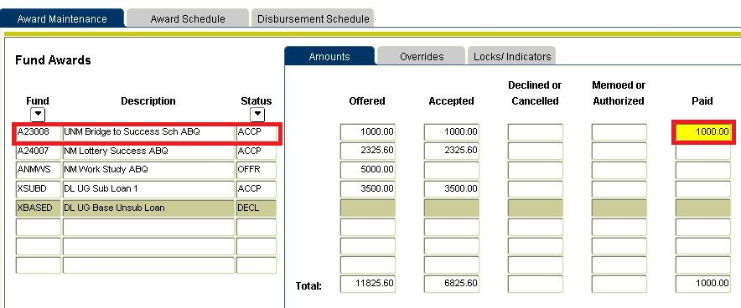
Scholarships in Banner can be viewed on RPAAWRD
Money that has been paid will show up in the ‘Paid’ Column
Brief description of the Award
Looking at this student, the ‘UNM Bridge to Success Sch’ has been paid to the student’s account.
ACCP – the award has been Accepted
CANC – the award has been Canceled
DECL – the award has been Declined
OFFR – the award has been Offered
(e.g. work-study/loans)

Slide 14
2 - Processing the Free Application for Federal Student Aid (FAFSA)

Slide 15
FAFSA Eligibility Requirements
Information on FAFSA Eligibility Requirements can be found in FastInfo Answer:
4804
Be a U.S. citizen or eligible non-citizen
Have a valid Social Security Number
Males 18-25 must be registered with Selective Services – www.sss.gov
Have a high school diploma or GED Certificate or pass an “ability to benefit” exam approved by the U.S. Department of Education
Be enrolled in a degree or certificate program
Non-degree only for required prerequisites into a Graduate Program OR Teachers Certification
No drug convictions for an offense that occurred while receiving financial aid
Student must not owe a refund on a Federal Grant or be in default on a Federal Student Loan
Student must demonstrate financial need for Subsidized Loans only

Slide 16
The FAFSA establishes the Expected Family Contribution (EFC)
FAFSA Process:
First - The student completes the Free Application for Federal Student Aid (FAFSA), signs it with a federally issued PIN (available at pin.gov) and sends it to the Department of Education Central Processing System (CPS).
Second - The CPS computes the applicant's Expected Family Contribution (EFC) using a federal need analysis formula – Federal Methodology.
Third - The Federal Methodology is used to calculate a student's and family's ability to contribute to postsecondary education, the EFC.
EFC is the number that is used to determine eligibility for Federal and State Financial Aid
Information on EFC can be found in FastInfo Answer: 1504

Slide 17
Information Needed to Complete the FAFSA
Student’s Social Security Number. (Be sure that it is what is printed on the social security card)
Student’s Driver’s License (If Any)
Student ‘s W-2 Forms and Other Records of Money Earned
Student’s (and Spouse’s, if student is married) Federal Income Tax Return
Student’s (and Spouse’s, if student is married) Bank Statements
Student’s (and Spouse’s, if student is married) Untaxed Income Records:
Child support received
Temporary Assistance for Needy Families (TANF)
Untaxed money received or paid on the student’s behalf and not reported elsewhere
Veterans non-educational Benefit records
Student’s (and Spouse’s, if student is married) current business and investment mortgage information, business and farm records, stock, bond, and other investment records
Student Alien Registration or Permanent record card (If non-U.S. Citizen)
If the Student is Dependent, Parent information will be needed as well.
Information regarding a Student’s Dependency/Independency Status can be found in FastInfo Answer: 1512

Slide 18
UNM’s Receipt of FAFSA Information
Department of Education sends the report to UNM
UNM loads FAFSA information into Banner (nightly)
Viewed on RNANAxx
Student lists UNM as a school they would like to have their FAFSA information sent
School Code: 002663
The FAFSA can be completed at FAFSA.gov
Information on how a student files a FAFSA is found in FastInfo Answer: 1130

Slide 19
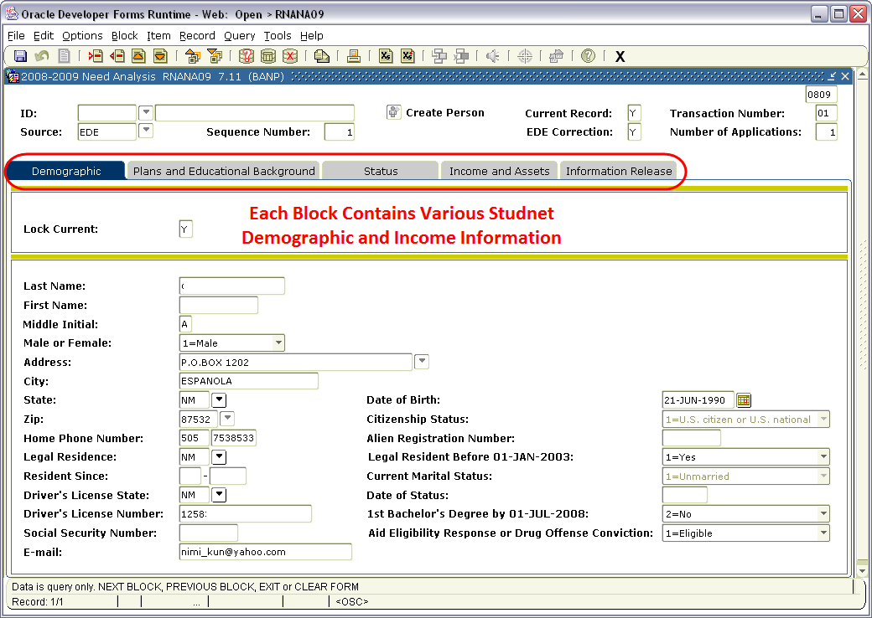
The FAFSA in Banner can be viewed on RRAAREQ and RNANAxx
The xx =are the last two numbers of the Financial Aid Year
Ex: The 2008-2009 Year = RNANA09
Receipt of the FAFSA can be confirmed on RRAAREQ and RNANAxx.
RNANAxx contains the actual FAFSA information entered by the student.

Slide 20
Rejected FAFSAs
Rejected by The Department of Education
A FAFSA is rejected when there is not enough information on the application to calculate an EFC.
OR
Severely Conflicting Data
A FAFSA is rejected if the data on the application is severely conflicting and an EFC cannot be determined.

Slide 21
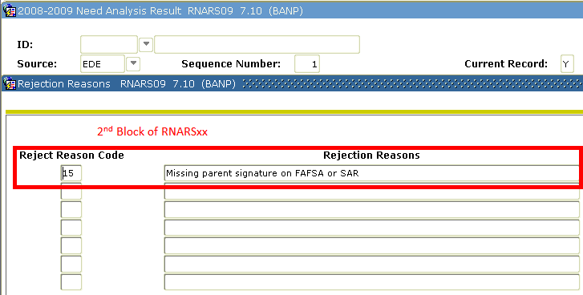
Rejected FAFSAs in Banner can be viewed on RRAAREQ and RNARSxx 2nd Block
By Checking the 2nd Block of RNARSxx, the student’s FAFSA has been Rejected for ‘Missing Parent Signature’.
To resolve Reject issues, the student has to correct the data at FAFSA.gov

Slide 22
3 – UNM’s Uses for FAFSA Information

Slide 23
The Need Analysis
COA is UNM’s ‘Cost of Attendance’
EFC is determined by the Department of Education
COA
-
EFC
=
Gross Need
The University of New Mexico uses this information to determine a student’s eligibility for Need Based Financial Aid.

Slide 24
The Basic Need Analysis Formula Can Be Viewed at the Bottom of RPAAWRD
Example: The Student’s Cost of Attendance is 17,448.36
MINUS
The Student’s Expected Family Contribution (EFC) is 2,443.00
EQUALS
The Student’s Eligibility for Need Based Aid is 15,005.36

Slide 25
Pell EFC versus SAR EFC
Pell EFC
SAR EFC
The Pell EFC is based on 9 months of attendance.
The Pell EFC is used to determine a Student’s Eligibility for a Federal Pell grant.
The SAR EFC is dynamic and is used to calculate a Student’s Eligibility for Need Based Aid.

Slide 26
Pell EFC versus SAR EFC on RPAAWRD
To be eligible for a Federal Pell Grant, the student must have a Pell EFC below 5,273.00 as well as meet other criteria covered later.

Slide 27
Viewing other FAFSA Information in Banner
ROASTAT
‘Aid Application Received’ is the date UNM uses for Priority Awarding.
For Priority Awarding, the Received Date must be before March 1.
RNARSxx
‘Dependency Status’ is the dependency UNM uses to determine if the student needs to provide parent information on the FAFSA.
Dependent students MUST provide Parent Income information and parent’s signature on the FAFSA.
Transfer Students
Transfer students MUST have their FAFSA sent to UNM. The student must visit FAFSA.gov and enter UNM’s School Code on their FAFSA: 002663
Financial Aid received at UNM may differ from Aid offered at another school.

Slide 28
4 - Cost of Attendance

Slide 29
The Cost of Attendance is Established by Each School
Enrollment Based
Tuition/Fees
Books/Supplies
Duration Based
Housing
Transportation
Miscellaneous
Adjusted when student drops below full-time
Adjusted when length of term changes (i.e. 16wk vs. 8wk)
We have 5 Standard Budget Components
Examples of Non-Standard Budget Components are:
Course Fees, Computer Purchases, Consortium tuition
-These are added on an individual basis

Slide 30
Financial Aid Enrollment
Students can request an increase in Cost of Attendance.
Inquiries should be directed to a Financial Aid Expert.
Undergraduate
¾ time =
9-11 hours
Full-time =
12 or more Hours
12-18 hours: tuition is the same
19 + hours: tuition charged per credit hour
½ time =
6-8 hours
ALL student Budgets are assumed Full-time
Undergraduate Full time = Financial Aid budgets exactly at 12
Increases can be made for enrollment above 12 hrs

Slide 31
Financial Aid Enrollment
Students can request an increase in Cost of Attendance.
Inquiries should be directed to a Financial Aid Expert.
Graduate
¾ time =
7-8 hours
Full-time =
9 or more Hours
9-12 hours: tuition is the same
13 + hours: tuition charged per credit hour
½ time =
5-6 hours
ALL student Budgets are assumed Full-time
Graduate Full time = Financial Aid budgets exactly at 9
A student’s actual cost for tuition can be added to a cost of attendance.

Slide 32
UNM Tuition
Undergraduate
12-18 hours same
tuition charge
Per Credit Hour charge for 19 hours and more (at which point COA can be adjusted)
Per Credit Hour charge for 13 hours and more (at which point COA can be adjusted)
9-12 hours same
tuition charge
Graduate
Per Credit Hour charge
for 11 hours and less
Per Credit Hour charge
for 8 hours and less
For Tuition Rates visit
http://www.unm.edu/~bursar/tuitionrates.html

Slide 33
Duration - Financial Aid Period
Fall/Spring
32 Weeks
Spring Only
16 week Term
Fall Only
16 week Term
Financial Aid Assists in paying for Room and Board,
Transportation, and Miscellaneous Expenses by establishing an Estimated Cost of Attendance based on the student’s Financial Aid Period.
The greater the Aid Period the higher the student’s Cost of Attendance.
Information regarding the Summer Financial Aid Period will be covered at a later date.

Slide 34
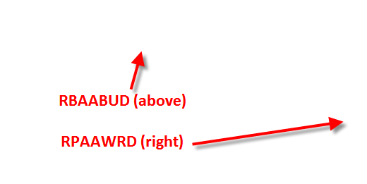
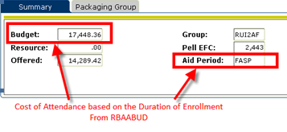
Cost of Attendance Forms Can Be Viewed in Banner on RBAABUD and RPAAWRD
The Cost of Attendance and Financial Aid Period on RBAABUD are viewable at the bottom of RPAAWRD.

Slide 35
Consortium Agreements
Process :
1st page filled out by UNM Academic advisor
Student must attach a copy of schedule at Host School
Allows students to combine enrollment at another institution for Financial Aid Purposes (e.g. 6 hours at UNM + 6 hours at CNM = 12 Financial Aid Hours)
2nd page filled out by Host school’s Financial Aid office
Cost of Attendance is updated on RBAABUD to reflect UNM tuition AND NEW budget component is added for Host school tuition
Purpose:
Form MUST be submitted by 2nd week of classes
Student is responsible for paying Host School even if no funding is available at the time payment is due.
Lottery Scholarship will be adjusted to pay for UNM Tuition AND Host School Tuition
Student only allowed to receive Federal Aid at one Institution
Consortium Agreement can be accessed at finaid.unm.edu under the forms link.

Slide 36
5 – Student Documentation

Slide 37
Reasons to Request Documents
All documents submitted, must be signed and contain the student’s UNM ID.
Documents can be dropped off, faxed, mailed, or emailed.
Financial Aid Contact Information can be found in FastInfo Answer: 2163
Examples of Conflicting Data Documentation
Verification of Social Security Number
Verification of Name or Date of Birth
Verification of Student Grad/Undergrad status
Verification of Martial Status
All verification and conflicting Data MUST be resolved before a student can be awarded Federal Financial Aid
UNM will request documentation to confirm eligibility for Federal Financial
Aid
UNM must resolve all conflicting information
UNM selects 10% of Students For Income Verification
Examples of Eligibility Documentation
Request for Appeal for Satisfactory Academic Progress
Request Confirming Defaulted Loan has been resolved
Request for Documentation Confirming Citizenship
Examples of Verification Documents
Tax Information
W2s
Untaxed Income Documentation

Slide 38
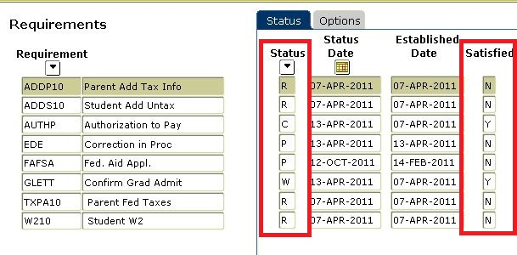
View Requested Documentation on RRAAREQ
Short description of document
Date document was requested
Unsatisfied Codes
Numbered Codes
‘R’ = Requested, Not Yet Received
‘A’ = Additional Information Needed
‘I’ = Received Incomplete
‘S’ = Lacking Signature
‘U’ = Document Unclear
Satisfied Codes
‘C’ = Received and Complete
‘W’ = Waived
Only used for Tribal Financial Need Analysis (FNA) and Outside Checks
‘2’ = FNA Completed and Sent to Tribe
‘4’ = Check Received
‘6’ = Received a Denial Letter from Tribal Agency
There will be a note on RHACOMM
Common RRAAREQ ‘Status’ Codes
‘M’ = Doc rcvd, file incomplete
‘P’ = Received, pending review
Status field displays the status of the document – See common RRAAREQ codes
If the satisfied field is “Y” the document is complete and NO further action is needed

Slide 39
More RRAAREQ…
The AUTHP (Authorization to Pay) is ‘R’ (Requested, Not Yet Received) status.
Because the Satisfied Field is ‘N’ (No), Money will not disburse to the student’s account.
The AUTHP is not required for Packaging or Memo. However, it must be satisfied before Federal Financial Aid can be Disbursed.
PRELN was requested as a result of the XSUBGD Award made on RPAAWRD.
Packaging = Awarding
The PRELN (Pre-loan Counseling) is ‘R’ (Requested, Not Yet Received) status.
The Satisfied Field is ‘N’ (No). However, it does not prevent Packaging or Memo. It will affect the Disbursement of XSUBGD listed under ‘Fund’ on RRAAREQ
Note: The FAFSA is required for Packaging, Memo and Disbursement

Slide 40
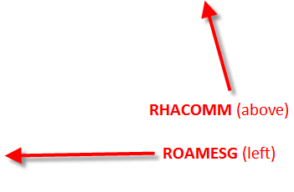
RRAAREQ, RHACOMM and ROAMESG
Because the ‘Satisfied’ field is “N”, the document is NOT complete and further action is needed.
For unsatisfied status codes (‘R’, ‘A’, ‘I’, ‘S’ and ‘P’), there are often notes on RHACOMM and ROAMESG providing more information about the document
Messages and Notes regarding the student’s file can be found on RHACOMM and ROAMESG
RHACOMM is used for leaving internal notes. The student is unable to view notes left in RHACOMM
ROAMESG is used for leaving messages to the student. These active messages can be viewed on LoboWeb by the student as long as the ‘Expiration Date’ has not passed.

Slide 41
Reminders when checking RRAAREQ
First: Look on RRAAREQ for any Unsatisfied Documentation required for a process (‘Packaging’, ‘Memo’, or ‘Disbursement’)
Second: Check RHACOMM for notes regarding the student’s file.
Third: Check ROAMESG for messages sent to the student by the Student Financial Aid Office.
Students can check the Status of Documents Submitted by logging into LoboWeb.
Instructions on how students can check the status of their
Financial Aid can be found in
FastInfo Answer: 3798

Slide 42
6 – Packaging Student Awards

Slide 43
UNM ALWAYS Awards in the best interest of the Student
Free Money First
Federal Grants
Self-Help Money Second
NM State Work Study
Loans Last
Perkins Loan
Subsidized Loans
Unsubsidized Loans
PLUS Loans
Scholarships
Federal Work Study
NM No-Need Work Study
State Grants
Institutional Grants
Eligibility for various types of Financial Aid are based on the Need Analysis. Typically, students with a lower EFC and greater Unmet Need are eligible for more favorable types of Financial Aid.

Slide 44
Awarding Criteria – Free Money First
PACKAGING ORDER | LIMITED FUNDS
Scholarships, Dependent Ed, Bridge, Lottery, GA, TA | Varies
Pell Grant | No
SSIG | Yes
UNM 3% (UNM I) | Yes
UNM Grant II | Yes
SEOG | Yes
College Affordability | Yes
Grants with ‘Limited Funds’ are awarded to students with the Lowest EFC, Greatest Unmet Need, and Earliest FAFSA Application.
The FAFSA should be filed before March 1 of every year to be considered for Priority Awarding. Students must also have a complete file. More Information regarding the Priority Deadline can be found in FastInfo Answer: 1131

Slide 45
GRANT Eligibility
EFC between 0 and 5273
2011-2012 Annual Maximum award $5,550
$2,775 Semester Maximum
Undergraduates only, with no prior degree
Students in their last two years of Doctor of Pharmacy degree are NOT eligible for a Pell Grant.
Student has all documents required for ‘Packaging’ on RRAAREQ
Pell Grant
Other Grants
Student State Incentive Grant (SSIG)
UNM 3% Grant
UNM II Grant
College Affordability
Federal Supplemental Educational Opportunity Grant (SEOG)
Eligibility information for Other Grants the Financial Aid Office offers can be found
in the Financial Aid website’s
Awarding Criteria.

Slide 46
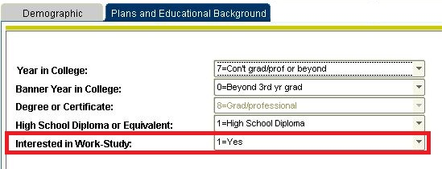
Awarding Criteria – Self-Help Money Second
PACKAGING ORDER | LIMITED FUNDS
NM Work Study | Yes
Federal Work Study | Yes
NM No-Need Work Study | Yes
Work Study Money is awarded to students who met the March 1st Priority date and who indicate “YES” to “Interested in Work-study” on the FAFSA
‘Interested in Work-study’ can be viewed on RNANAxx 2nd Block.
Eligibility and benefits of Work Study can be found in FastInfo Answer: 1537
Student must have indicated an interest in Work-Study on the
FAFSA for an OFFER of
Work-study to be made.

Slide 47
Awarding Criteria – Loan Money Last
PACKAGING ORDER | LIMITED FUNDS
Nursing Loan | Yes
Perkins Loan (cannot receive if receiving a Nursing Loan) | Yes
Subsidized Direct Loans (Undergraduate only beginning 2012-2013) | No
Unsubsidized Direct Loans (Undergraduate/Grad/Professional) | No
Graduate/Professional PLUS | No
Parent PLUS (Available to Parents of Dependent Students only - NOT PACKAGED) | No
Additional Unsubsidized Loan (ONLY for Dependent Students whose parents are denied a PLUS Loan | No
Other than Perkins and Nursing Loans, Stafford Loan monies can be awarded at any time during the school year. The type of loan the student is eligible for is determined by the amount of
Unmet-Need the student has.
LOAN AWARDING:
Students not previously awarded loans, are awarded loans in an “OFFERED” status. Students can ACCEPT or DECLINE their loan on LoboWeb under the “Accept Award Offer “ Tab.
Students who have previously received loans at UNM and are otherwise eligible, are automatically awarded the maximum for the year. Students can submit the “Loan Change Form” to adjust Loan type (subsidized/unsubsidized), amount and duration.
Information on how to apply for a student loan can be found in FastInfo Answer: 1525
Information on the different types of loans can be found in FastInfo Answer: 1523 and 1497

Slide 48
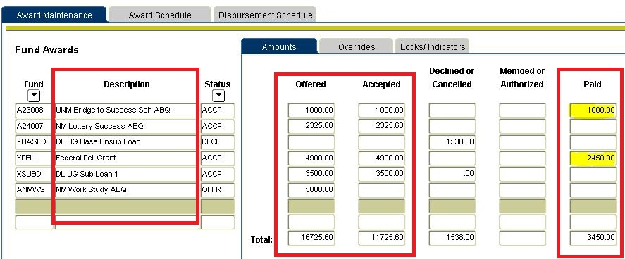
View Student Awards in Banner on RPAAWRD
To view amounts awarded for each term select the ‘Award Schedule’ Tab
Description of the
Financial Aid Awarded
The Offered and Accepted amounts will always match unless the Award is in an ‘Offered’ status
Displays the amount of money disbursed to the student account.
For Loans the ‘Paid’ amount may be slightly less than the ‘Offered’ and ‘Accepted’ amount due to Origination Fees.
Award Status Codes:
‘ACCP’ – Accepted
‘CANC’ – Canceled
‘DECL’ – Declined
‘OFFR’ – Offered
Looking at this student, the ‘UNM Bridge to Success Sch’ has been disbursed to the student’s account.
The ‘NM Lottery Success’ has not yet paid the student’s account.
The ‘Direct Unsubsidized Loan’ has been ‘declined’.

Slide 49
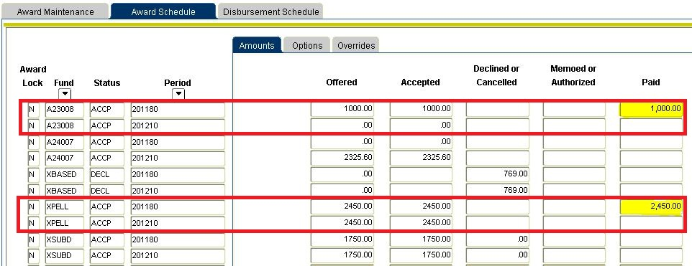
View Student Awards by Semester on RPAAWRD 2nd Block
Awards by Term can be viewed on RPAAWD 2nd Block under the ‘Award Schedule’ Tab.
This is used to determine the amount of money awarded and disbursed
to a student’s account by semester.
‘A23008’ is awarded for Fall (201180) only and has been disbursed to the student account.
‘A24007’ is awarded for Spring (201210) only and has NOT been disbursed to the student account.
‘XPELL’ is awarded for both Fall and Spring. However, only the Fall (201180) has been disbursed (i.e. Paid) to the student account.

Slide 50
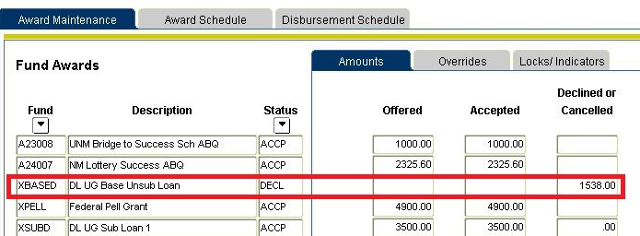
RPAAWRD, RHACOMM and ROAMESG
The ‘XBASED - DL UG Base Unsub Loan’ is in a DECL (Declined) Status. As a result, there should be a note on RHACOMM regarding the award.
Messages and Notes regarding the student’s
file can be found on RHACOMM and ROAMESG
RHACOMM is used to leave internal notes
ROAMESG is used for leaving messages to the student. These active messages can be viewed on LoboWeb by the student as long as the ‘Expiration date’ has not passed.

Slide 51
7 - More About Student Loans

Slide 52
Student Loan Eligibility
More information regarding Loan Eligibility can be found in FastInfo Answer:
3860 and 1525
Be a U.S. citizen or eligible non-citizen
Have a valid Social Security Number
Males 18-25 must be registered with Selective Services – www.sss.gov
Have a high school diploma or a GED Certificate or pass an exam approved by the U.S. Department of Education
Be enrolled at least half-time in a degree or certificate program
Non-degree only for required prerequisites into a Graduate Program OR Teacher’s Certification
No drug convictions for an offense that occurred while receiving financial aid
Student must not owe a refund on a Federal Grant or be in default on a Federal Student Loan
Student must demonstrate financial need for Subsidized Loans only

Slide 53
Loan Types Offered by UNM
Perkins
Must demonstrate financial need
Must have an EFC below $1,500
No interest or payments while student is at least ½ time
5% Fixed interest rate
Can be forgiven with Service
Subsidized
Must demonstrate financial need
No interest or payments while student is at least ½ time
Undergraduates Only beginning 2012-2013
Unsubsidized
Not based on financial need
Cannot exceed the University of New Mexico cost of attendance
Accrues interest upon disbursement
No payments while the student is at least ½ time
More information on the types of Loans offered and current Loan interest rates can be found in FastInfo Answer: 1523

Slide 54
Parent Loans
More information on Parent PLUS Loans and Interest Rates can be found in
FastInfo Answer: 3885, 4329, and 4325
Parent PLUS Loans
Loan is in the name of the parent
Credit Based
Not based on financial need
Cannot exceed UNM’s cost of attendance
Accrues interest upon disbursement
Must begin payment 60 days after disbursement
Parent can request deferment while child is in school (interest does still accrue)

Slide 55
Student Loan Limits
Independent Undergraduate
$9,500 Freshman
No more that $3,500 subsidized
$10,500 Sophomore
No more than $4,500 subsidized
Dependant Undergraduate
$5,500 Freshman
No more than $3,500 subsidized
$6,500 Sophomore
No more than $4,500 subsidized
$12,500 Junior/Senior
No more than $5,500 subsidized
Independent students are not eligible for Parent PLUS Loans.
$7,500 Junior/Senior
No more than $5,500 subsidized
Additional Amounts:
Freshman/Sophomore: $4,000 in unsubsidized
Junior/Senior: $5,000 in unsubsidized
Additional amounts are only available if Parent PLUS Loan is denied
More information about Student Loan Limits can be found in FastInfo Answer: 1529

Slide 56
Graduate Student Loan Limits
Annual
Limits
No more than $8,500 in subsidized
Graduate PLUS Loan
A Loan in the name of the student
Accrues interest upon disbursement
Credit based
Not based on financial need
Cannot exceed UNM’s cost of attendance
Requires payment within 45 days after disbursement
Student can request a deferment while in school, interest does still accrue
$20,500
Subsidized available through 2011-2012 only
Overall limits will remain $20,500 after 11/12
More information about Student Loan Limits can be found in
FastInfo Answer: 1529

Slide 57
The Student’s Loan Process
Loan Awarded
Awarded Automatically in an ‘Offered’ Status for new students
Must complete Pre-Loan Entrance Counseling
Must sign a Master Promissory Note (MPN)
Awarded Manually through a loan request form
The status of the Entrance Counseling can be viewed on RRAAREQ.
The Award can be viewed on RPAAWRD
If the status is Unsatisfied, the student must complete the Entrance Counseling at www.studentloans.gov
The Completed MPN can be verified on the 2nd block of RPALORG
If the MPN has not been completed, the student can visit studentloans.gov for instructions on completing the MPN.
If student previously had a loan, will automatically be awarded in ‘Accepted’ Status
OR
The completed Entrance Counseling will be Satisfied on RRAAREQ within 24 business hours
Loan Request instructions can be found in FastInfo Answer: 1525
Pre-Loan Entrance Counseling instructions can be found in FastInfo Answer: 1531
MPN information can be found in FastInfo Answer: and 1526

Slide 58
8 – Disbursements and Billing

Slide 59
Disbursement
Disbursement continues throughout the term
Disbursement occurs at the beginning of each term
Fall Disbursement
Begins First day of the Fall Semester
Continues throughout the semester
Spring Disbursement
Begins First day of the Spring Semester
Summer Disbursement
Disbursement is variable
Continues throughout the semester
Continues throughout the semester
Disbursement is based on the student first day of classes (1st 4 week, 2nd 4 week, etc).

Slide 60
Disbursements can be viewed on RPAAWRD
Money that has been paid will show up in the ‘Paid’ Column
Brief description of the Award
Looking at this student, the ‘UNM Bridge to Success Sch’ has been ‘Paid’ to the student’s account.
ACCP – the award has been Accepted
CANC – the award has been Canceled
DECL – the award has been Declined
OFFR – the award has been Offered
(e.g. work-study/loans)
… and verified on TSAAREV or RSIAAREV
The UNM Bridge to Success has been disbursed (‘Payment’ Field) to the student’s Bursar Account on Aug 17, 2011.

Slide 61
Money that has not Disbursed
Applicant has financial aid holds
Outstanding non-fund tracking requirements
Applicant is not enrolled
Check ROAHOLD for Active Holds
RRAAREQ has Unsatisfied Requirements
Student is not enrolled
Violates fund disbursement rules
Consult with a Financial Aid Expert
Disbursement load is greater than packaging load
Student is enrolled for less hours than expected
Not Making Sat Acad Prog (Title IV)
Student may need to Petition to receive Financial Aid
Disbursement Amount is Greater than Loan Amount
Consult with a Financial Aid Expert
Disbursement Errors can be viewed on ROIDISB. Listed are common ROIDISB Errors and the resolution.
Disbursement for Loans is based on full-time enrollment.
(REMINDER: Student’s Cost of Attendance is partially based on enrollment.)
If the student the student is enrolled for less than expected, there will be a request on RRAAREQ for Enrollment.
ENROL Indicates the student is enrolled for less hours than budgeted for.
To resolve this, the student has to increase their enrolment OR a Financial Aid Expert has to adjust the student’s Cost of Attendance to reflect their new enrollment hours. (Enrollment Hours can be viewed on ROAENRL).
ENROLX – Under Enrolled for Summer

Slide 62
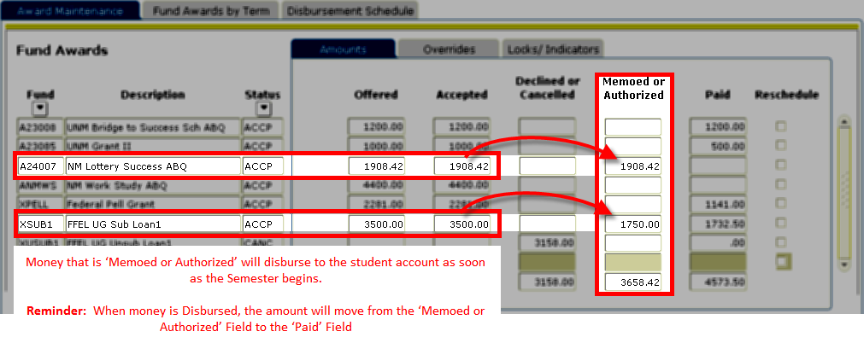
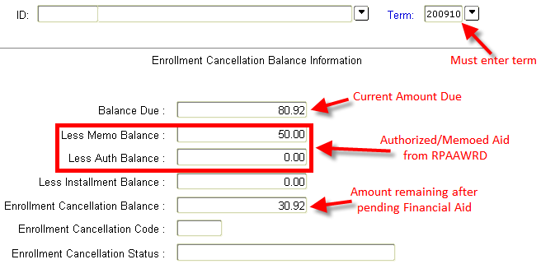
Pending Disbursements on RPAAWRD– Authorized/Memoed
REMINDER: If Financial Aid has not disbursed, check ROIDISB for list of possible reasons.
Authorized/Memoed Financial Aid are pending disbursements.
Authorized/Memoed Financial Aid allows the Bursar’s Office to anticipate Financial Aid for the upcoming semester.
Authorized/Memoed Financial Aid may prevent Enrollment Cancellation OR Reduce the amount due on a payment plan.
Enrollment Cancellation Balances can be Viewed on TZIDBAL
TO BE CANCELED

Slide 63
After Disbursement, Money is Refunded to the Student
Disbursed Financial Aid
Minus the amount owed the Bursar’s Office
Equals the amount refunded to the student
Student Refunds are issued to the student in the form of a Direct Deposit OR mailed check.
Information from the Bursar’s Office can be found in the following FastInfo Answers
Viewing a Bill On-line
Direct Deposit
Mailed Checks
Enrollment Cancellation
Payment Plans
When a Disbursement will be issued
FastInfo Answer: 3167
FastInfo Answer: 2526
FastInfo Answer: 2657
FastInfo Answer: 2682
FastInfo Answer: 2663
FastInfo Answer: 2527

Slide 64
9 - Satisfactory Academic Progress (SAP)

Slide 65
Satisfactory Academic Progress (SAP) Policy
To remain eligible for Financial Aid, students must maintain meet ALL the criteria listed.
If a student is deficient in one area, the student must be approved through a petition process to continue receiving Financial Aid.
GPA Requirements
2.0 GPA for students with 31+ attempted hours
Complete 67% of classes attempted vs. earned
W, F, I, WF, NC are counted as attempted but not earned
100 and 200 level classes for Graduate students are counted as attempted but not earned
150% of Program Maximum
192 attempted hours (150% of 128 University minimum for Bachelor’s programs)
Graduate students must maintain at least a 3.0 GPA
141 attempted hours (150% of 94 by the University) for students in University College
Graduate Student minimum time frame based on years
7 years for Masters
10 years for PhD
1.7 GPA for students with 30 attempted hours or less
Certificate students must maintain a 2.0 GPA
Same standard for double majors and students pursuing a 2nd Bach
Repeated courses can only count as “earned” credit once
The complete SAP policy can be found in FastInfo Answer: 3796

Slide 66
Students within 12 hours of their Program Maximum
Applies only to all Students pursuing a Bachelor’s Degree
Students who mathematically cannot receive their degree before the maximum time have to submit a petition or be funded for the remaining hours under 150% max.
If we know that the student cannot graduate by the 150% max, the student has to petition.
Academic Progress is evaluated annually – at the end of the Spring Semester – on all students with a FAFSA.
For Example
A student has a 1.9 GPA at the end of Spring and has a 2.1 GPA at the end of Summer, they can use this information in their petition. The code is NOT AUTOMATICALLY GOOD.

Slide 67
The SAP Codes
For students who are making academic progress in all three areas: GPA, %, and Max Time Frame
NOPROG (RNOPRO)
For students failing to make progress in one or more area
UND12 (RUND12)
For students who are within 12 hours of maximum time frame (requires a petition)
GOOD
CLOSE (RCLOSE)
For students who are within 125% of Max
ROVER
For students who are over the amount of remedial hours allowed (30 hours)
Must be awarded manually
Student must petition to receive aid
Student must petition to receive aid
Not required to submit a petition
SAP Codes can be Viewed on ROASTAT 2nd Block

Slide 68
Interim SAP Codes
X
No SAP evaluation
GRADE
Not all grades are reported – Grade of ‘NR’ Exists on SHATERM
TROUT
Not all transcripts have been received per the ‘Checklist’ on SAAADMS’
CONCUR
Student is concurrently enrolled in high school per SGASTDN
ADMIT
Student has no SGASTDN Record or it is Inactive
ERROR
Not enough information to evaluate
Interim SAP Codes are reviewed nightly for a change in status.
For Example, if a student with a SAP Code of ‘TROUT’ has a transcript entered on the SAAADMS ‘Checklist’ the SAP Code will be changed that night to either GOOD, UND12, or NOPROG.

Slide 69
Submitting a Petition for SAP
SAP Petition must contain
Once the SAP Petition is submitted
Allow 7 to 10 business days for reading
Petition Coversheet
Unofficial Grade Transcript
Written Statement from student
Supporting documentation (if applicable)
Degree Summary or University College Transition form (if student is failing SAP for Program Maximum or Under 12)
A decision is made by one reader
Decisions on SAP Petitions
Result of Petition can be Probation
Result of Petition can be Denied
Result of Petition can be placed on Academic Plan
If denied, petition goes to 2nd reader
SAP Decision Codes can be found on ROASTAT along with the result of the petition on ROAMESG.
PROBATION Codes:
PROB – semester probation
(to qualify for Probation, student must be able to be ‘mathematically’ GOOD at the end of one semester)
Denied Codes:
READD – Readers Denied the SAP Petition
Academic Plan Codes:
APG - GPA
APP - %
APM - Max
APGP – GPA, %
APGM – GPA, Max
APGMP – GPA, %, Max
APMP – Max, %
APFAIL – Fail Academic Plan
All Academic Plan Codes beginning with ‘X’ require a signature and a meeting with a Financial Aid Expert.

Slide 70
10 – Communication With Students

Slide 71
Communication With Students
LoboWeb
Award Letter
Used anytime award information changes
SAP Notification
Emails
Failing Sap
Close to Max Time
Results of Petition
Exit Emails
Student graduates
Less than ½ time

Slide 72
List of Useful Banner Forms and Job Aids
Award Information
RPAAWRD
RHACOMM
RPAAWRD
RNARSxx
FAFSA Information
RNANAxx
Rejected FAFSA
RNARSxx – 2nd Block
Cost of Attendance
RBAABUD
RPAAWRD
Financial Aid Period
RBAABUD
RPAAWRD
EFC Information
Enrollment
Satisfactory Academic Progress (SAP)
ROASTAT – 2nd block
Other Resources
ROAENRL
RPAARSC
Document Tracking
RRAAREQ
RHACOMM
Loan Information
RPAAWRD
RPALORG
Disbursement and Billing
RSIAREV/TSAAREV
TSICSRV
ROAUSDF
ROAMESG
ROIDISB – error messages
‘Click’ and Print each Job Aid
Job Aid-Financial Aid FastInfo Index.doc
Job Aid-Code Financial Aid Quick Sheet.xls
Job Aid-Financial Aid Common Banner Forms.doc

