Slide 1
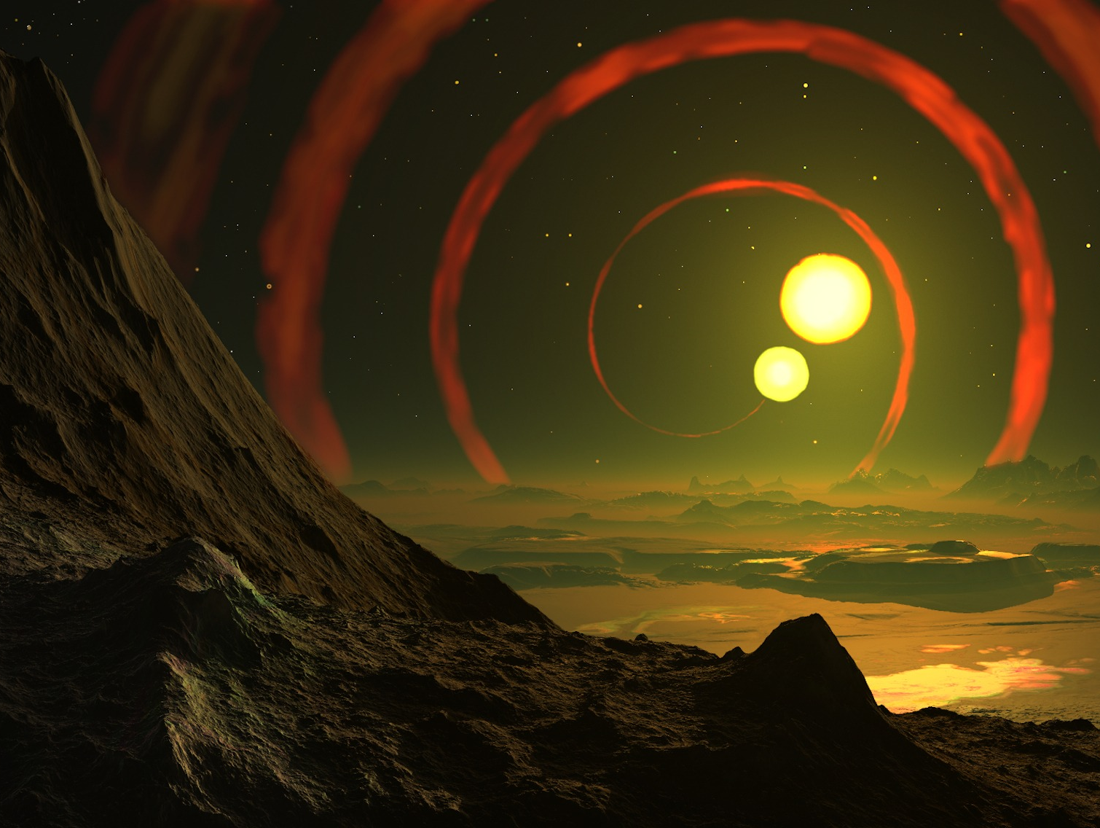
2A
REALM 2: BRAINSTORM
2B
LOCK TASK
2H
2C
2F
2E
2G
2D

Slide 2
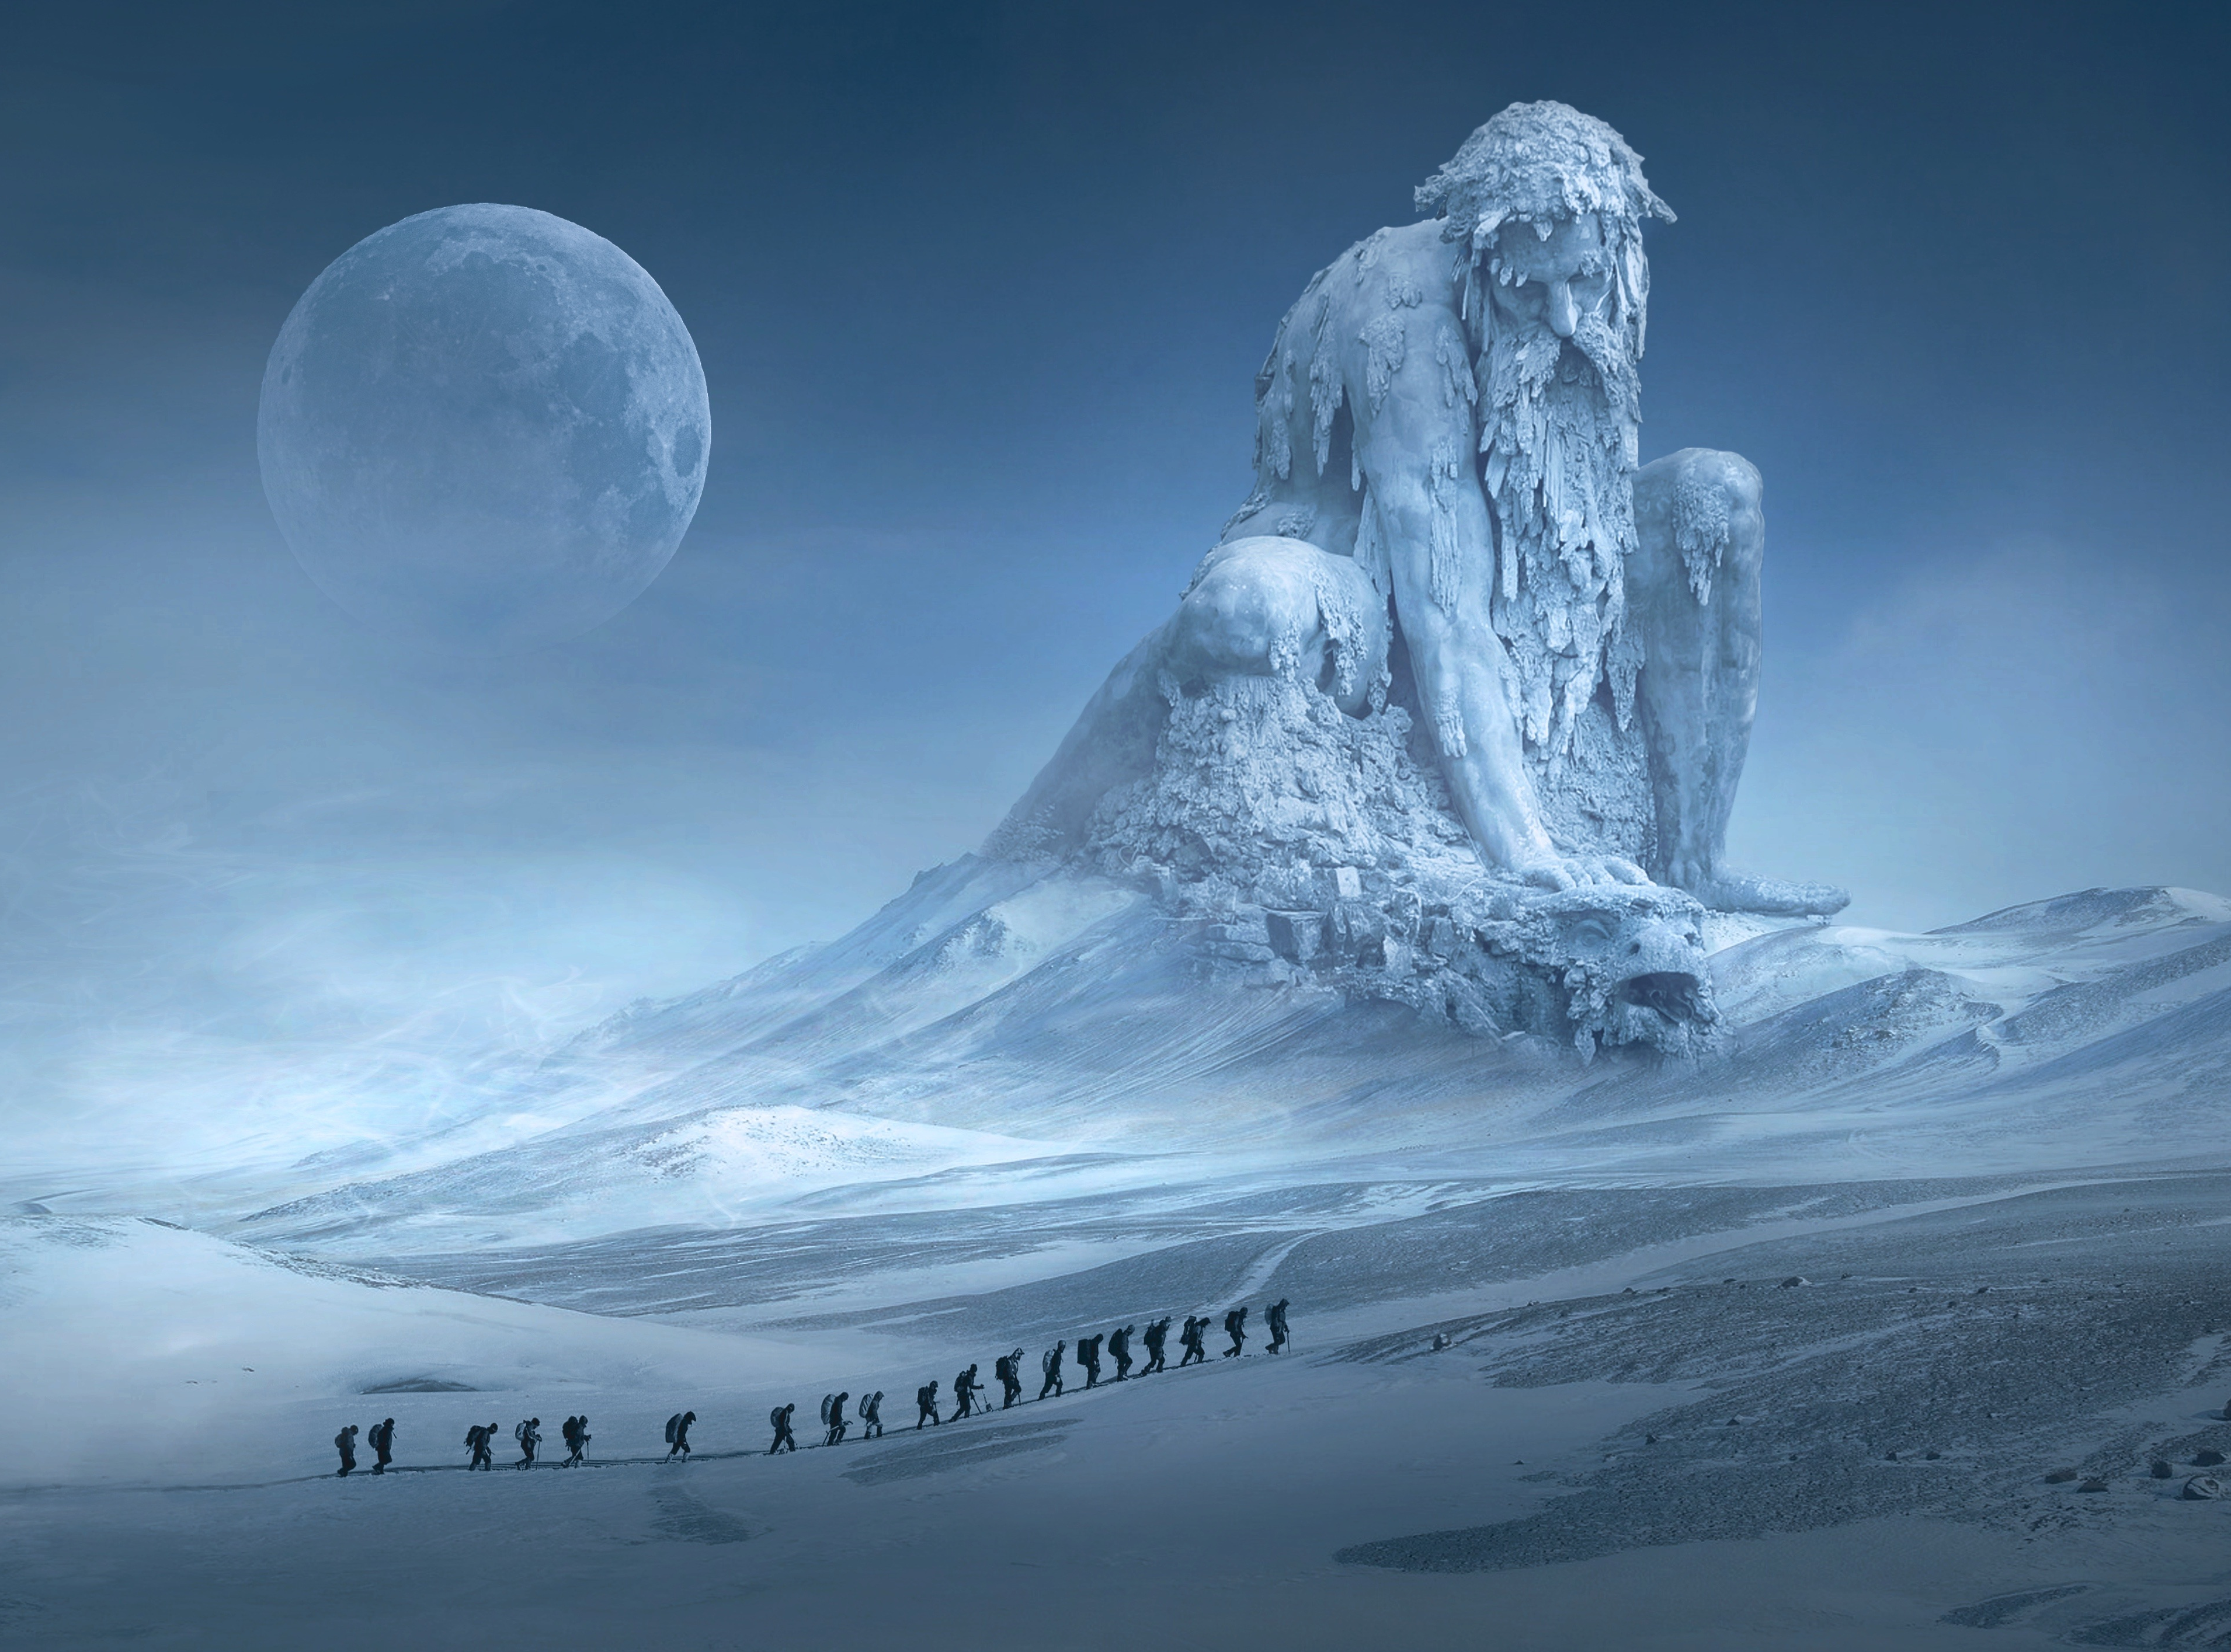
4A
4B
4C
4F
4E
4D
LOCK TASK
REALM 4: SEARCH FOR RESOURCES

Slide 3
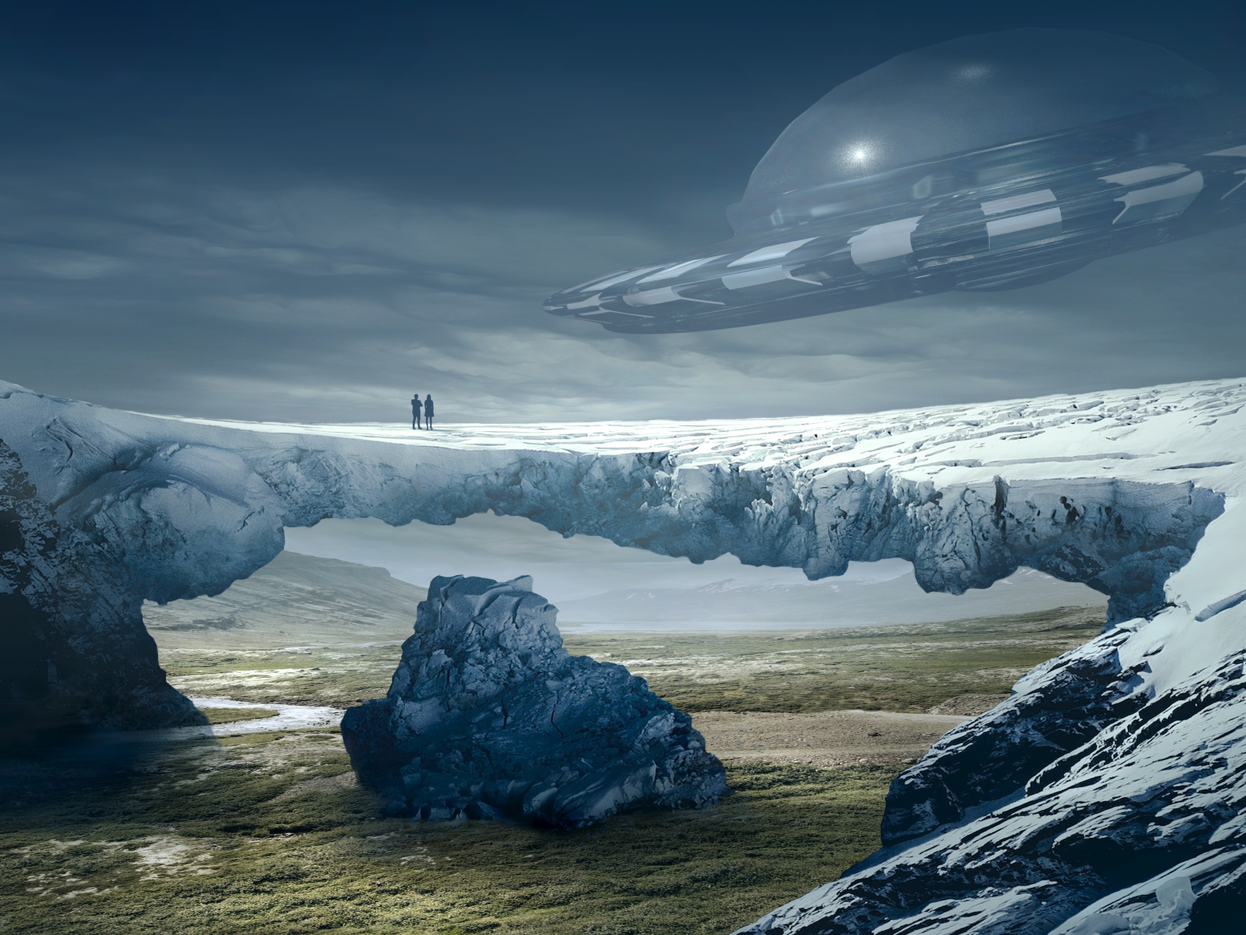
REALM 5: EVALUATE RESOURCES
5A
5B
5C
5D
LOCK TASK

