Slide 1
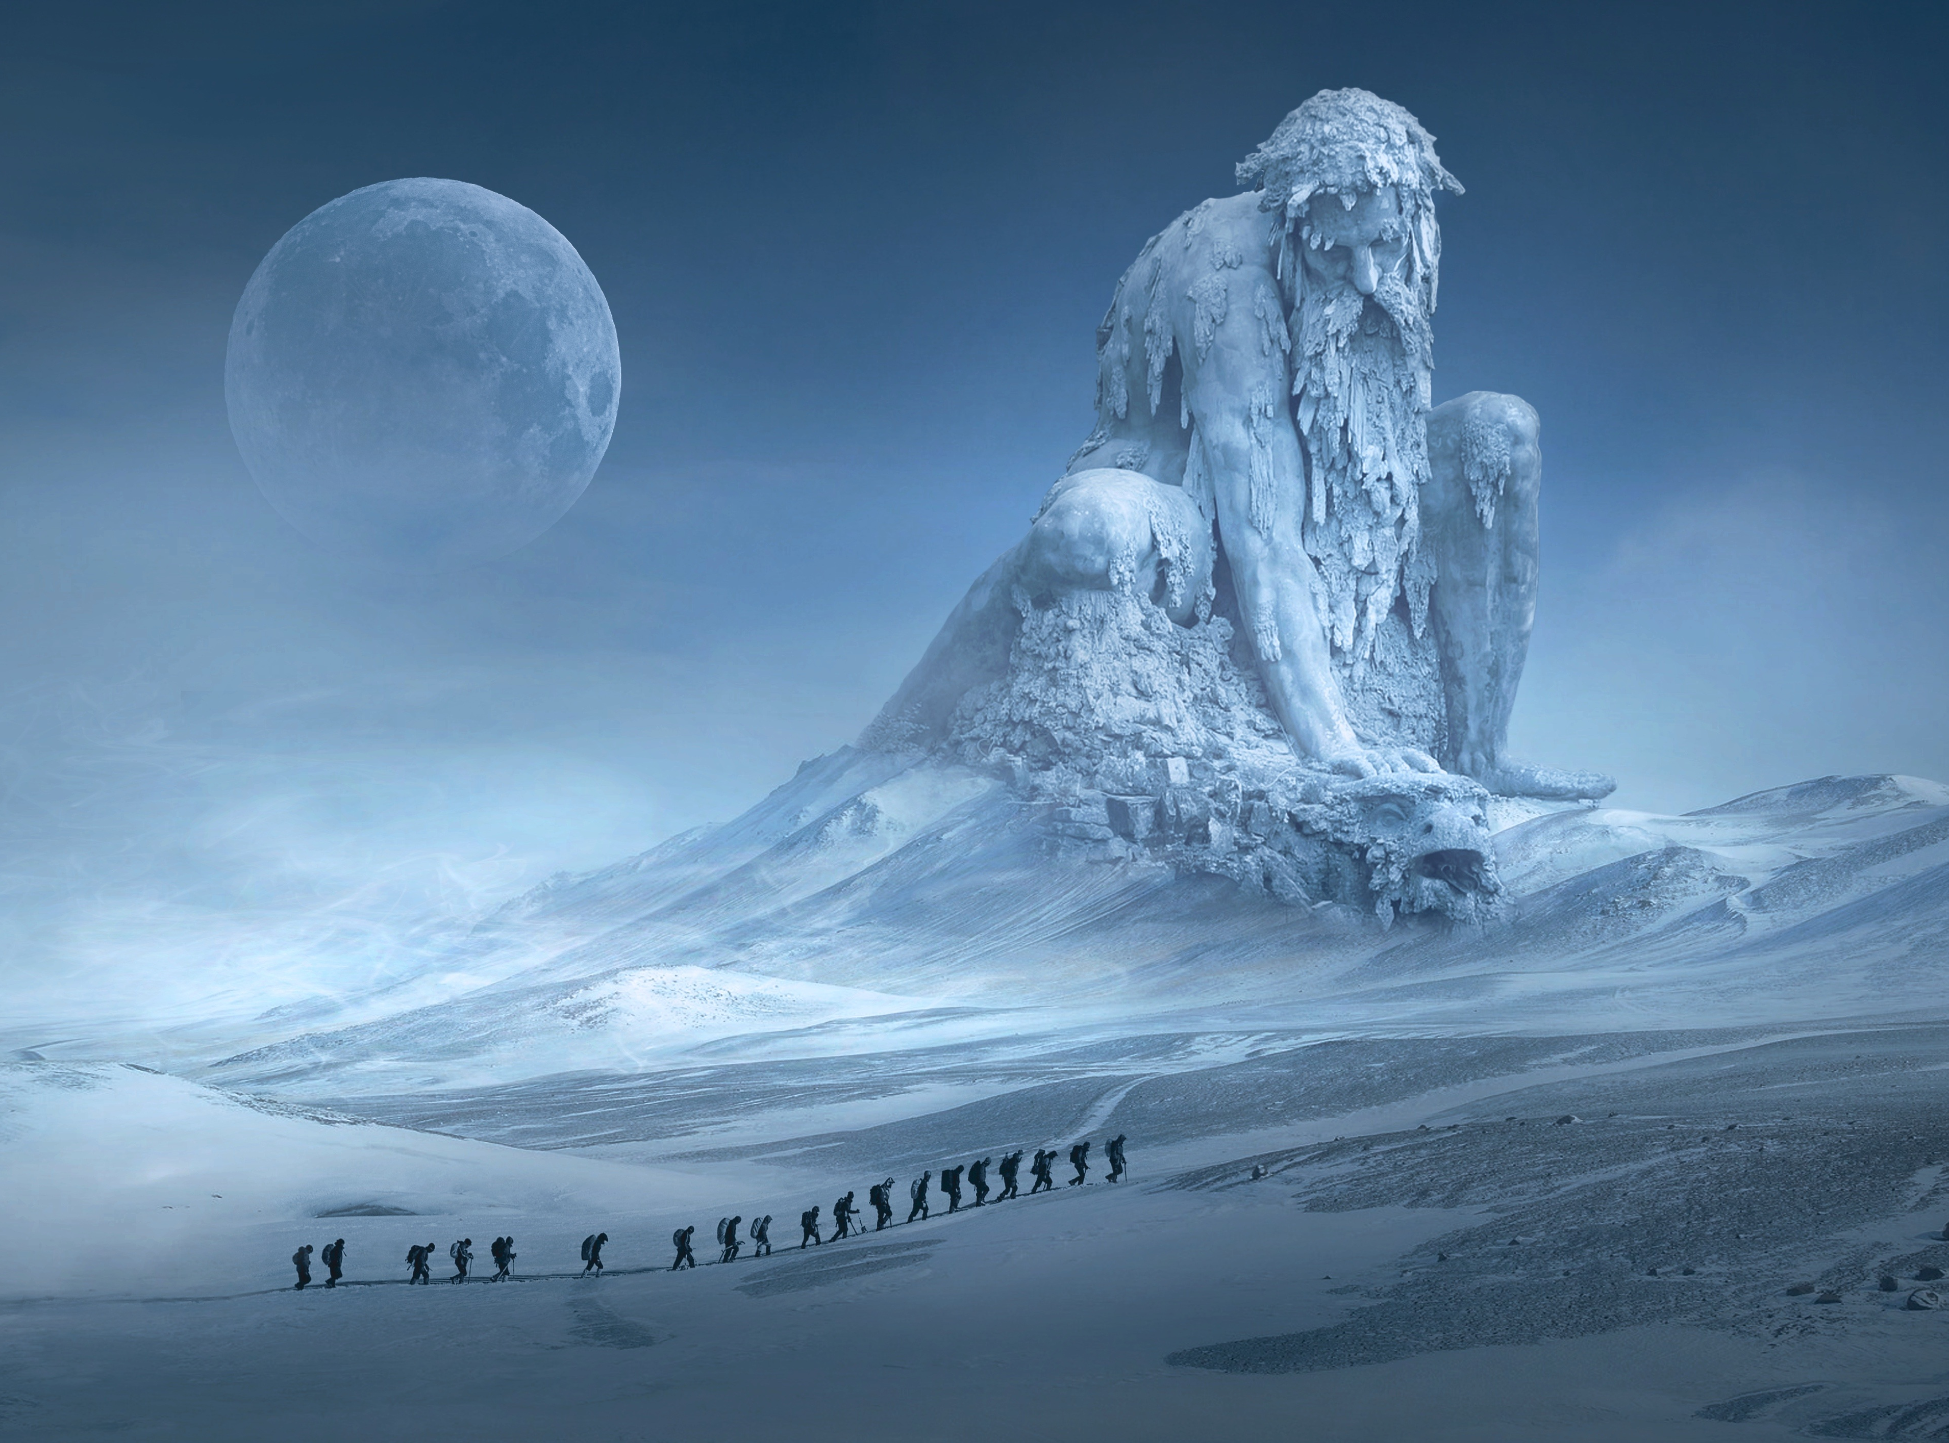
4A
4B
4C
4F
4E
4D
LOCK TASK
REALM 4: SEARCH FOR RESOURCES

Slide 2
REALM 5: EVALUATE RESOURCES
5A
5B
5C
5D
LOCK TASK

