Slide 1
Deal me in! Using card sets to create interactive experiences at your library
Soledad Garcia-King
LeAnn Weller
NMLA Miniconference
March 22, 2019

Slide 2
Project Card Game
Discover
LibGal Planning
Click
and
Reveal
Iota Story

Slide 3
Close
Pick A Project
Draw 1 Subject/Topic Card
Draw 1 Assignment Card
Draw 1 Audience Card
Draw 1 Color Card
Answer Questions based on Color Card
Share with Neighbor

Slide 4
Close
Planning Game
Group chooses institution profile & gameboard
Individuals choose 2 Topic Planning cards
Group chooses 8 topic planning cards from the 12 selected by individuals
Group places . Topic planning cards on game board

Slide 5
Close
Iota Story Game
Draw 1 card of each color.
Red card determines # of characters in story
Blue card determines # of settings in story
Yellow card determines # & type of product(s) to be produced
Green determines the # of endings
Shape on green card determines time period of story
Basic plot is “Cinderella.”

Slide 6
Close
Discovery
Open gift bag
Examine card sets
Answer: How could you use cards?
Share

Slide 7
Cards
Flexible
Engaging
Multi-functional
Promotes critical thinking, reflection, analysis
Fun

Slide 8
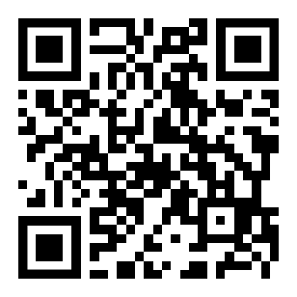
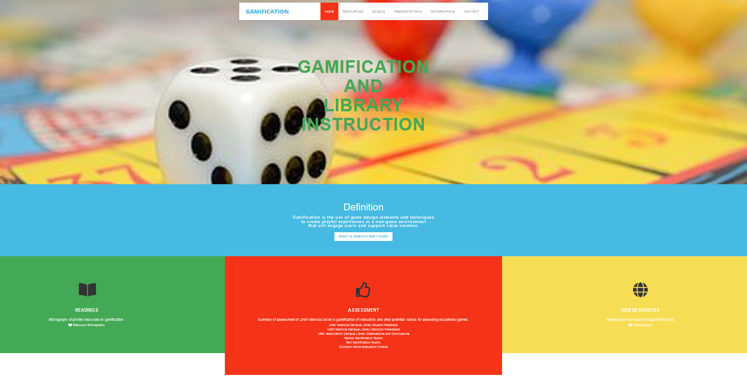
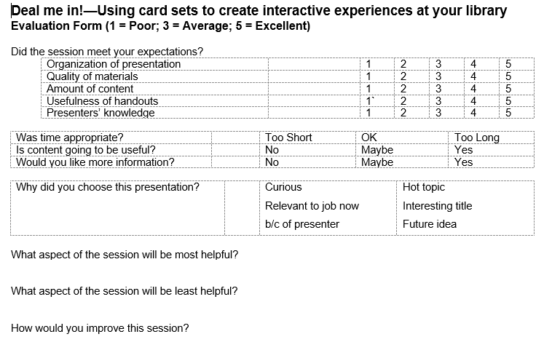
Questions?
Website
Evaluation Form
http://www.unm.edu/
~lweller1/gamification
https://esurvey.unm.edu/
opinio/s?s=104652

