Slide 1
Engineering Design Models

Slide 2
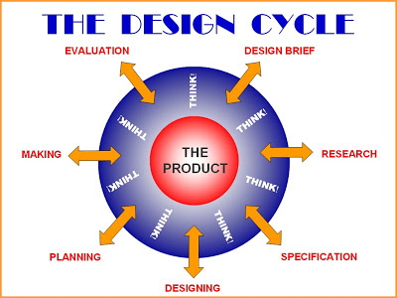

Slide 3
Engineering Design Process
What similar things exist?
Define Problem or Need
Does it work?
Modify & redesign
Research Investigate Gather Info
Select & Test
Does solution meet need?
Brainstorming
Proof of concept
Propose Design Solutions
Analyze Evaluate Solutions
Notes:
Slide from NSDL/NSTA Web Seminars: Teach Engineering. The presenters were Dr. Martha CyrDirector of K-12 Outreach and Adjunct Professor in Mechanical Engineering at the Worcester Polytecnic Institute and Dr. Mike Mooney, Associate Professor of Engineering at the Colorado School of Mines. http://learningcenter.nsta.org/products/symposia_seminars/NSDL/webseminar9.aspx
See also info at http://www.nasa.gov/audience/foreducators/plantgrowth/reference/Eng_Design_5-12.html
http://www.idea-nz.com/processhome.htm
http://www.basimmousilli.com/2009/12/web-design-methodology-from-concept-to-completion/

Slide 4
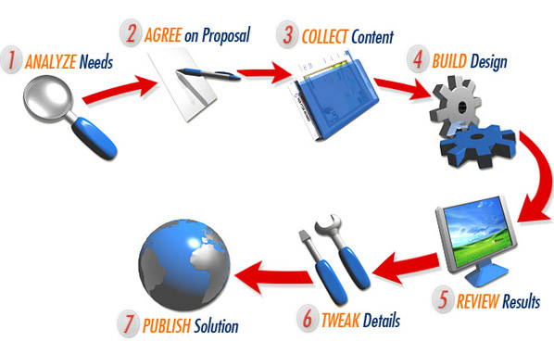

Slide 6
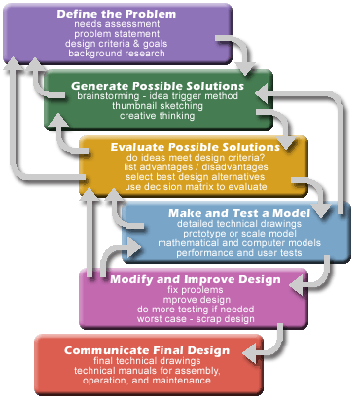

Slide 7
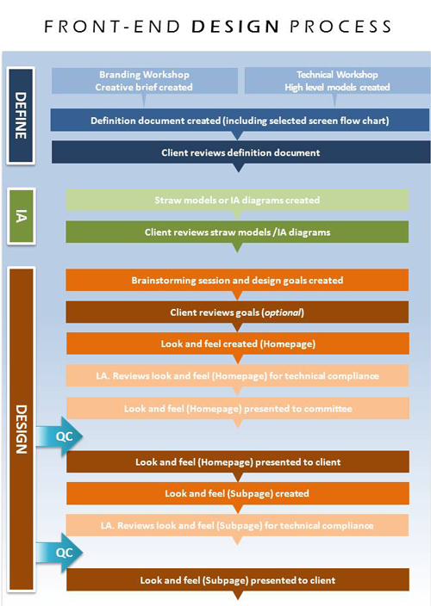

Slide 8
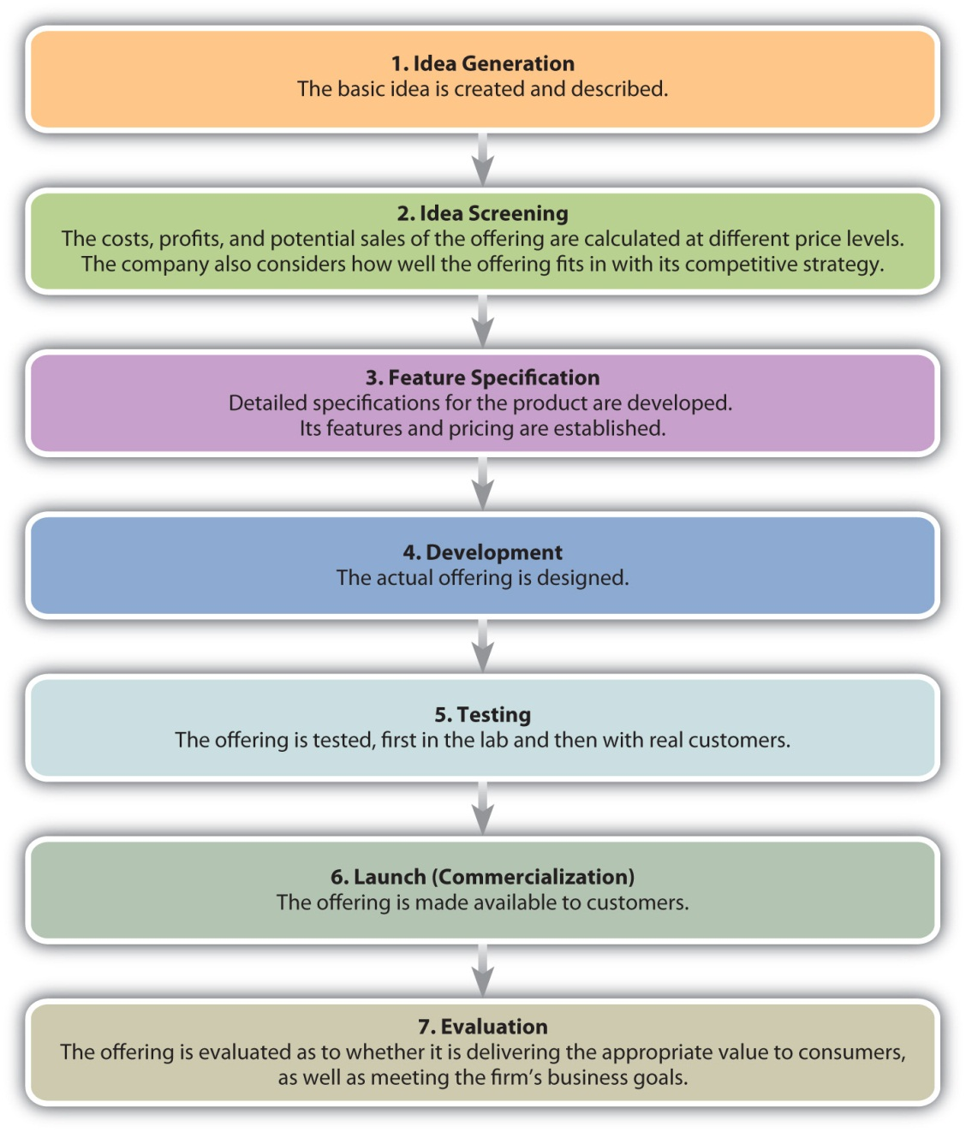

Slide 9
