Slide 1
Food Store Location Analysis
Albuquerque New Mexico, 2010
Prepared for: Geography 586L - Spring Semester, 2014
Larry Spear M.A., GISP
Sr. Research Scientist (Ret.)
Division of Government Research
University of New Mexico
http://www.unm.edu/~lspear
Preliminary (OLS-Global) Version – Update 4/19/14

Slide 2
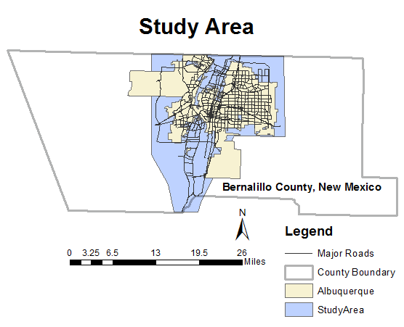

Slide 3
Preface
Follow-up to thesis research completed, 1982
Also Applied Geography Conference, 1985
Previous work using 1970 and 1980 data
Used state-of-art technology at the time
Pen and Ink and Zip-a-Tone (decal) cartography
SAS (Statistical Analysis System)
ESRI’s Automap II (first product) and Fortran
IBM Mainframe computer at UNM
Updates with recent GIS and statistical facilities – OLS (Global) and GWR (Local) versions planned

Slide 4
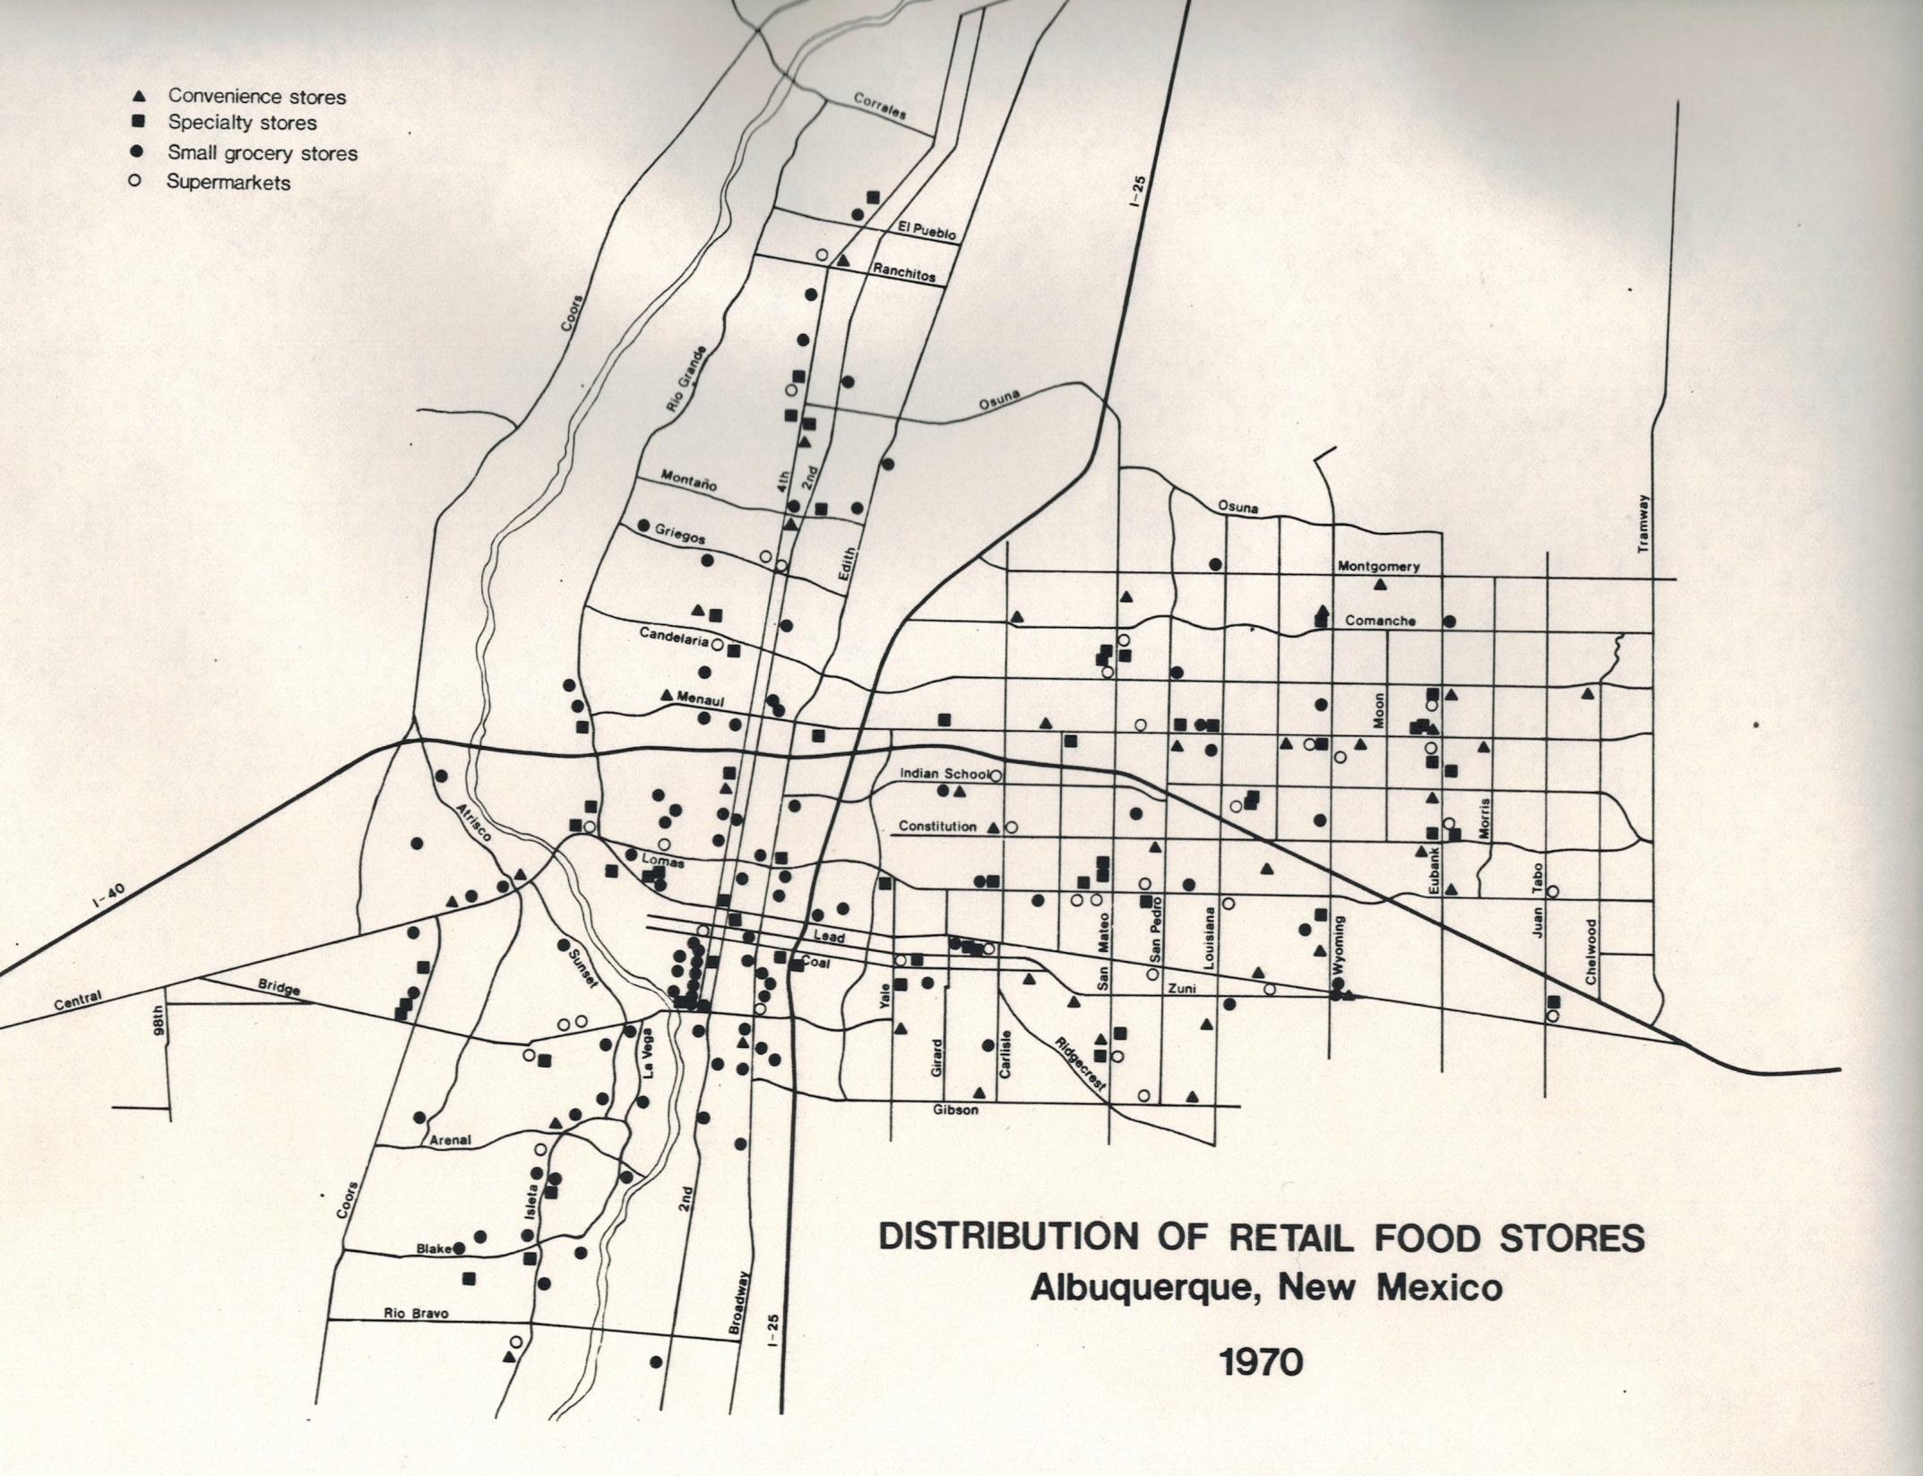

Slide 5
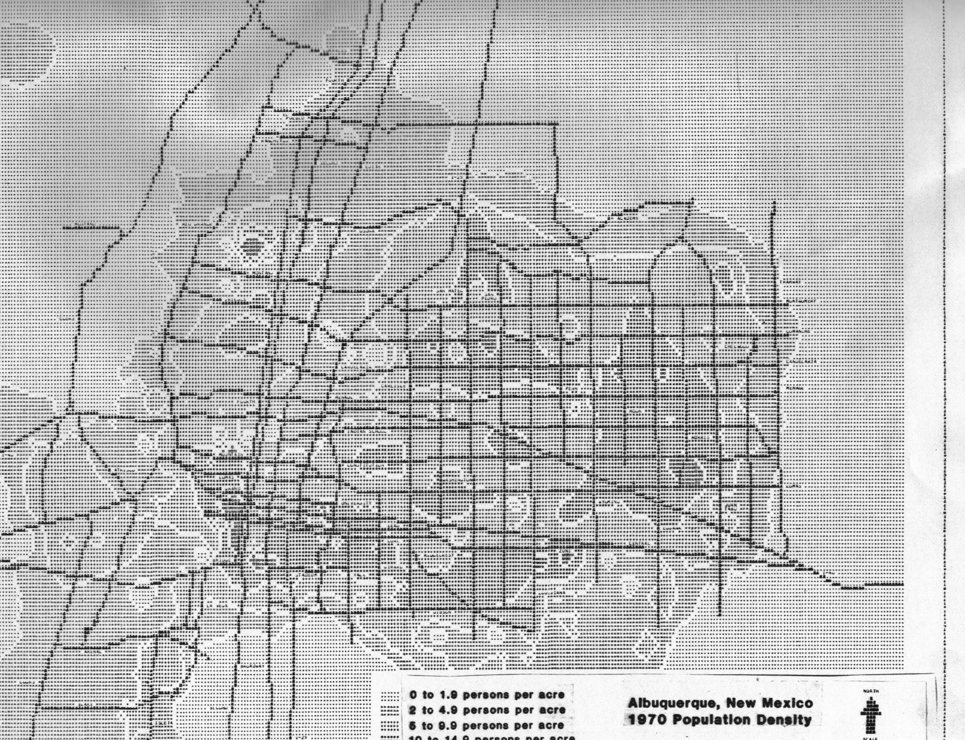

Slide 6
Research Project Components
A well defined research project should address
- Theory (previous research and practice)
- Method (established and proposed statistical and spatial techniques)
- Application/Results (maps, tables, charts, and future research)
This presentation follows this outline

Slide 7
Theory
Economic Geography and Retail Geography (sub field)
-Food stores are lower-order retail service
-Tend to locate close to residential customer population they are intended to serve
Most previous research focused on customer shopping patterns
-Delineation of trade or market areas
-Based on rational customers (consumers) who shop at closest store???
Also proprietary sales (geocoded customer location) data collected by individual companies (*Not Shared)

Slide 8
Method
Can a method be employed (developed) to:
-Test assumption (hypothesis) that full-service food stores tend to locate with respect to residential population
Needs to use readily available (non-proprietary) store and population (potential customer) data
Should be easy to apply with generally available GIS and statistical software
Should be useful to others (not just supermarket corporations) like city planners and small business owners

Slide 9
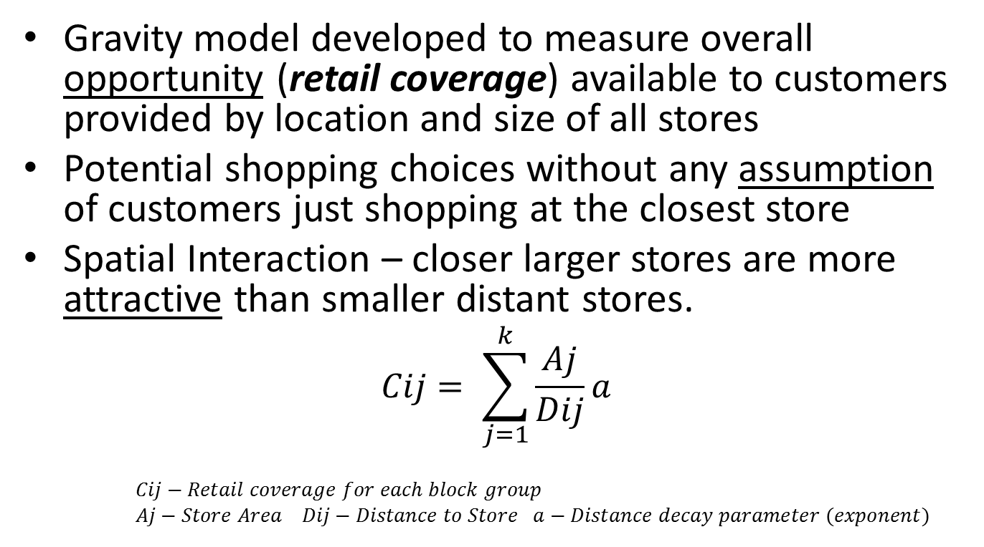
Method – Gravity Model
Gravity model developed to measure overall opportunity (retail coverage) available to customers provided by location and size of all stores
Potential shopping choices without any assumption of customers just shopping at the closest store
Spatial Interaction – closer larger stores are more attractive than smaller distant stores.
$$Cij= \sum_{j=1}^{k}{\frac{Aj}{Dij}a}$$
$Cij−Retail coverage for each block group$
$Aj−Store Area$ $Dij−Distance to Store a−Distance decay parameter (exponent)$

Slide 10
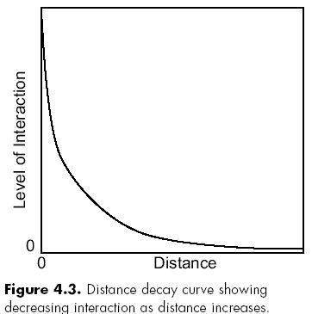
Spatial Interaction and Distance Decay

Slide 11
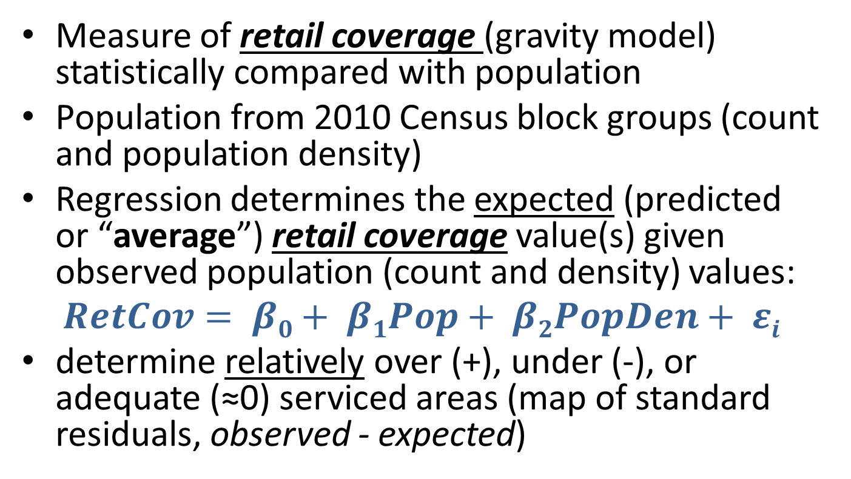
Method – Ordinary Least Squares Regression (OLS - Global)
Measure of retail coverage (gravity model) statistically compared with population
Population from 2010 Census block groups (count and population density)
Regression determines the expected (predicted or “average”) retail coverage value(s) given observed population (count and density) values:
$$RetCov= β0+ β1Pop+ β2PopDen+ εi$$
determine relatively over (+), under (-), or adequate (≈0) serviced areas (map of standard residuals, observed - expected)

Slide 12
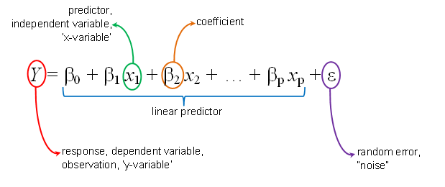
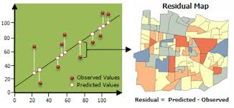
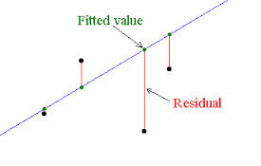
ESRI Graphic ?
Residual = Observed Y – Predicted Y
Positive (+)
Negative (-)
Residual = Observed - Predicted

Slide 13
Application – (Analysis Results)
ArcGIS ModelBuilder used to perform analysis and produce the maps (layers) – IDW and OLS Tools – also SPSS, Minitab, and R for statistics
Layer 1 – Food Store Density, approximate size of store (n=59, ArcGIS World Imagery, Geocoding)
Layer 2 – Population Density per square kilometer by census block group 2010 (n=417)
Layer 3 – Retail Coverage from Gravity Model
Layer 4 – Retail Servicing from regression (OLS – Global), map of standardized residuals

Slide 14
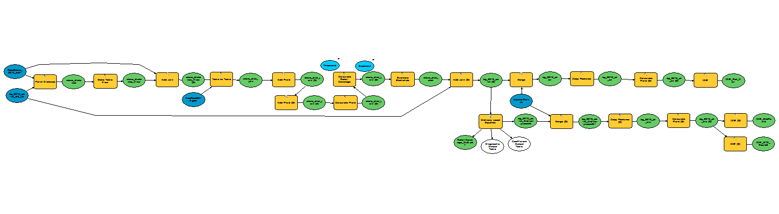
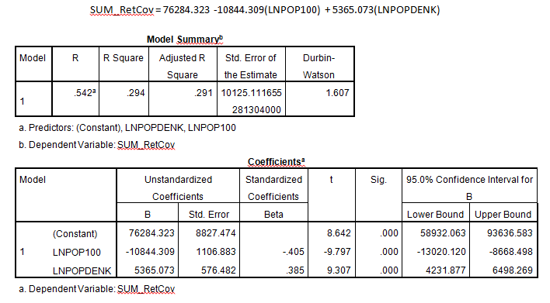
ArcGIS ModelBuilder and Regression (OLS) Results (Preliminary March, 2014)

Slide 15
Linear Regression Assumptions and Diagnostics
*Geographic data never meets all assumptions
Normally distributed (kinda OK) – transformations of population (LnPOP100), and population density (POPDENK to LnPOPDENK?)
Multicollinearity (OK?) – LnPOP100 and LnPOPDENK not globally but locally correlated
Redundant variables (OK) – VIF much less than 7.5
Linear relationship (Violation) – LnPOP100 curvilinear (biased?)
Normally distributed standard residuals (OK?), Jarque-Bera* significant, also non-linear relationship
Residual heteroscedasticity (Violation) – residuals increase with value of independent variables (non-constant variance)
Nonstationary spatial relationships – Robust_Pr (OK), Koenker p*
Possible solution – Geographically Weighted Regression (GWR -Local) may improve results, OLS OK for initial study (“models the average relationship” not used as a predictive model), <AICc better

Slide 16
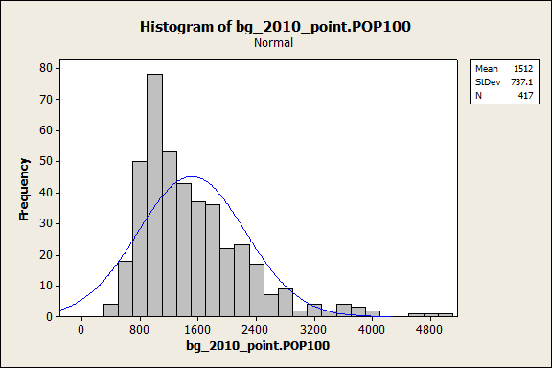
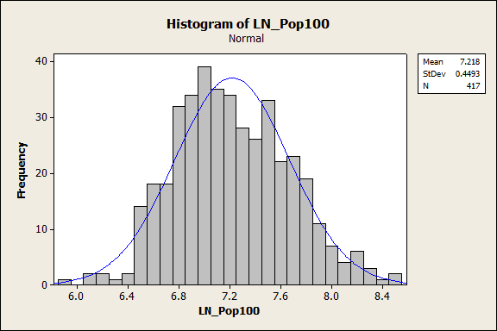
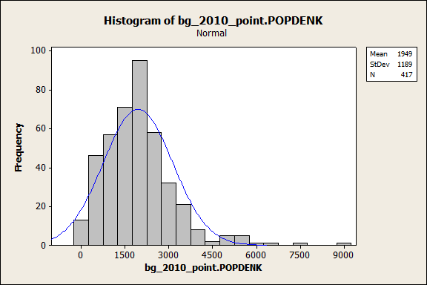
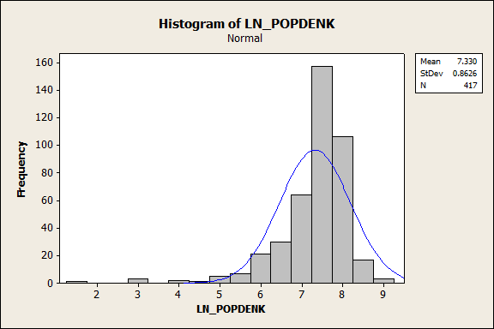
Sum_RetCov = 76284.3 -10844.3(LnPOP100) + 5365.0(LnPOPDENK)
*Preliminary Results (March, 2014)

Slide 17
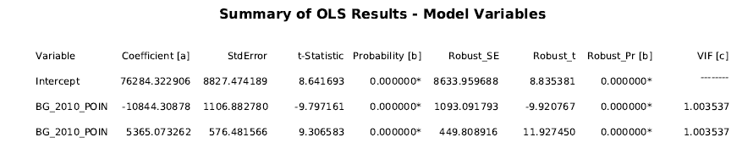
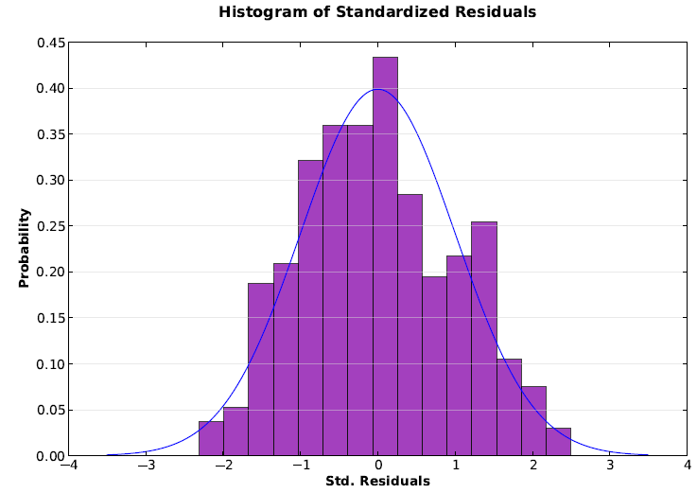
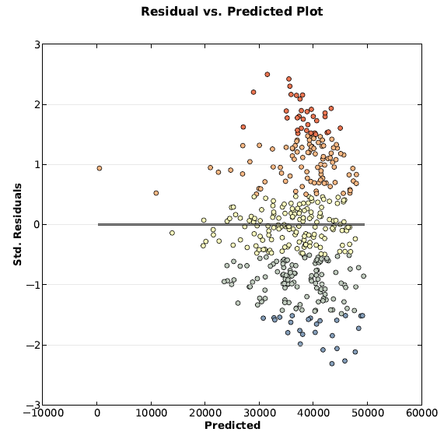
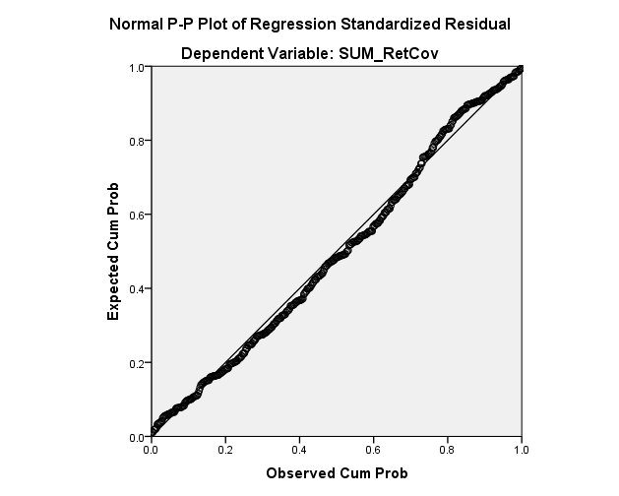
ArcGIS ModelBuilder and Regression(OLS-Global) Results (Preliminary March, 2014)

Slide 18
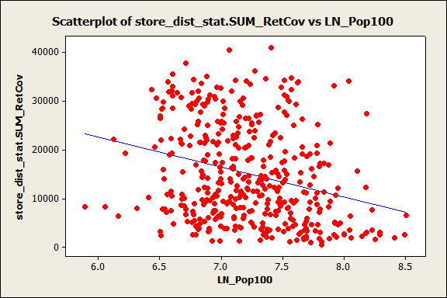
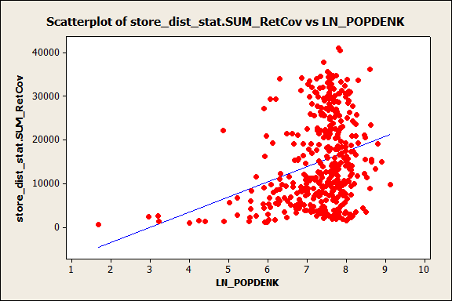
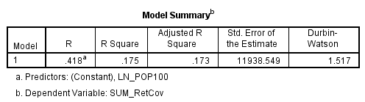
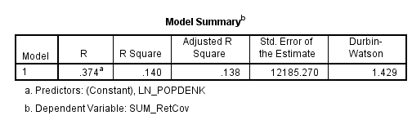
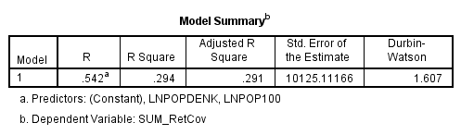
*Block groups with large populations and
small values of retail coverage (under-served?)
Correlations: LN_Pop100, LN_POPDENK
Pearson correlation of LN_Pop100 and LN_POPDENK = 0.059
P-Value = 0.226
*Durbin-Watson: residuals have only
moderate positive correlation (1-4, 2 is none)

Slide 19
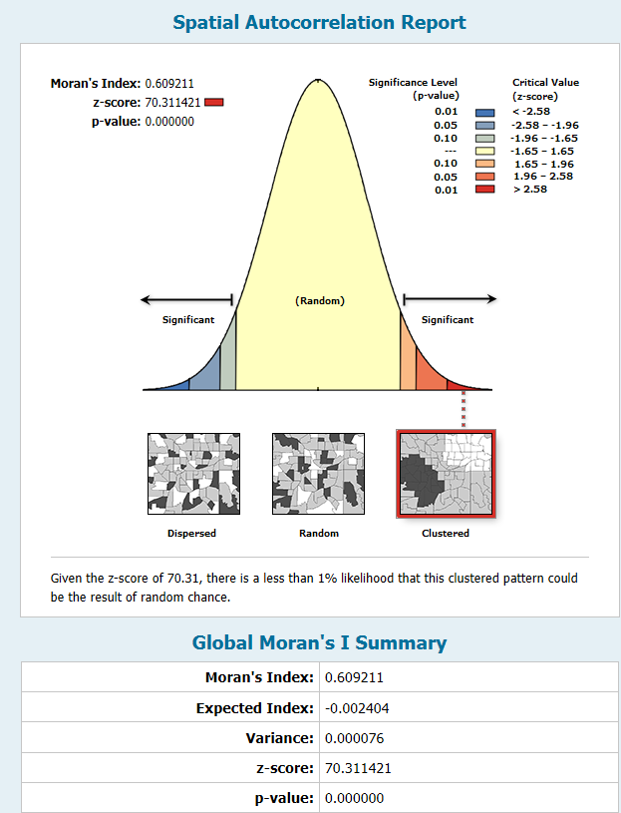
Standard Residuals
OLS Regression
Preliminary Results
March, 2014
Note: Residual clustering is
expected for this application

Slide 20
Base Data Layers

Slide 21
Analysis (Results) Layers
Preliminary Results (March, 2014)

Slide 22
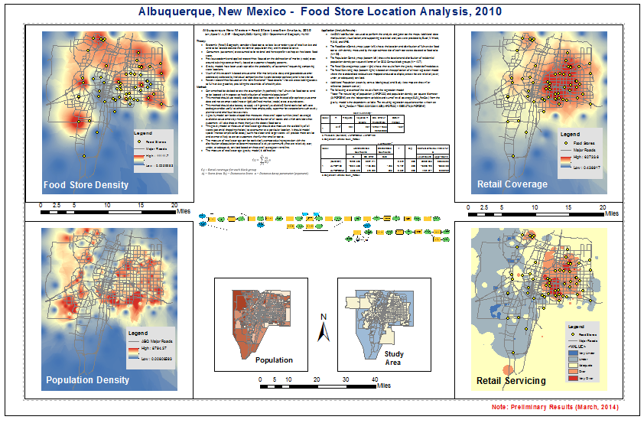

Slide 23
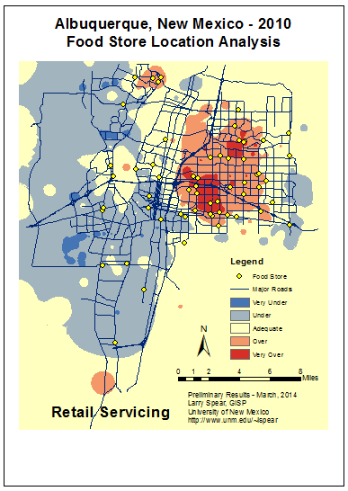

Slide 24
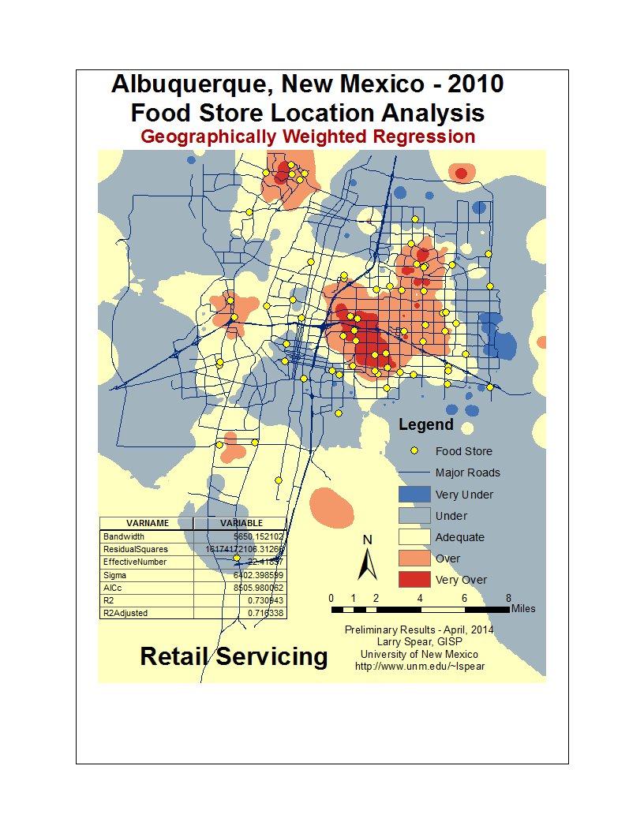
OLS (R2a=.291) and GWR(R2a=.716)

Slide 25
What Next?
Further validation of store food areas (determine and exclude non-food areas) by field survey
Use Manhattan and Network distances
Apply Geographically Weighted Regression (GWR) – Need to learn (study) more about this local technique!
Updates for 2014 stores (gain and loss) and updated population estimates
ArcGIS Server (on ArcGIS Online)
Develop Python script (on ArcGIS Resources)
Presentation(s) and Publication

Slide 26
