Slide 1
Geographic Access to Primary Care Physicians in New Mexico: ArcPy to Python 3 (GeoPandas) Prepared for: Geography 528 (Advanced Programming for GIS) Spring Semester, 2018
Larry Spear M.A., GISP
Sr. Research Scientist (Ret.)
Division of Government Research
University of New Mexico
http://www.unm.edu/~lspear
Version 2.4- 4/27/18

Slide 2
Background - Introduction
Traditional (Government) - Population-to-Physician Ratio – County based, regional availability measure, “rational Service area” (US DHHS). Easy to prepare and understand!
Gravity Model (Academic) – “potential spatial accessibility” prepared by the Division of Government Research at the University of New Mexico (DGR, UNM) for the New Mexico Health Policy Commission (NM HPC) from 1988 to 2002. More difficult to prepare harder to explain!
No formal academic publication (NM HPC Quick Facts, available online).
Used both SAS (Statistical Analysis System) and ArcGIS – ArcMap in combination (dBase file transfer).

Slide 3
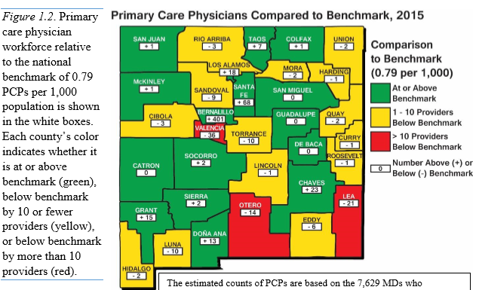
Population-to-Physician Ratio (Physician / Population) NM Health Care Workforce Committee - 2016 Annual Report
Problems: Patients cross county boundaries to access physicians
Counties too large to reveal internal spatial variation

Slide 4
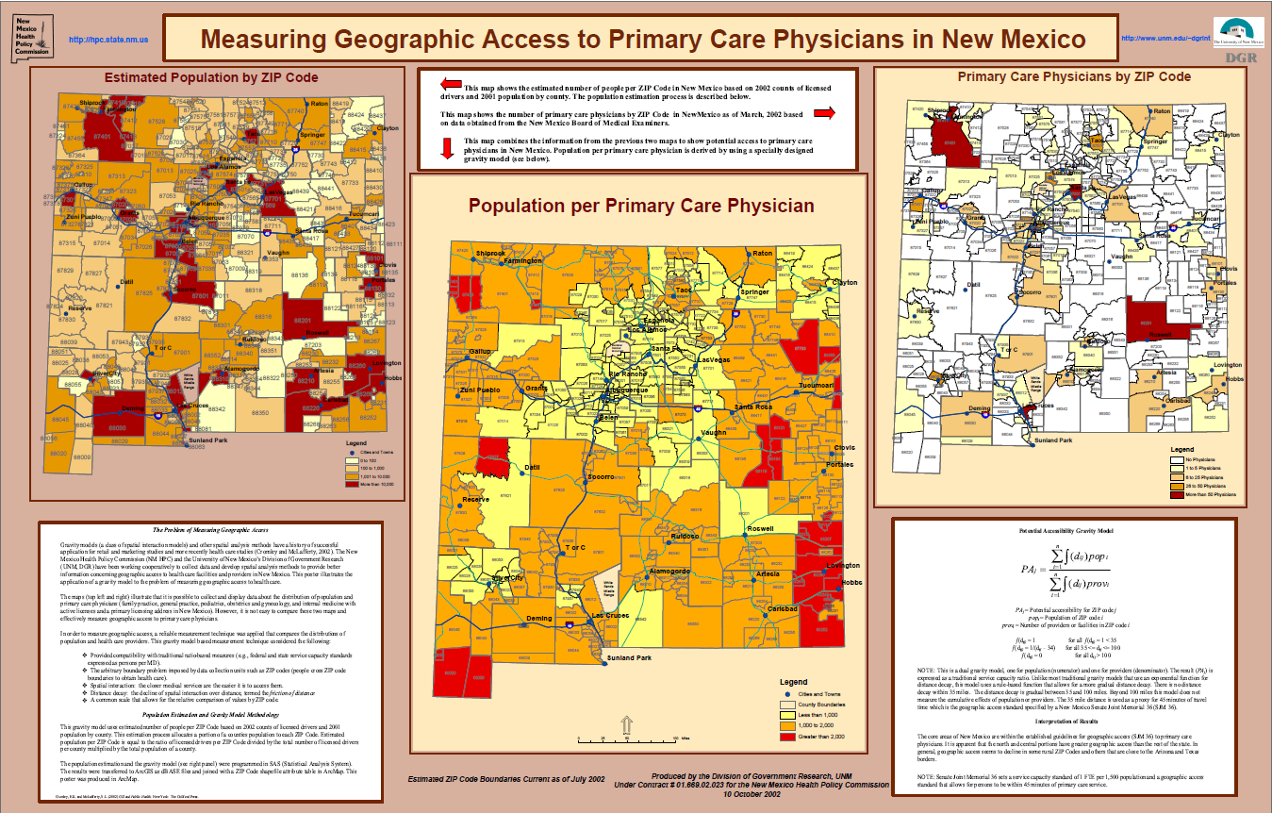
2002 ESRI SWUG (Taos, NM) – Winning Poster
Based on ZIP Codes (population and boundary estimates) – Euclidean Distances - Before Easy Geocoding!

Slide 5
DGR used well developed commercial software packages
SAS for data management and data analysis
ArcGIS – ArcMap for GIS spatial data display and analysis
University educational versions (affordable at UNM)
Note: SAS had data set (data frame w/ embedded loop) since 1970s.

Slide 6
Background – Research Question
Gravity Model measures potential accessibility (Estimate Spatial Interaction) of patients at a given location (Demand) to all physicians at other locations (Supply). Not revealed accessibility (actual based on survey data)
Since 2002, other researchers have developed and published more elaborate GIS based methods - Floating Catchment Methods. (I just found ArcPy code, Wang, 2017)
Project goals: to develop a Python (GeoPandas) Script Tool to program (Phase I) and statistically compare (Phase II) the Gravity Model and Floating Catchment Methods.
Have also previously developed versions of the Gravity Model using - ArcGIS Model Builder and Python (ArcPy), QGIS Python (PyQGIS), also R (Spatial Data Frame).

Slide 7
The Data (ZIP Codes and Census Tracts)
Gravity Model: One-Step,
Combines Physician and
Population Data in Census
Tracts
Note: Results by Census Tract
Potential Accessibility =
(Ratio) Supply / Demand
Floating Catchment Method:
Two-Step, Physicians in Zip Codes
and Population in Census Tracts
Note: Results by Census Tract
Potential Accessibility =
(Ratio) Supply / Demand
2002 Primary Care Physicians (Total=1,167: Supply and Destination) – ZIP Codes (n=400)
2002 Population Estimates (Total=1,874,598: Demand an Origin) – Census Tracts (n=499)

Slide 8
The Models
One Step Hierarchical Gravity Model (1SHGM) – DGR’s Gravity Model (SAS, ArcPy, PyQGIS, R) now Python3 (GeoPandas). A learning process as part of previous Geography classes.
Generalized Floating Catchment Area Method (G2SFCA) – From Prof. Fahui Wang, Louisiana State Univ., Dept. of Geography and Anthropology (ArcPy) now SAS and Python3. This class (Phase I).
Many varieties (FCA, 2SFCA, E2SFCA) in published literature.
Major research question: Statistically compare results (Phase II – Null Hypothesis (H₀) - No Significant Difference between 1SHGM and 2SFCA).
Note: Can use Euclidean distances, road based distances, or travel times (prepared using ArcGIS Online, Origin – Destination Matrix).
1 Step (ODM 249,001 obs, 499*499) – 2 Step (ODM 199,600 obs, 499*400)

Slide 9
Potential Accessibility
DGR’s Gravity Model (1SHGM)
PA_{j} = Potential accessibility for Census Tract
Pop_{i} = Population of a Census Tract
Prov_{i} = Number of Providers / Facilities in Census Tract
Note: Rule-Based, Hierarchical-Zonal, Specified by NM SJM 1996

Slide 10
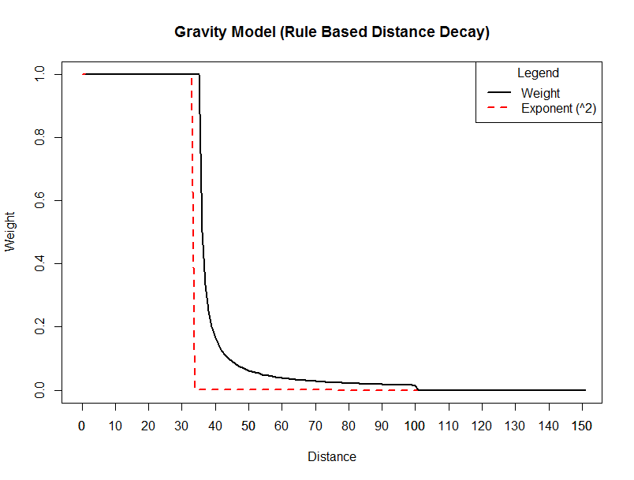

Slide 11
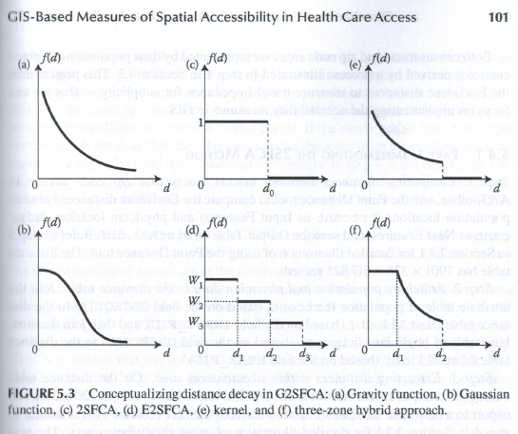
Generalized Two Step Floating Catchment Area Model, (Wang, 2017)
Distance Decay Functions:
Gravity (GM) – Neg. Exponential
Floating Catchment Methods (FCM)
2SFCA – Zonal
E2SFCA – Zonal, Gaussian, Kernel
Generalized (G2SFCA - Wang, 2017)
Power, Exponential, and Gaussian
Note: The two-step floating
catchment area method is
a special case of the gravity-
based method (Wang, 2017).
Note: The gravity-based
measure developed by DGR
uses a three-zone hybrid
approach. One-Step
Hierarchical Gravity Model,
1SHGM. (NM SJM, 1996).
Special Note: I am working
on developing a Python 3
with GeoPandas version of
the G2SFCA using a three-
Zone hybrid approach to
compare to the 1SHGM.

Slide 12
Python 3 Program (Jupyter Notebook - Steps)
Calculate Origin-Destination (Demand-Supply) Matrix in ArcGIS
Read the Data: Physician(Supply, ZIP Codes - centroids); Population (Demand, Census Tracts - centroids); O-D Matrix (road distance table); Census Tract Polygons (for data display).
Supply Location Catchment Area (First Step of 2SFCA – Summarize population potential for each supply location – with exponential distance decay):
Demand Location Catchment Area (Second Step of 2SFCA – Calculate supply / demand ratio and summarize for each demand location – with exponential distance decay):
Write out Results and Merge with Census Tract Polygons.
Get Summary Statistics and Data Visualization (Histogram, Boxplot, and Map).

Slide 13
1
First Catchment Area
*SUPPLY *
Calculate Population Potential with Exponential Distance Decay
Summarize by
DName
Second Catchment Area
*DEMAND*
Calculate RATIO with
Exponential Distance
Decay
Summarize by
OName
ArcGIS OD Matrix
(Road Distance)
OName & DName
Merge
By
OName
2
Population
Census Tracts
Demand
Origins
6
MB_DocAvlgMatrix_Raw
ArcGIS OD Matrix
(Road Distance)
OName & DName
MB_DistMatrix_Final
3
5
Physicians
ZipCodes
Supply
Destinations
Merge
By
DName
4
Merge
By
DName
MB_DocAVlgMatrix2

Slide 14
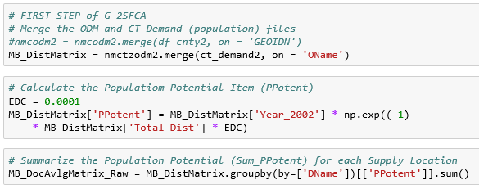
Supply Location Catchment Area (First Step):

Slide 15
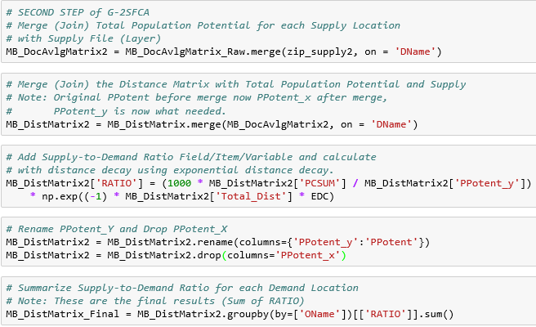
Demand Location Catchment Area (Second Step):

Slide 16
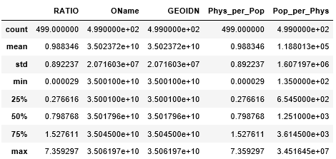
Gravity Model (1SHGM)
Mean=0.630 Std= 0.304 Min=0.043 Max=2.743
Floating Catchment Method (G-2SFCA)
Mean=0.988 Std=0.892 Min=0.000029 Max=7.359
Note: 1SHGM is more compact
and less skew than G-2SFCA
** Physicians per 1,000 Population

Slide 17
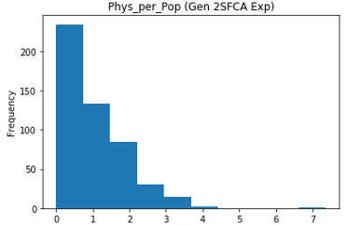
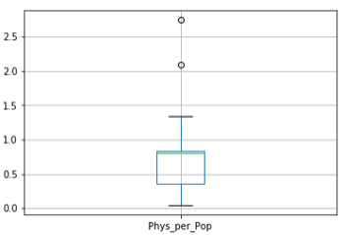
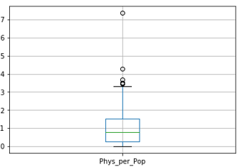
Preliminary Results (Data Visualization Example) Note: Simple mean varies by method, weighted mean should be the same? (Wang, 2017) How to calculate numerically? “not close” - This statistical property can be proven (see last slide!)
Gravity Model (1SHGM)
Floating Catchment Method (G-2SFCA)
Mean = 0.630
Std = 0.304
Min = 0.043
Max = 2.743
Mean = 0.9883
Std = 0.892
Min = 0.000029
Max = 0.7359
Weighted Mean
(SAS) = 0.08892
Note: The National
Benchmark is 0.79
per 1000 population.
New Mexico 2002 is
0.622 per 1000 pop.
(T_Phys / T_Pop)*1000
Unfair Comparison!
G-2SFCA is NOT a
hierarchical (zonal)
model. More work
to program using
PyCharm and SAS.

Slide 18
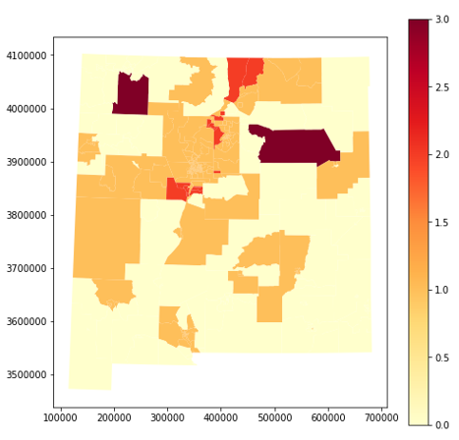
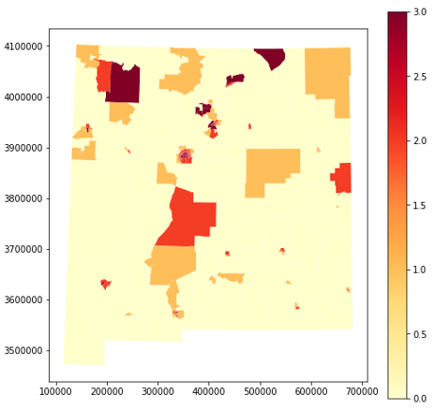
Preliminary Results (Map Examples)
Values
Phys_per_Pop
Gravity Model (1SHGM)
Floating Catchment Method (G-2SFCA)
2.7 7.4
2.0
1.0
0.5
Web Map (Bokeh)
Web Map (ArcGIS Online)
Web Map (Bokeh)

Slide 19
Continuing Research and Development (Phase I and II)
Finish Python 3 development using PyCharm IDE (user interface).
Analysis of Variance (ANOVA) possible: Null Hypothesis (H0) No significant difference between the 1SHGM and 2SFCA methods?
Can prepare: Relative and Absolute Difference Maps – Also Correlation Coefficients.
Problem: the data are not independent – Spatial Autocorrelation! (can measure).
Time to ask (consult with) a “Real Statistician” to determine the best way to conduct the statistical analyses.
Note: Benchmark data (“Revealed Accessibility”) on patient to physician travel (allows model calibration) not generally available in U.S. commercial healthcare system. Other countries (Canada, Australia and UK, etc.) a possibility. Based on surveys (ex. Retail location – Customers geocoded from credit card purchases).
Results could be published and code (Python and SAS) with example data made available for other researchers to use.

Slide 20
Conclusion - Observations
The ArcPy versions are very slow (about 20 to 25 minutes).
The Python and SAS versions are much quicker (< 1 minute) but no higher-quality map output. (use ArcGIS or QGIS when needed).
Traditional population-to-physician service capacity ratios easy to understand and have a compelling reason for use: Get More Funding From Legislature!
The 1SGM is more similar to the traditional service capacity ratios. It may be easier to explain to non-professionals (state legislators) than the 2SFCA.
Hence, the 1SHGM may be a good first-choice followed later by the more elaborate 2SFCA.
There is no “Best Method” and the choice of method should fit the intended use. 2SFCA (regional) and 1SHGM (statewide)?
More research necessary to evaluate edge effects, MAUP, model calibration with survey data (revealed accessibility).

Slide 21
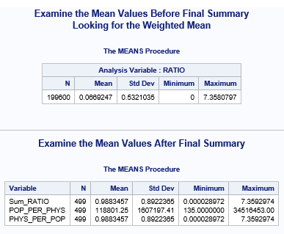

Slide 22
