Slide 1
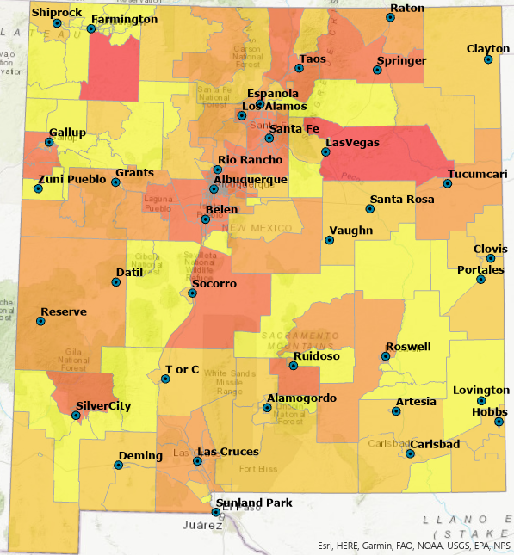
Comparing Health Care Accessibility Gravity Models
Larry Spear M.A. Geography, UNM
Senior Research Scientist (Ret.)
Division of Government Research, UNM
https://www.unm.edu/~lspear
Geography 601: Intro to Geographic Theory & Application
December 3, 2021 (Revised 7/3/2022)
Primary Care Physicians per 1,000 Population (2002)

Slide 2
Movement is a key concept for geographic inquiry.
Bunge (1962) movement a focus for theoretical development in spatial science.
Spatial interaction - the movement or flow of people, goods, or information over space (Fotheringham 2001).
Spatial interaction decreases with distance (distance decay).

Slide 3
Gravity models measure spatial Interaction.
Approximate measure of unknown spatial interaction.
Developed in economics to study retail and shopping behavior.
Now used for health care accessibility studies.
Two types: One-Step (early) and Two-Step (recent) models.

Slide 4
Problem: Patients cross boundaries for health care.
Population
2002 NM Census Tract Data
Physicians

Slide 5
Early Solution? Potential Accessibility
One-Step Gravity Model (1SHGM)
PA_{j} = Potential accessibility for Census Tract, Zip Code, etc.
Pop_{i} = Population of a Census Tract, Zip Code, etc.
Prov_{i} = Number of Providers / Facilities in Census Tract, etc.
Note: Developed by DGR, UNM for the NM HPC (1998-2002) - Rule-Based, Hierarchical-Zonal (NM SJM 1996)

Slide 6
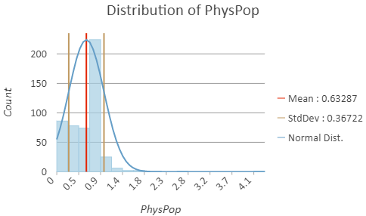
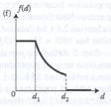
A one-step gravity model is a possible solution.

Slide 7
Two-step gravity models are recent developments.
Two-step models a special case of one-step models (Wang 2017).
Conceptual separation of supply (physicians) and demand (population) to measure accessibility.
GIS, geocoding, and digital road networks have facilitated use.
Many two-step models have been developed and compared.

Slide 8
More Recent Solution? Generalized Two-Step Floating Catchment Area Model (G2SFCA) From Wang 2017
$$A_{i}=∑_{j}\frac{S_{ij}f(d_{ij})}{∑_{k}P_{k}f(d_{ij})}$$
A_{j} – Accessibility at location i
S_{j} – Supply (number of physicians) or facility
P_{k} – Demand (population) size at spatial unit k
d_{ij} – Travel cost measured by travel time or distance
f – Distance decay function (exponential, gaussian, etc.)

Slide 9
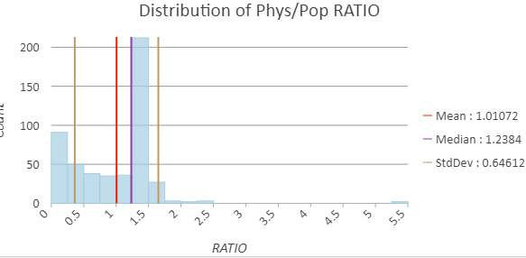
A two-step gravity model is another possible solution.

Slide 10
Are the results from a one-step and two-step models statistically similar or different?
ANOVA, T-Tests (H0: 1SHGM = E2SFCA) and Correlation (r).
Maps of results and statistical visualizations (Charts, etc.).
Empirical Tests: Spatial regression methods to compare with government measures of health inequalities and disparities.
GIS (ArcGIS Pro, QGIS), Python (Jupyter Notebooks), SAS, R.
* Future research methods – Note: E2SFCA a hierarchical G2SFCA.

Slide 11
All models are wrong, but some are useful. From G. Box 1976 and 1987
One-step less complicated, easier for governmental policy makers (state legislators) to understand.
One-step is similar to the population-to-physical service area method used by government agencies (health disparities).
Two-step (G2SFCA) more complicated, better concept of supply & demand.
Both models can over-estimate or under-estimate in rural or urban (no model is better than the other – appropriate scale areal units?).
** Evaluate MAUP (Census Block Groups & Tracts, ZIP Codes)

Slide 12
Selected Citations from Literature Review:
Box, G. E. P. 1976. Science and Statistics. Journal of the American Statistical Association 71(356) 791-799.
Box, G. E. P. and Draper, N. R. (1987), Empirical Model-Building and Response Surfaces, John Wiley & Sons.
Bunge, W. W. 1962. Theoretical Geography, Lund, Royal University.
Fotheringham, A. S. 2001. Spatial Interaction Models. International Encyclopedia of the Social & Behavioral Sciences :14794–14800.
NM SJM 36 (New Mexico Senate Joint Memorial 36). 1996. 42nd New Mexico Legislature.
Wang, F. 2017. Quantitative Methods and Socio-Economic Applications in GIS (2nd ed.). CRC Press.

