Slide 1
Geographic Access to Family Practice Physicians in New Mexico: Exploratory Spatial Analysis Prepared for: Geography 580L (Spatial Statistics) Spring Semester, 2017
Larry Spear M.A., GISP
Sr. Research Scientist (Ret.)
Division of Government Research
University of New Mexico
http://www.unm.edu/~lspear
Version 2.3 – 5/3/17

Slide 2
Background
Project originally prepared by the Division of Government Research at the University of New Mexico (DGR, UNM) for the New Mexico Health Policy Commission (NM HPC).
Most of GIS work done under contract as part of a larger body of data management work and special reports including Hospital Inpatient Discharge Data (HIDD) from 1998 to 2002.
No formal academic publication (NM HPC Quick Facts).
Used both SAS (Statistical Analysis System) and ArcGIS in combination (dBase file transfer).
Note: SAS had data set (data frame) since 1970s.

Slide 3
Background
SAS used to program a Gravity Model to measure potential accessibility of patients at a given location to all physicians at other locations. (Spatial Interaction)
ArcMap used to produce map display of results.
Current project goals: to develop a R Script Tool to program the Gravity Model and display the results on a map entirely within R without SAS. (QGIS and ArcGIS Pro maps if necessary, Next R function development)
Also use GWR (Geographically Weighted Regression) to evaluate the relationship of gravity model results (dependent var.) to socio-economic data (independent vars.)
Note: Previous developments - ArcGIS Model Builder and Python (ArcPy), also QGIS Python (PyQGIS)

Slide 4
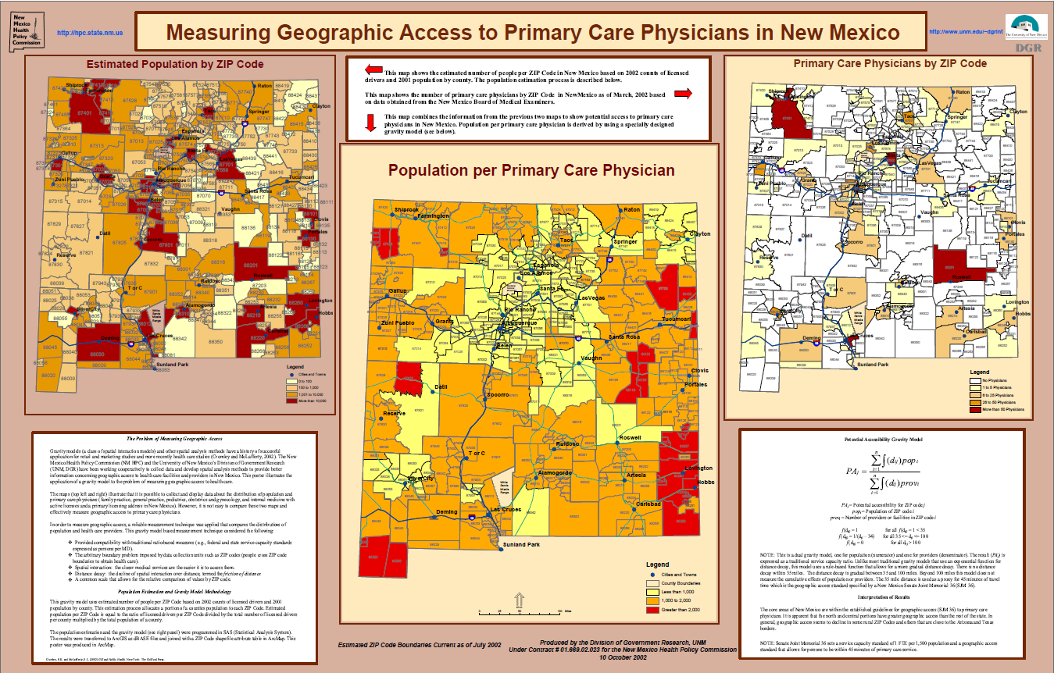
2002 ESRI SWUG (Taos, NM) – Winning Poster

Slide 5
DGR used well developed commercial software packages
SAS for data management and data analysis
ArcGIS for GIS spatial data display and analysis
University educational versions (affordable at UNM)

Slide 6
The Problem - Measurement
How to measure geographic access (spatial interaction) of population to healthcare providers and facilities?
Solution – Develop a reliable method to measure (and compare) the distribution of facilities and providers and the population. Note: Does not solve physician shortages, provides a better way to monitor change.
Reliable measurement requires a geographic framework in which to collect and organize observations.
This project used Census Tract (centroids) for calculations and boundaries (polygons) for data display.
Note: Family practice physician data (2013) from infogroup (Esri business partner, purchased by NM DOIT) and population/socio-economic data (2013) from Census ACS.

Slide 7
The Problem(s)
Reliable measurement requires a common scale that allows for comparison of values.
Reliable measurement requires a method to handle arbitrary boundaries imposed by data collection units (geographic framework).
Traditionally used Federal and State service capacity standard is a ratio of persons per physician by county geography. (regional availability approach)
Note: Big counties and patients cross boundaries.

Slide 8
A Common Measurement Scale
Service Capacity Standards (traditional measure - Fed. and State guidelines).
Ratio of provider or facilities per population.
Can be expressed as either:
One M.D. per 1,500 persons (Prov./ Pop.)
1,500 persons per M.D. (Pop. / Prov.) **What we used, and NM service capacity goal ( NM GADS workgroup?) - Geographic Access Data System
NM Legislature SJM 36 (1996) also 45minute maximum travel time (about 35 miles distance).

Slide 9
Potential Accessibility
DGR’s Gravity Model
PA_{j} = Potential accessibility for Census Tract
Pop_{i} = Population of a Census Tract
Prov_{i} = Number of Providers / Facilities in Census Tract

Slide 10
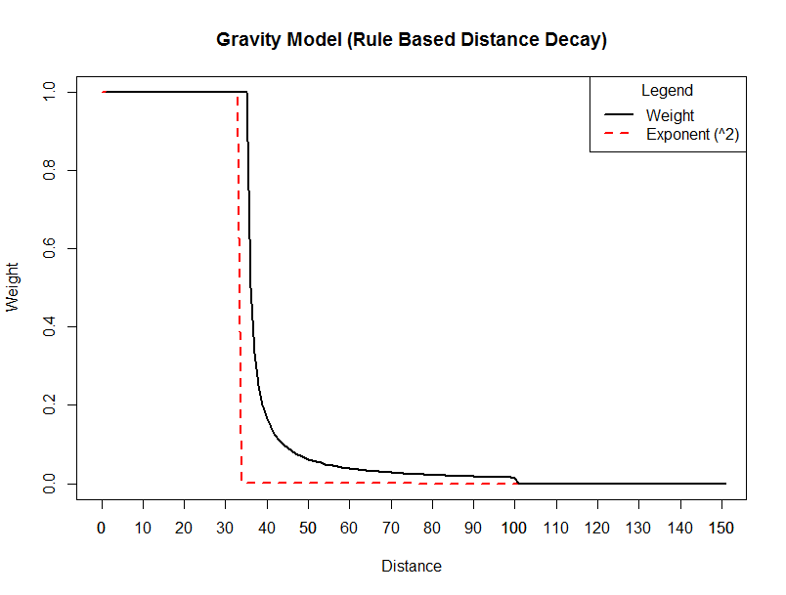

Slide 11
Analysis Steps using R (ArcGIS Pro & QGIS)
Read in data from ArcGIS Pro (R-ArcGIS Bridge)
Create SPDF’s (Spatial Point/Poly Data Frames)
Examine data and make test plots (R maps)
Subset data (tract centroids) for gravity model
Run the gravity model and plot (R & Arc Map) results
Merge gravity model results (point & poly) with Census ACS data
ArcGIS Pro Exploratory Regression
Perform R OLS ( diagnostics and Moran’s I)
Perform R GWR (diagnostic maps with QGIS & ArcGIS Pro) Note: R - merge and cbind back to tract polygons

Slide 12
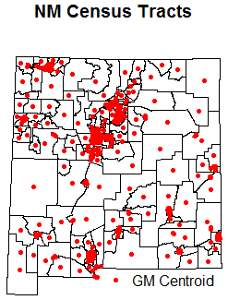

Slide 13
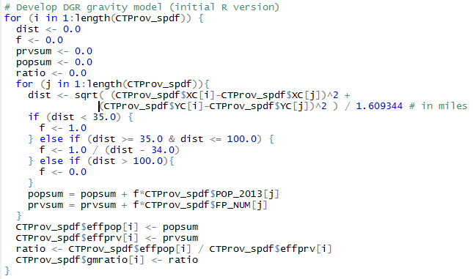
DGR Gravity Model (R Version)
Note: Nested for loops, no attach for spdf

Slide 14
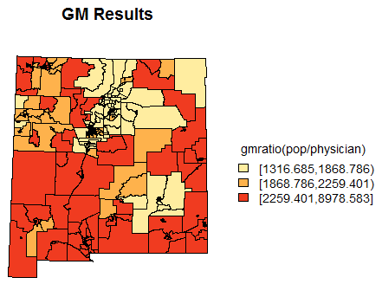
Note: Hard to control class breaks in R

Slide 15
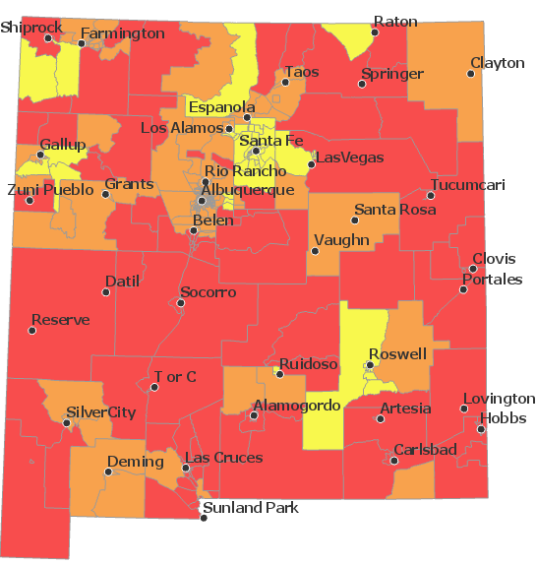
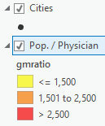
Gravity Model Results (ArcGIS Pro)

Slide 16
Note: Geographic (socio-economic) data are rarely normally distributed even after transform

Slide 17
Transform Gravity Model Results (gmratio to ln_gmratio)

Slide 18
ArcGIS Pro – Exploratory Regression lnGMRatio = -House_Avg +PerCapita_Inc +White +HispLat

Slide 19
R – OLS Results

Slide 20
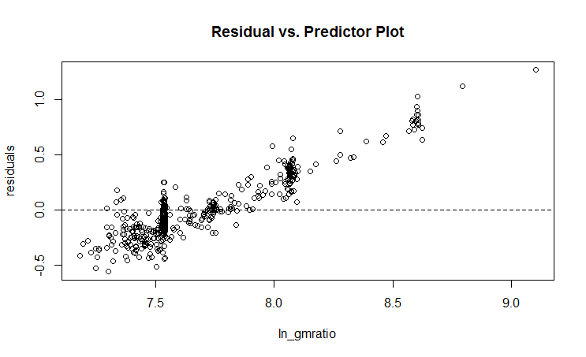
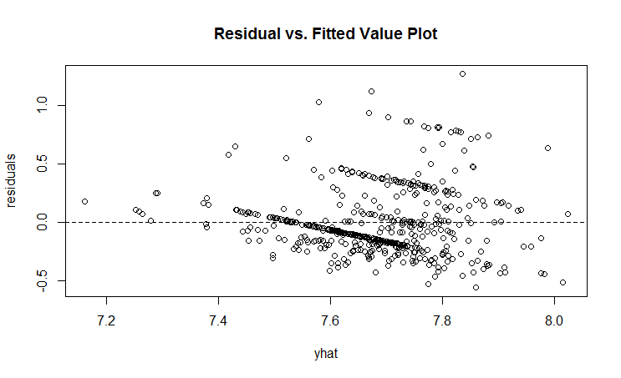
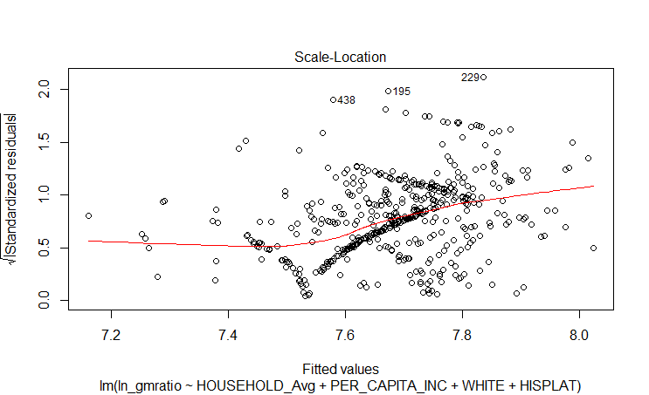
R – OLS Diagnostics

Slide 21
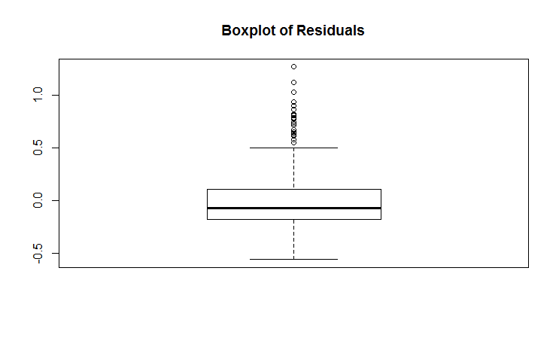
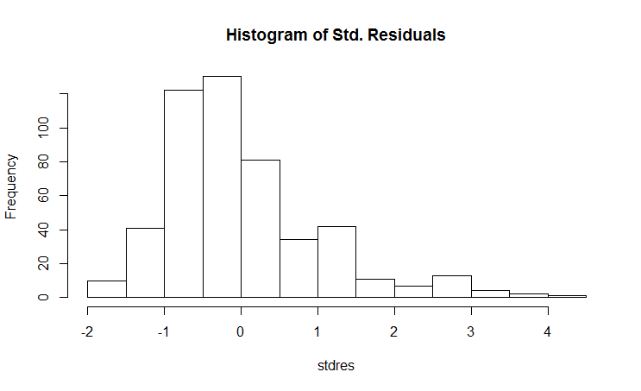
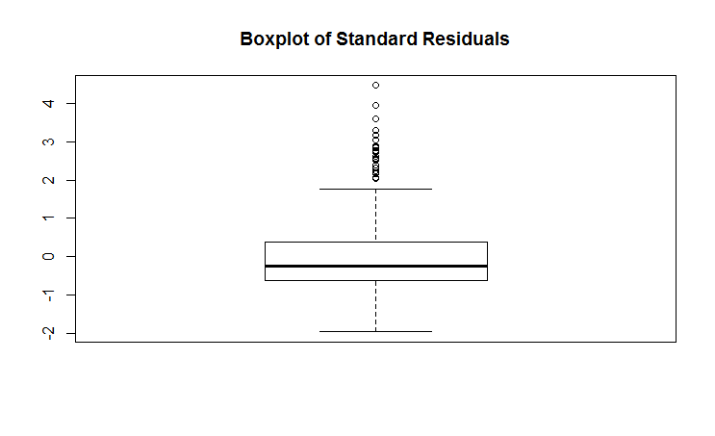
R – OLS Diagnostics

Slide 22
R – Residual Spatial Autocorrelation

Slide 23
R – GWR Results

Slide 24
R – Residual Spatial Autocorrelation

Slide 25
QGIS Makes Better Maps than R

Slide 26
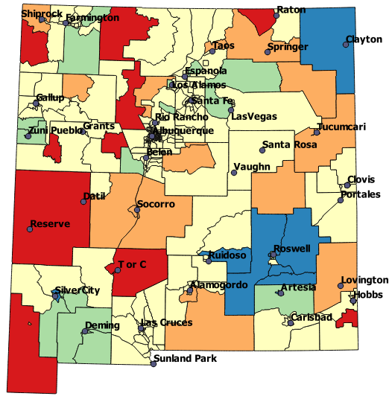
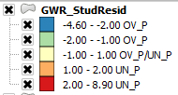
GWR – Residuals (Stud_resid)
- Blue and Green over-predict,
enough physicians under
used by population?
- Yellow good predictions,
adequate number of
physicians?
- Red Orange under-predicted,
not enough physicians?
* Lower
Moran’s I
Less
Clustered ->

Slide 27
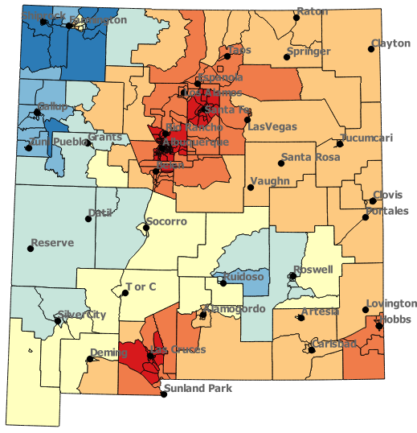
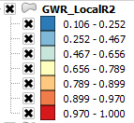
GWR – Local R² (Local_R2)
-Better fit high
population
areas.
-NW Reservations
number of
physicians not
available.
-SE people go to
Texas for care.

Slide 28
Special Note: - The interpretation of GWR coefficients is based on some understanding of
the underlying processes in the area of study. These interpretations can be
difficult and subjective. However, they can provide new insight for
further study.

Slide 29
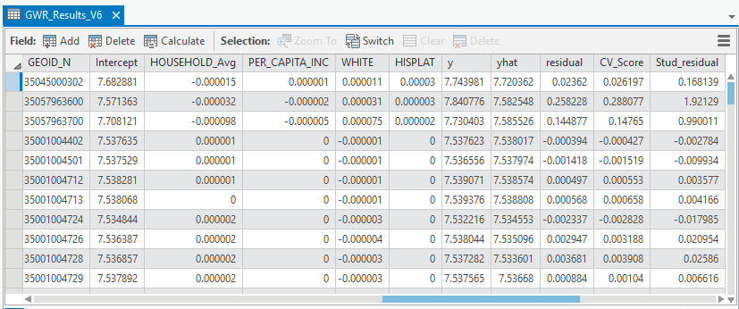
Switch to ArcGIS Pro Maps
Note: Beta Coefficients very small, problem with QGIS Maps
* Could redo analysis without transformed GMRatio to LN_GMRatio (easier to interpret, maybe next time)
Additional Note: Linear regression does not require normally distributed dependent or
Independent variables. However, transformations are preferred for more accurate results.
The only normality assumption is for resulting residuals (errors).

Slide 30
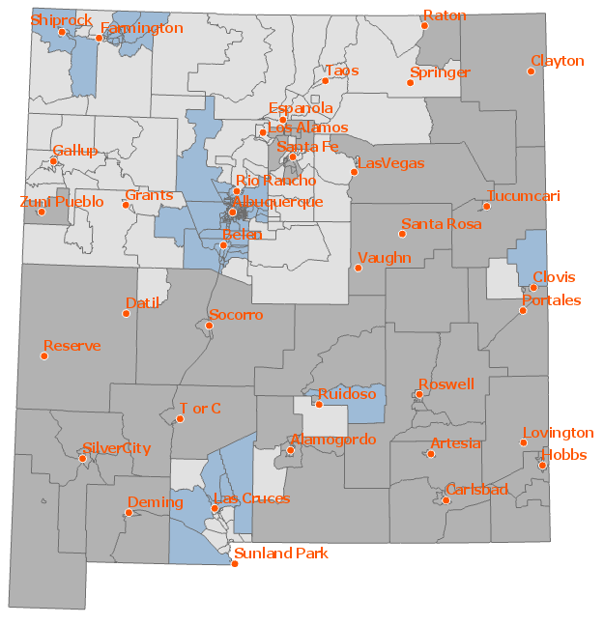
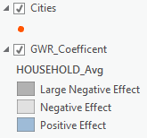
GWR Coefficient Influence - HOUSEHOLD_AVG – Why Different?
Negative coefficients - an inverse relationship, as HOUSEHOLD_AVG increases LN_GMRATIO decreases. Trending to less population per physician. (SF & LA)
Positive coefficients – a direct relationship, as HOUSEHOLD_AVG increases LN_GMRATIO increases . Trending to more population per physician. (ABQ & LC)

Slide 31
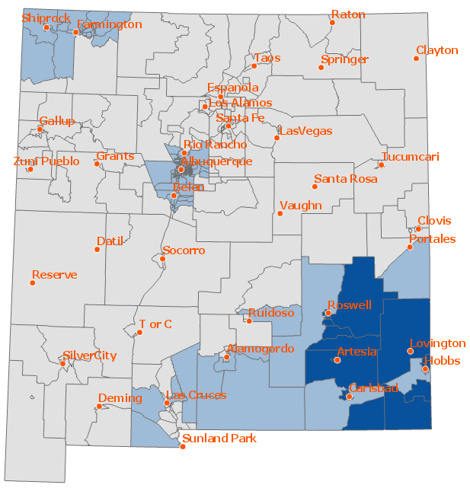
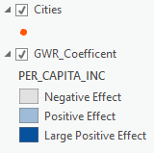
GWR Coefficient Influence – PER_CAPITA_INC
Negative coefficients - an inverse relationship, as PER_CAPITA_INC increases LN_GMRATIO decreases. Trending to less population per physician. (Rural pop. loss, SF & LA gain MDs)
Positive coefficients – a direct relationship, as PER_CAPITA_INC increases LN_GMRATIO increases . Trending to more population per physician.
(SE – go to Texas for care)

Slide 32
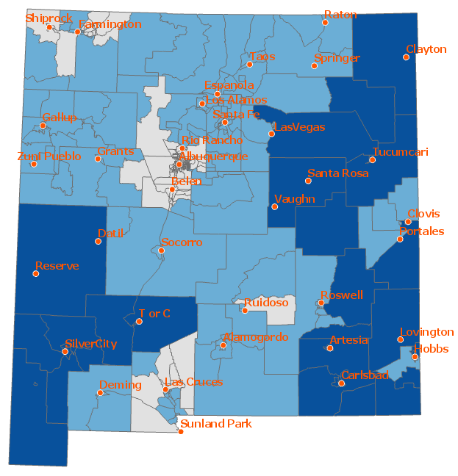
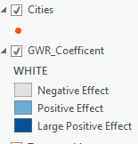
GWR Coefficient Influence – WHITE
Negative coefficients - an inverse relationship, as WHITE increases LN_GMRATIO decreases. Trending to less population per physician.
(ABQ & LC attract MDs)
Positive coefficients – a direct relationship, as WHITE increases LN_GMRATIO increases . Trending to more population per physician. (Rural & SE)

Slide 33
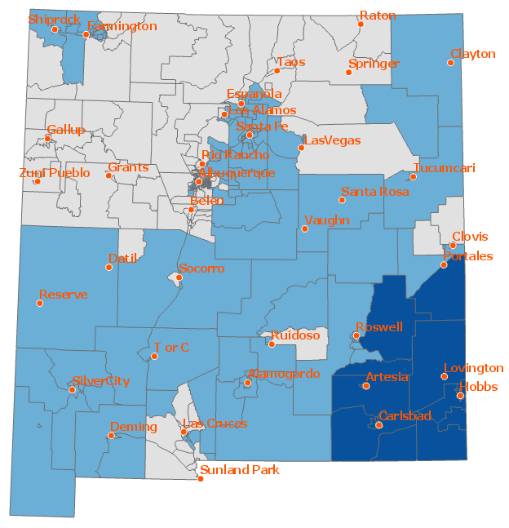
GWR Coefficient Influence – HISPLAT
Negative coefficients - an inverse relationship, as HISPLAT increases LN_GMRATIO decreases. Trending to less population per physician. (N. & W. out-migration, aging)
Positive coefficients – a direct relationship, as HISPLAT increases LN_GMRATIO increases . Trending to more population per physician.
(ABQ, SF, not LC)

Slide 34
Conclusions and Comments
The quality of the infogroup physician data may have strongly affected the results – not an accurate count of physicians. Census ACS are also just survey estimates!
The DGR gravity model produced reasonably realistic results – drive time distance an improvement. (Next – ArcGIS PRO Network O-D Matrix & Python - PANDAS)
GWR produced interesting, and sometimes difficult to explain localized spatial patterns. Subjective Interpretation.
More study to compare DGR gravity model to recently developed more elaborate methods (2SFCA, E2SFCA).
More study to reevaluate selection of socio-economic factors to use with GWR (SES, Esri Tapestry) – better understand local influences for physician distribution.

