Slide 1
Geographic Access to Primary Care Physicians in New Mexico Prepared for: Geog. 491(Problems) and Geog. 499 (Python programming) Fall Semester, 2014
Larry Spear M.A., GISP
Sr. Research Scientist (Ret.)
Division of Government Research
University of New Mexico
http://www.unm.edu/~lspear
Presented 12/02/14 (revised version 3.3 – 01/07/15)

Slide 2
Background
Project originally prepared by the Division of Government Research at the University of New Mexico (DGR, UNM) for the New Mexico Health Policy Commission (NM HPC).
Most of GIS work done under contract as part of a larger body of data management work and special reports including Hospital Inpatient Discharge Data (HIDD) from 1998 to 2002.
Never a formal academic publication.
Used both SAS (Statistical Analysis System) and ArcGIS in combination.

Slide 3
Background
SAS used to program a Gravity Model to measure potential accessibility of patients at a given location to all physicians at other locations.
ArcGIS used to produce map display of results.
Current project goals to develop a Python Script Tool to program the Gravity Model and display the results on a map entirely within ArcGIS without SAS.
Also update results with current data and publish and present them at professional conferences.

Slide 4
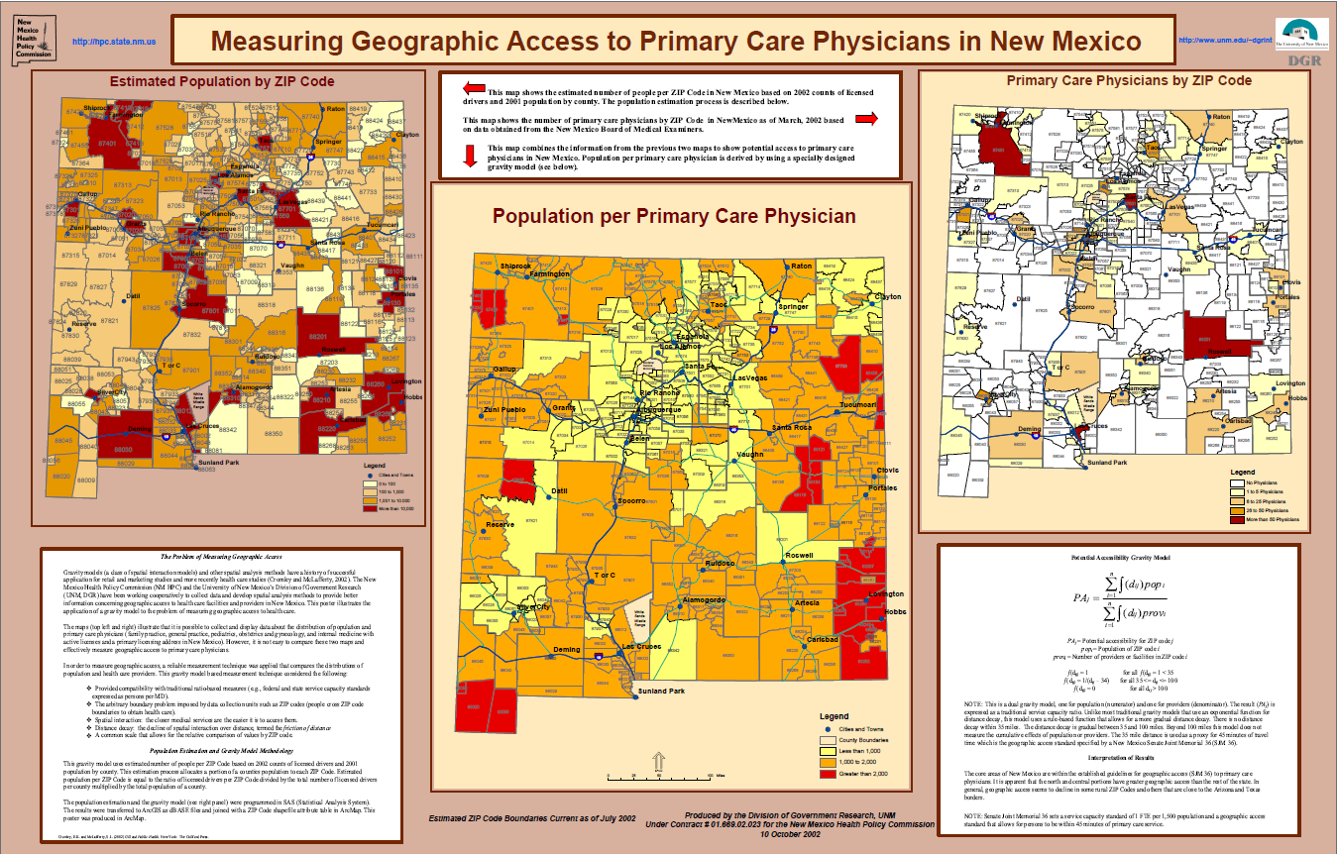
2002 ESRI SWUG (Taos, NM) – Winning Poster

Slide 5
DGR used well developed commercial software packages
SAS for data management and data analysis
ArcGIS for GIS spatial data display and analysis
University educational versions (affordable at UNM)

Slide 6
The Problem - Measurement
How to measure geographic access to healthcare providers and facilities?
Solution – Develop a reliable method to measure (and compare) the distribution of facilities and providers and the population. Note: Does not solve physician shortages, provides a better way to monitor change.
Reliable measurement requires a geographic framework in which to collect and organize observations.
We used ZIP Codes (centroids) for calculations and estimated boundaries (polygons) for data display.

Slide 7
The Problem(s)
Reliable measurement requires a common scale that allows for comparison of values.
Reliable measurement requires a method to handle arbitrary boundaries imposed by data collection units (geographic framework).
Commonly used Federal and State service capacity standard is a ratio of persons per physician by county geography.
Note: Big counties and patients cross boundaries.

Slide 8
A Common Measurement Scale
Service Capacity Standards (traditional measure - Fed. and State guidelines).
Ratio of provider or facilities per population.
Can be expressed as either:
One M.D. per 1,500 persons (Prov./ Pop.)
1,500 persons per M.D. (Pop. / Prov.) **What we used.

Slide 9
Geographic Framework – ZIP Codes
Healthcare data (patients, providers, facilities, etc.) have many geographic (locational) components.
Some geographic components used for healthcare data collection are: geographic coordinates, county, census block and tract.
An address with a ZIP Code is another more widely available component of most healthcare data.
Geocoding (address locators) not widely available yet.
This study uses ZIP Codes as the geographic framework (estimation of many boundaries in rural New Mexico).

Slide 10
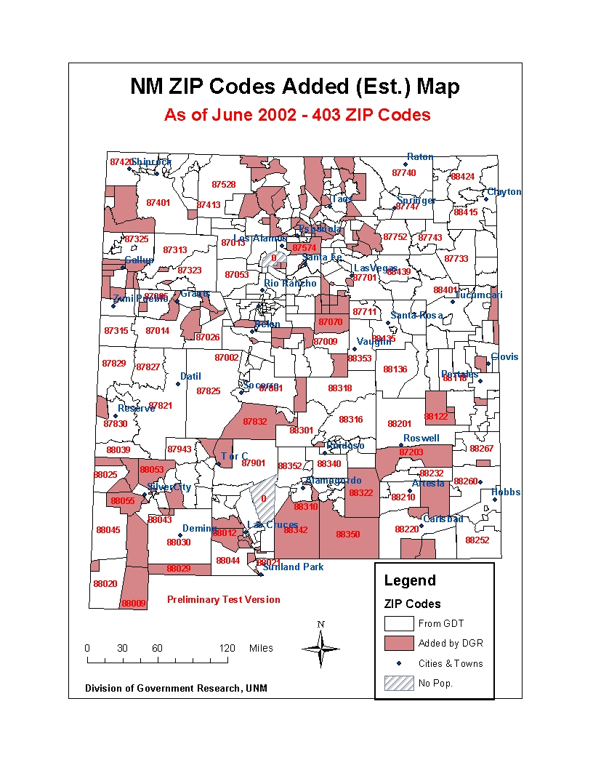

Slide 11
Potential Accessibility
DGR’s Gravity Model

Slide 12
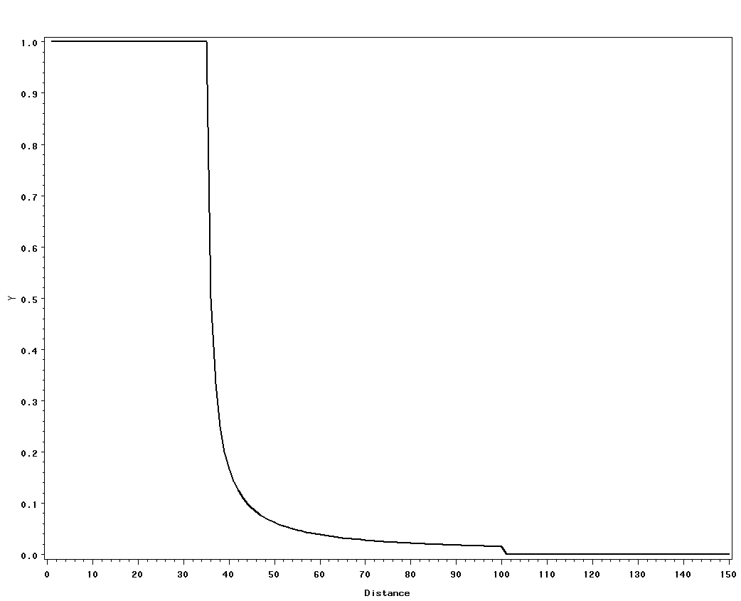
Distance Decay (Rule-Based “piecewise” Function)

Slide 13
Programming Goals for Geog. 491 & 499 (Fall 2014)
Build on previously developed SAS Macro and develop within ArcGIS using ArcPy.
Previously: SAS Macro ---> dBase ---> ArcMap
First Step: ArcGIS ModelBuilder
Currently: ArcGIS Python Tool
Note: Replace manual steps of file transfer (SAS to ArcGIS) plus creating layer symbology.
Goal: Fully automated gravity model calculation and display of results.

Slide 14
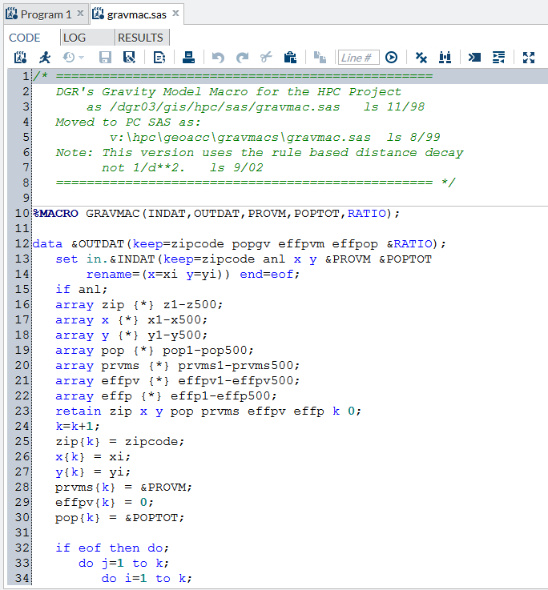
SAS Macro
1998 - 2002

Slide 15
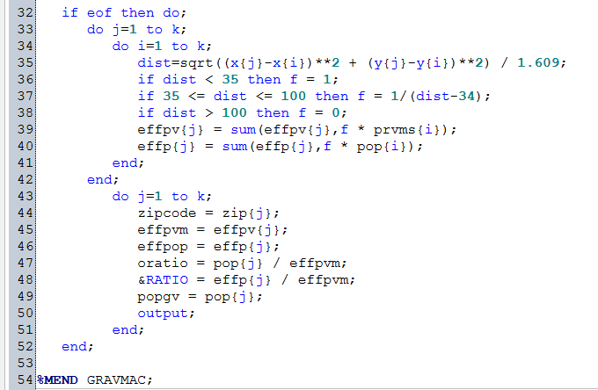
SAS Macro Language – Arrays, Do Loops, Euclidean Distance

Slide 16
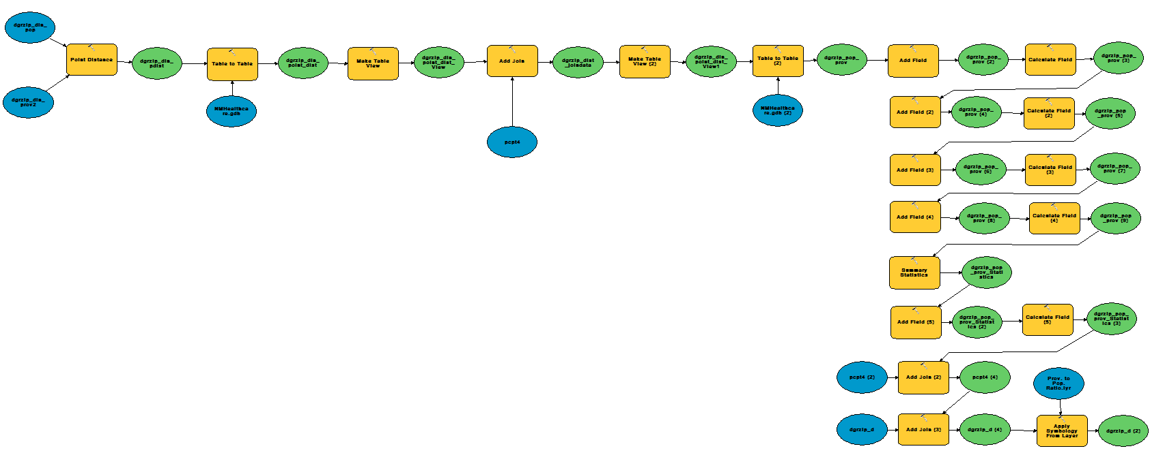
ArcGIS Python Script Development
ModelBuilder was first step
Created initial Python Script
Required substantial editing and testing

Slide 17
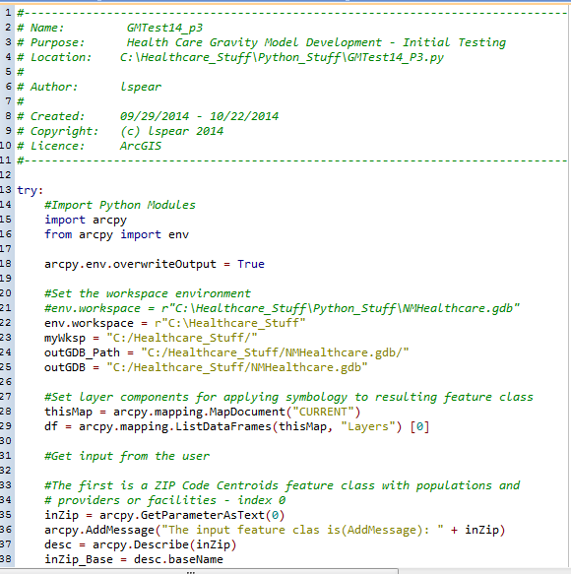
Python Script Tool (Beginning)

Slide 18
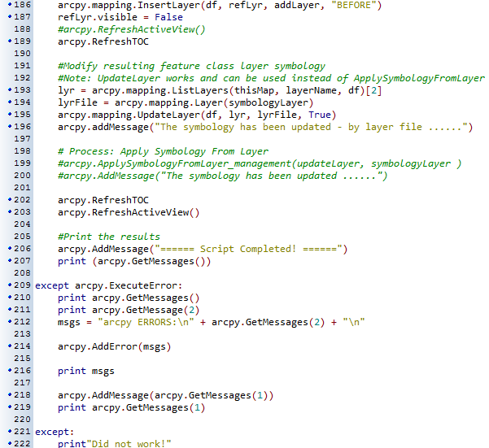
Python Script Tool (End > 200 lines)

Slide 19
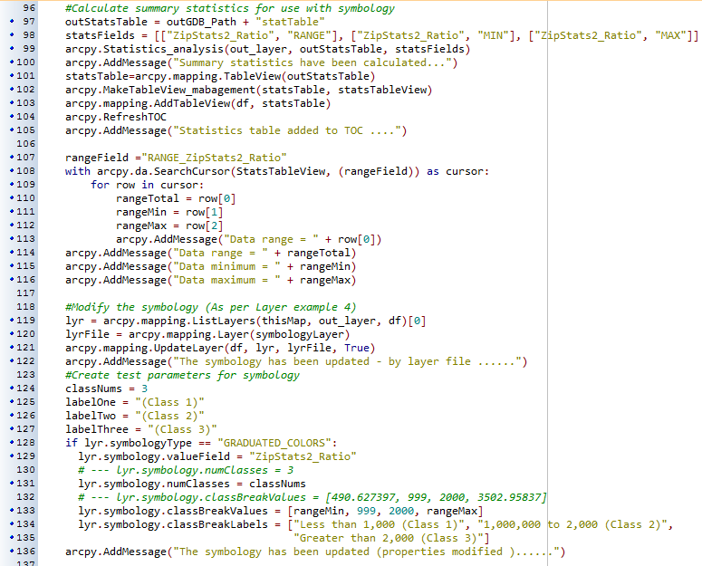
Current Problem – User Defined Class Breaks (additional code)

Slide 20
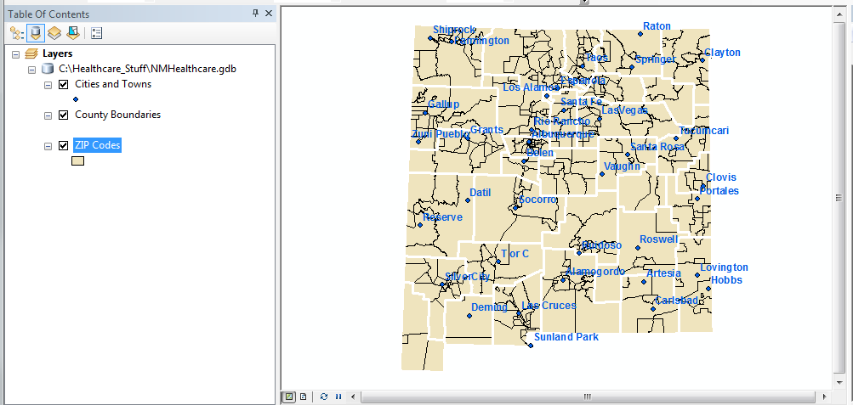
ArcGIS Python Script Development
ArcMap User Interface (ModelBuilder and Script Tool)

Slide 21
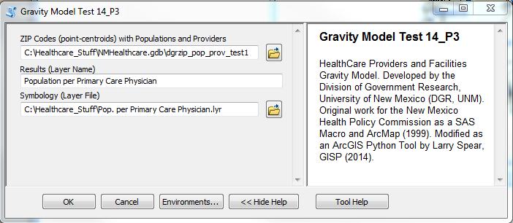
ArcGIS Python Script Development
Script Tool Next Step

Slide 22
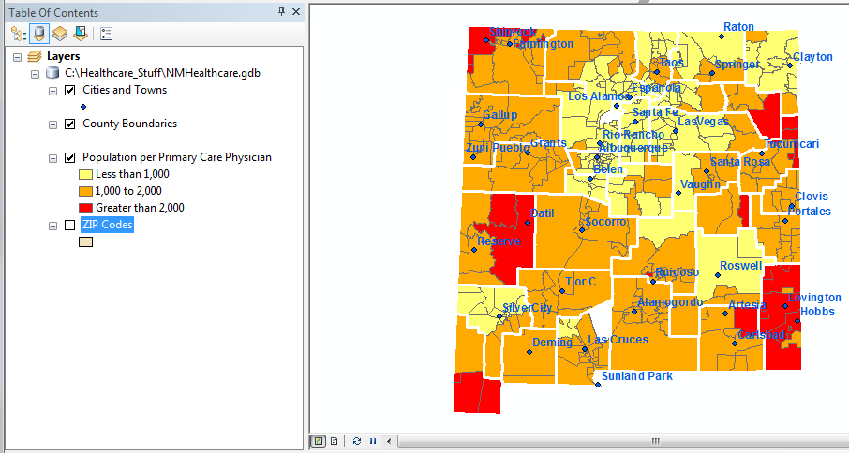
ArcGIS Python Script Development
Script Tool – Current Results

Slide 23
Problems Encountered update v3.3 01/07/15
Slow, takes about 5 minutes on a Pentium I3 Desktop (perhaps quicker on faster PC).
Perhaps too many ArcGIS Tools and conversions (Feature Class to Layers and Table Views and back and forth).
Joined files do not work with some tools (especially layer symbology – update layer files not manual).
Also cursors seem only to work as a stand-alone script but in this case not as a python script tool.
Possible Solution: Replace as many ArcGIS Tools as possible with dedicated Python Code.

Slide 24
Current and Future Research
Comparing results using DGR’s compound gravity model with other recently developed methods (need recent data from NM HPC now DOH, also DOH’s Small Area Geographic units).
The Kernel estimation method (in ArcGIS) that uses distance decay and various functions (some problems in low density rural areas) has potential.
Also, the Two Step Floating Catchment Area (2SFCA) method (service provider capacity and population data) is very interesting (similar to DGR method).
Road network distance replacing Euclidean distance (not available for entire state yet)?

